Slide 1
The X3D Geospatial Component: X3DOM implementation of GeoOrigin, GeoLocation, GeoViewpoint, and GeoPositionInterpolator nodes
Andreas Plesch
andreasplesch@gmail.com
Harvard University
Mike McCann
mccann@mbari.org
Monterey Bay Aquarium Research Institute

Slide 2
Background
Reddy et al. (2000) GeoVRML
X3D and geospatial component
Behr et al. (2009) X3DOM
Some geospatial support
Openness
Extensibility
User friendly nature

Slide 3
Motivation
X3D Geospatial
Unique niche between GIS and 3D graphics
Inherently 3D – spatial reference systems
Part of X3D scene graph – interactive
Many application areas
Geological or Geophysical
Oceanographic
Atmospheric

Slide 4
The X3D geospatial component and digital globes
Google Earth, Cesium and others
Seem to offer similar functionality
X3D Geospatial
Offers more generalized functionality
E.g. subsurface data visualization
Digital globe is possible application
Includes all features of X3D

Slide 5
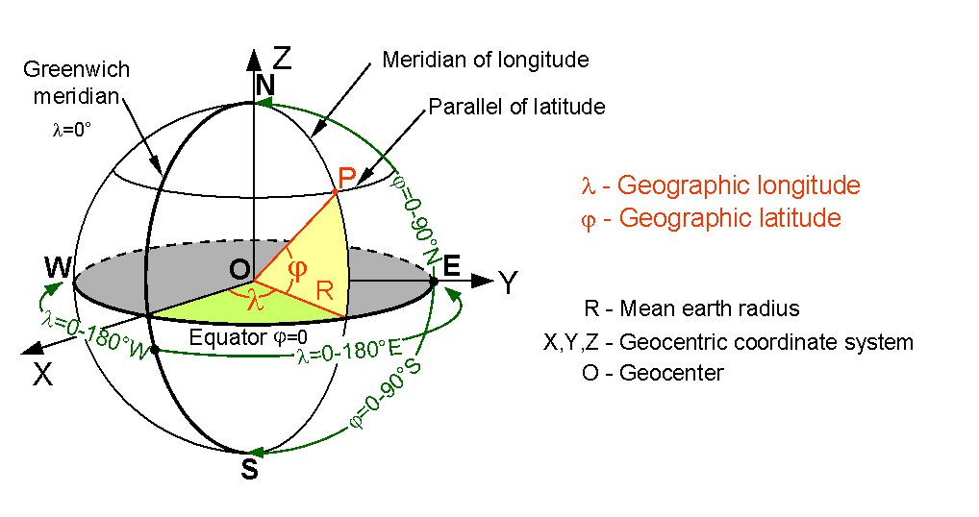
The geocentric coordinate system

Slide 6
The X3D coordinate system
Y
up
X3D coordinates
Cartesian
Abstract
Canonical units of meters
XZ is horizontal
+Y is up
X
Z

Slide 7
Geospatial Component
Handles all the transformations and precision calculations needed to convert between between these coordinate systems

Slide 8
GeoOrigin
Coordinates far from origin are large numbers
Optional GeoOrigin
Numbers subtracted
Smaller numbers for graphics pipeline
Needed for each Geo node

Slide 9
GeoOrigin
Implementation of rotateYUp in X3DOM
GeoOrigin is the point of rotation
Axis of rotation such that the direction pointing north becomes aligned with the scene -Z direction
Up direction is at the position of the GeoOrigin point which is constant throughout a scene

Slide 10
GeoLocation
Place geospatially unregistered nodes
Locate child node’s origin to the provided geospatial coordinates
Rotate the child’s +Y direction to the local Up direction
Child’s -Z direction towards the local north direction

Slide 11
GeoLocation
GeoLocation and GeoOrigin rotateYUp complication
GeoLocation position is likely different from the position of the provided GeoOrigin
Cannot skip both rotations
GeoLocation rotation (about child origin)
GeoLocation translation
GeoOrigin (back) translation
RotateYUp rotation

Slide 12
GeoViewpoint
Like X3DOM Viewpoint, but
Position in Geo coordinates
Orientation wrt local up
Attribute elevationScaling
Factor to auto adjust navigation speed based on elevation
Not used in EXAMINE-like modes
Lower limit of 1
Uses ellipsoid, not ground surface elevation
Supports rotateYUp for FLY-like modes

Slide 13
GeoPositionInterpolator
Interpolates between geospatial coordinates
Outputs
geoSystem coordinates
Scene coordinates (geocentric coordinates adjusted for a GeoOrigin)
Attribute onGreatCircle
Default is false
For large distances
SLERP algortihm

Slide 14
Experimental Nodes
X3DOM does not offer an X3D PROTO facility
Custom nodes can be implemented in X3DOM
Follow existing coding patterns
Import additional JavaScript source in HTML
Open source project

Slide 15
GeoOriginTransform
Use non-geospatial coordinate geometry and reference to a GeoOrigin
Build terrain mesh in geocentric coordinates
Apply offset and rotation for high precision uses
May be possible to replace with GeoTransform and new directive

Slide 16
GeoWebMap
Exploration of connecting “slippy” web maps in X3DOM
OpenLayers 3 or other 2D web map library that renders in container div
Dynamically constructs a GeoElevationGrid for image texture
Needs WebMercator geoSystem

Slide 17
Applications
Possible to build rich web applications with X3DOM Geospatial building blocks
Targeted applications for specific communities
MBARI’s Spatial Temporal Oceanographic Query System (STOQS)
Community Fault Model for Southern California

Slide 18
STOQS
Search YouTube for “STOQS robot data”
Geospatial (PostGIS) backend database
Faceted web search
2D and 3D geospatial data visualization
Used for understanding multivariate robot data

Slide 19
Community Fault Model
See pages linked from http://structure.harvard.edu
Can visualize deep fault structures
Cannot do this in other globe viewers

Slide 20
Summary
Important X3DOM nodes implemented
Enables large class of targeted applications
Conforms to ISO specification
GeoOrigin node is still desirable
Available in the current release of X3DOM

