Slide 1
Volumetric Texture Data Compression Scheme for Transmission
Web3D 2015 Paper Session2 19th Jun.
Yeonsoo Yang, Ankit Sharma, Girier Armand
IoT Technology Center, Advanced Software Technology Dept.
TOSHIBA Corporation

Slide 2
About TOSHIBA
※Source from https://www.toshiba.co.jp/worldwide/about/corporateprofile.pdf

Slide 3
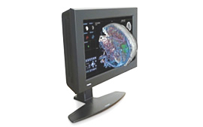
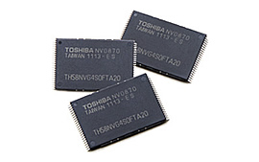
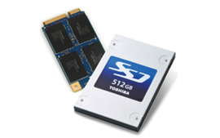
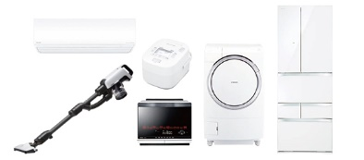
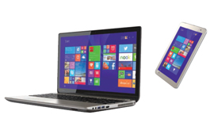
About TOSHIBA

Slide 4
About the application
How we implement with X3D/X3DOM?
Volumetric texture data compression scheme

Slide 5
Application Usage
1.Application
2. X3D/X3DOM
3. Compression
Application Domain
Disaster prevention by forecasting heavy rainfall
Demonstration Experiment from Jun. 2015
Osaka prefecture’s sewerage pumping system, fluvial and road info announcement system
Purpose is to help decision making with rainfall information whether or not to switch on
Get Alert Information
Make Decision
Do Control

Slide 6
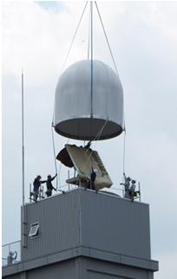
Real-time observation data is used
1.Application
2. X3D/X3DOM
3. Compression
PAWR (Phased Array Weather Radar) at Osaka Univ. in Japan
※Source from http://www.toshiba.co.jp/about/press/2012_08/pr_j3101.htm

Slide 7
How much real-time?
1.Application
2. X3D/X3DOM
3. Compression
Parabolic Radar
PAWR
In 10~ 30 sec. one single cycle can scan 100 angles of elevation
60km radius
TOSHIBA’s semiconductor technology is used

Slide 8
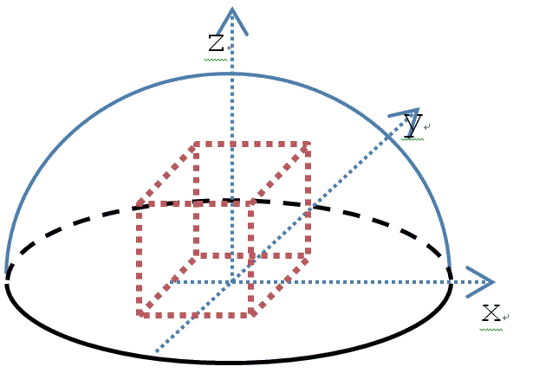
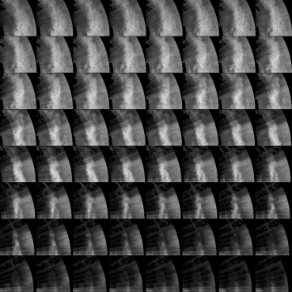
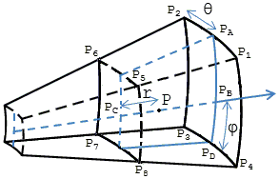
PAWR Data Pre-processing
1.Application
2. X3D/X3DOM
3. Compression
Real time scanned polar coordinates data
Data is interpolated into uniform Cartesian coordinates
Generate 2D texture Atlas Image
※Current WebGL and X3DOM doesn’t support 3D texture yet.
Looking forward to WebGL 2.0 releasement.
Notes:
100m Cartesian grid resolution

Slide 9
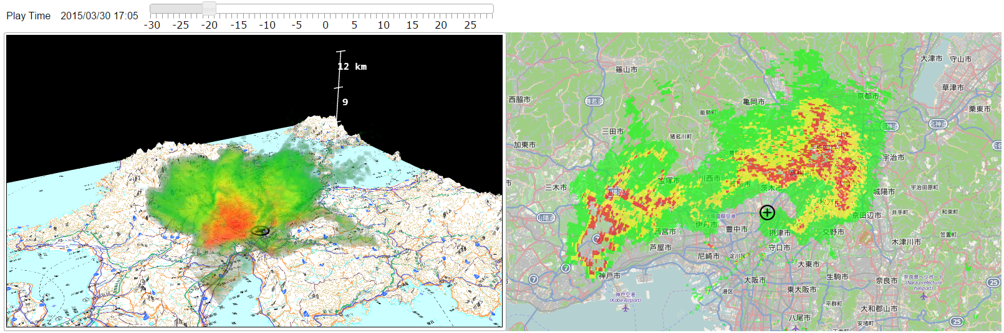
Functional Requirements
1.Application
2. X3D/X3DOM
3. Compression
※This achievement is part of “research and development of next-generation Doppler radar technology” contract research from National Institute of Information and Communications Technology Japan.
Animation
time varying volumetric data
2D/3D Time synchronization
3D animation is synchronized with 2D View animation
Interactivity
Fast retrieval of time indexed data

Slide 10
About the application
How we implement with X3D/X3DOM?
Volumetric texture data compression scheme

Slide 11
Adapted Technologies
1.Application
2. X3D/X3DOM
3. Compression
For Ubiquity
Browser based Web application
WebGL API
Declarative X3D/X3DOM 1.6 library
Visualization algorithm
3D Volume Ray-casting with transfer function
Geographical Info.
OpenLayers 2D Map, Japanese Geographical Survey Institute 3D elevation grid

Slide 12
Volume Rendering with X3D/X3DOM
1.Application
2. X3D/X3DOM
3. Compression
Add RadarVolumeStyle node with RenderedTexture dethMap
Add compression field in ImageTextureAtlas field
<VolumeData class='volume' dimensions='4.0 4.0 4.0'>
<ImageTextureAtlas id="atlas_2" containerField="voxels“
url="data/pawr_3d/20150616-174516.pawr.3D-R.osaka.xxxx.png"
numberOfSlices="64" slicesOverX="8" slicesOverY="8">
</ImageTextureAtlas>
<RadarVolumeStyle DEF="VOLREN2" id="volume_rendering_2" brightness="1.0“
class="volume_rendering" isoSurfaceCutoffValue="0.0" transparency="0.9“
intensityLimits="0.0 1.0" renderMode="2">
<ImageTexture DEF="transfer_2" containerField='transferFunction'
url='data/image/color_transfer.png'></ImageTexture>
<RenderedTexture DEF="dt_2" id="dt_2" class="depth_texture"
containerField=‘depthTexture’ update="always"
dimensions="1024 1024 4" depthMap="true“ compressed=“true”>
</RenderedTexture>
</RadarVolumeStyle>
</VolumeData>

Slide 13
We will commit to X3DOM 1.6.2 1.7
1.Application
2. X3D/X3DOM
3. Compression
RadarVolumeStyle
compression field in ImageTextureAtlas node
RadarVolumeStyle: XDNode{
SFNode [in,out] depthTexture [Texture]
SFNode [in,out] transferFunction [Texture]
SFFloat [in,out] isoSurfaceCutoffValue 0.4
SFFloat [in,out] transparency 0.7
SFFloat [in,out] brightness 2.3
SFFloat [in,out] accumFactor 0.1
SFVec2f [in,out] intensityLimits 0.1, 0.75
SFFloat [in, out] xSectionPosition 0.5
SFVec4f [in, out] xSectionOrientation 0.0, 0.0, 1.0, 0.0
SFFloat [in,out] renderMode 0
ImageTextureAtlas : Texture {
SFString [] crossOrigin NULL
SFBool [] hideChildren TRUE
SFNode [in,out] metadata NULL [X3DMetadataObject]
SFInt32 [] numberOfSlices 0
SFInt32 [] origChannelCount 0
SFBool [] repeatS TRUE
SFBool [] repeatT TRUE
SFBool [] scale TRUE
SFNode [] textureProperties NULL [TextureProperties]
MFString [in,out] url [] [URI]
SFBool [] compressed FALSE
}
Only for WebGL1.x extensions

Slide 14
About the application
How we implement with X3D/X3DOM?
Volumetric texture data compression scheme

Slide 15
Considerations
Transfer time/ file size
20 MB bps network speed
Keep image quality
Pre-processed data is 8 bit PNG
Rendering performance
GPU memory footprint

Slide 16
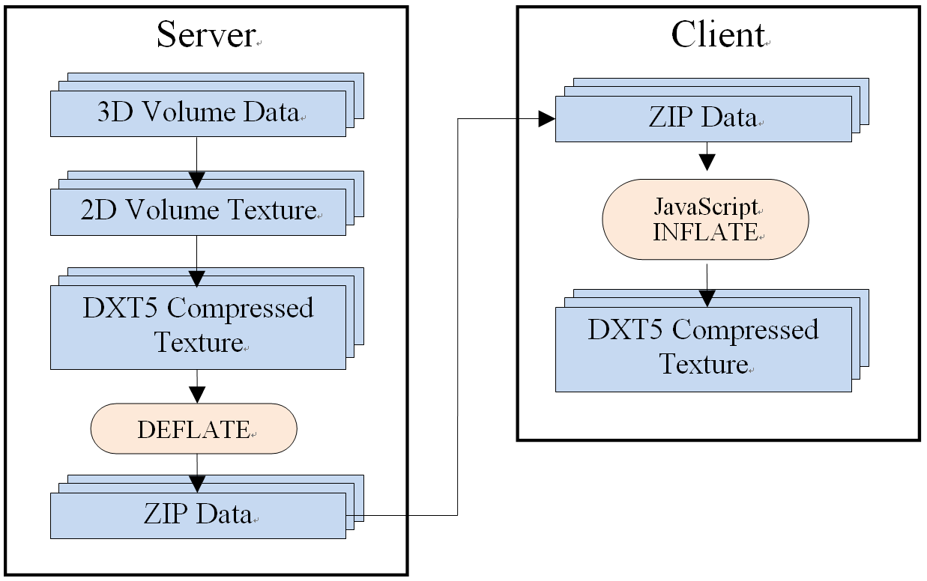
Texture Compression Scheme
1.Application
2. X3D/X3DOM
3. Compression
Take three steps
RGBA Channel Stacked 2D Texture
DXT5 Compression （Block Compression)
DEFLATE (LZ77 and Huffman encoding)
①
②
③

Slide 17
Step1: RGBA Channel Stack
1.Application
2. X3D/X3DOM
3. Compression
Size of PNG reduced into 1/4

Slide 18
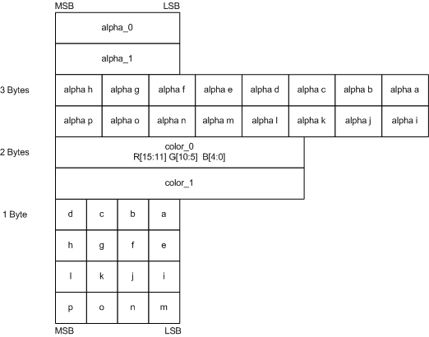
Step2: DXT5 Compression
1.Application
2. X3D/X3DOM
3. Compression
Size of Stacked PNG reduced into 1/4 DXT5 format
Needless to decompress in GPU pipeline
Included in Microsoft DirectX
2 alpha, 2 colors and those interpolations
alpha_0
alpha_1
１ | ２ | ３ | ４
５ | ６ | ７ | ８
９ | １０ | １１ | １２
１３ | １４ | １５ | １６
８ | ７ | ６ | ５ | ４ | ３ | ２ | １
16 | 15 | 14 | 13 | 12 | 11 | 10 | ９
color_0
color_1
4 | 3 | 2 | 1
8 | 7 | 6 | 5
12 | 11 | 10 | 9
16 | 15 | 14 | 13
16 blocks x 4 Bytes = 64 Bytes
16 Bytes
Step3: DEFLATE
Notes:
※Source from https://msdn.microsoft.com/en-us/library/windows/desktop/bb694531(v=vs.85).aspx

Slide 19
Experimental Results
1.Application
2. X3D/X3DOM
3. Compression
Average size of a single texture file
Dimensions Format | 128x128x64 | 256x256x256
Raw Data | 4MB | 64MB
RGBA Channel Stacked 2D Texture (uncompressed) | 1MB | 16MB
RGBA Channel Stacked 2D Texture (WebP format, lossless) | 0.271MB | 2.88MB
RGBA Channel Stacked 2D Texture (PNG format, lossless) | 0.301MB | 3.33MB
RGBA Channel Stacked DXT5 Compressed Texture Size | 0.333MB | 5.33MB
DEFLATE DXT5 RGBA Channel Stacked Compressed Texture | 0.184MB | 2.42MB
Time taken to INFLATE compressed texture at client
INFLATE RGBA Channel Stacked DXT5 Compressed Texture | 14.66 ms | 20.81 ms
Windows 8 PC
Intel Core i5-3320M CPU
Intel HD 4000 integrated graphics

Slide 20
Summary
As WebGL API, we chose X3D/X3DOM which is open and standard
For Interactivity and 2D/3D time synchronization, we implemented texture image based animation
To save file size/ transfer time without loosing image quality, we found out packing the data in RGBA channels followed by DXT5 and DEFLATE compression is most useful

