Slide 1
Hybrid Visualisation of Digital Production Big Data
Alun Evans, Javi Agenjo, Josep Blat
Universitat Pompeu Fabra, Barcelona, Spain

Slide 2
Modern film productions use terabytes
and terabytes of data

Slide 3
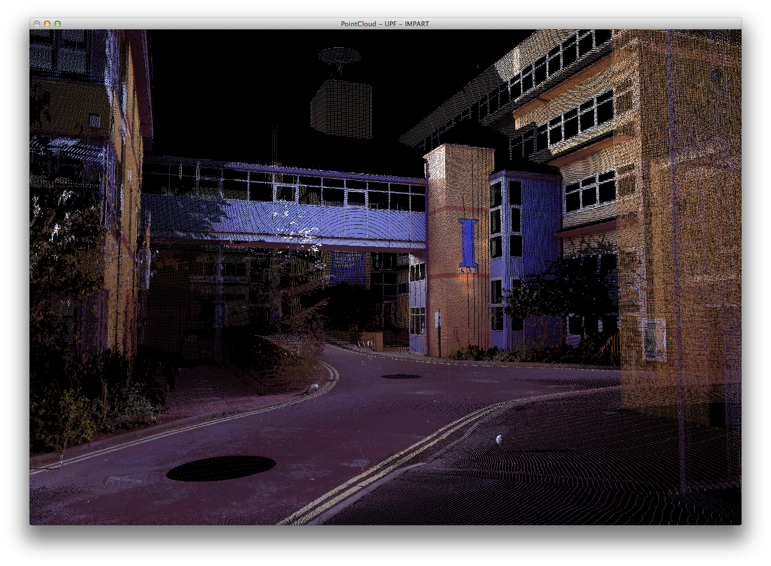
Pointcloud files from a LIDAR reconstruction of a set are hundreds of megabytes in size.
Then there’s static images, witness camera video, RGBD data, spheron capture etc.
All used during production and post-production

Slide 4
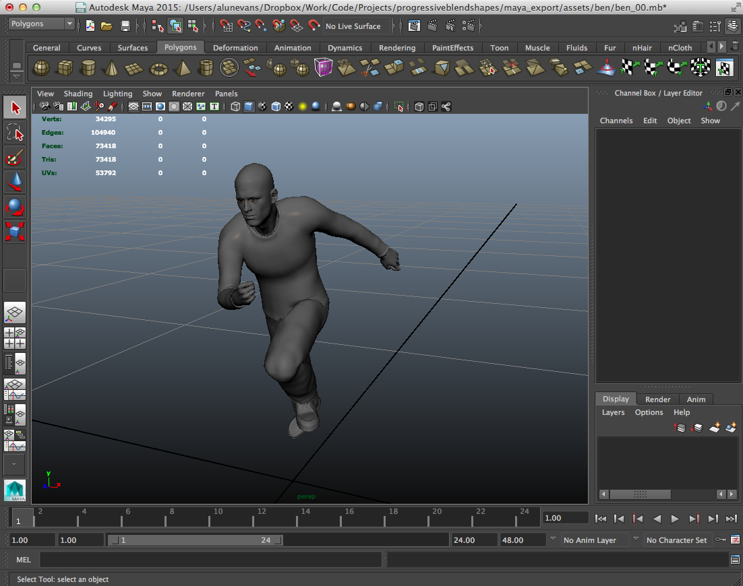
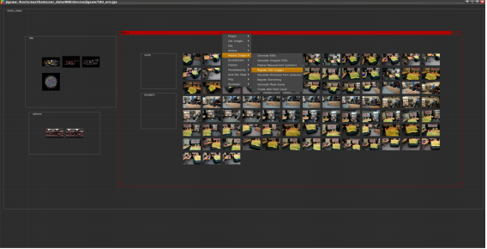
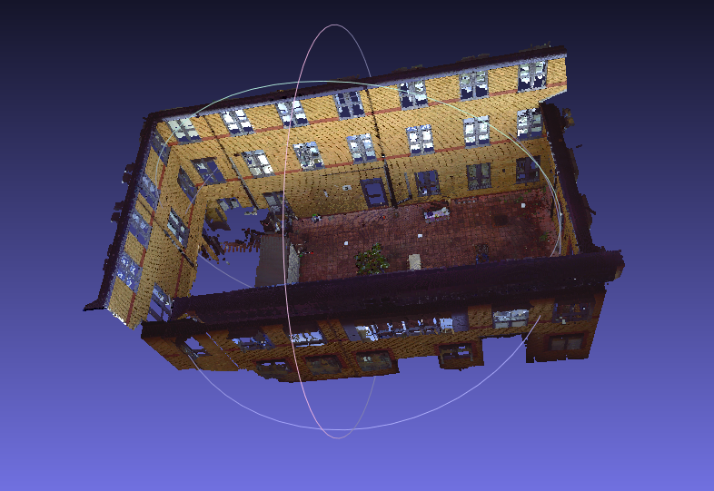
At the moment, visualisation of multimodal data is done in separate, dedicated tools
There is a need for an integrated tool which allows visualisation of various modalities

Slide 5
The browser is the ideal medium
It’s inherently multiplatform
It enables cloud-based and collaborative working
It encourages integration of multimodal data in a single application

Slide 6
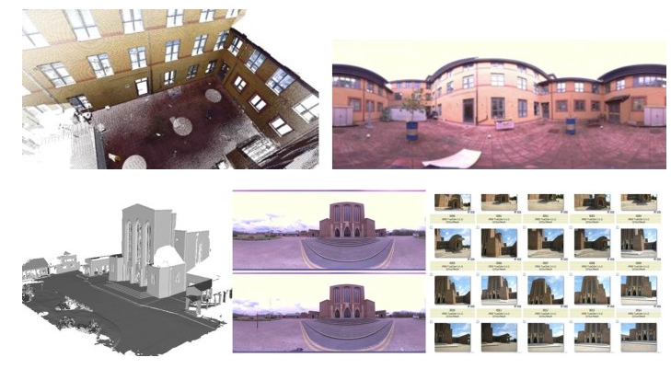
http://cvssp.org/impart/

Slide 7
A web application which combines:
Multiple point clouds in a 3D scene
Multiple videos positioned at camera locations within the 3D scene
Positioning of sensors

Slide 8
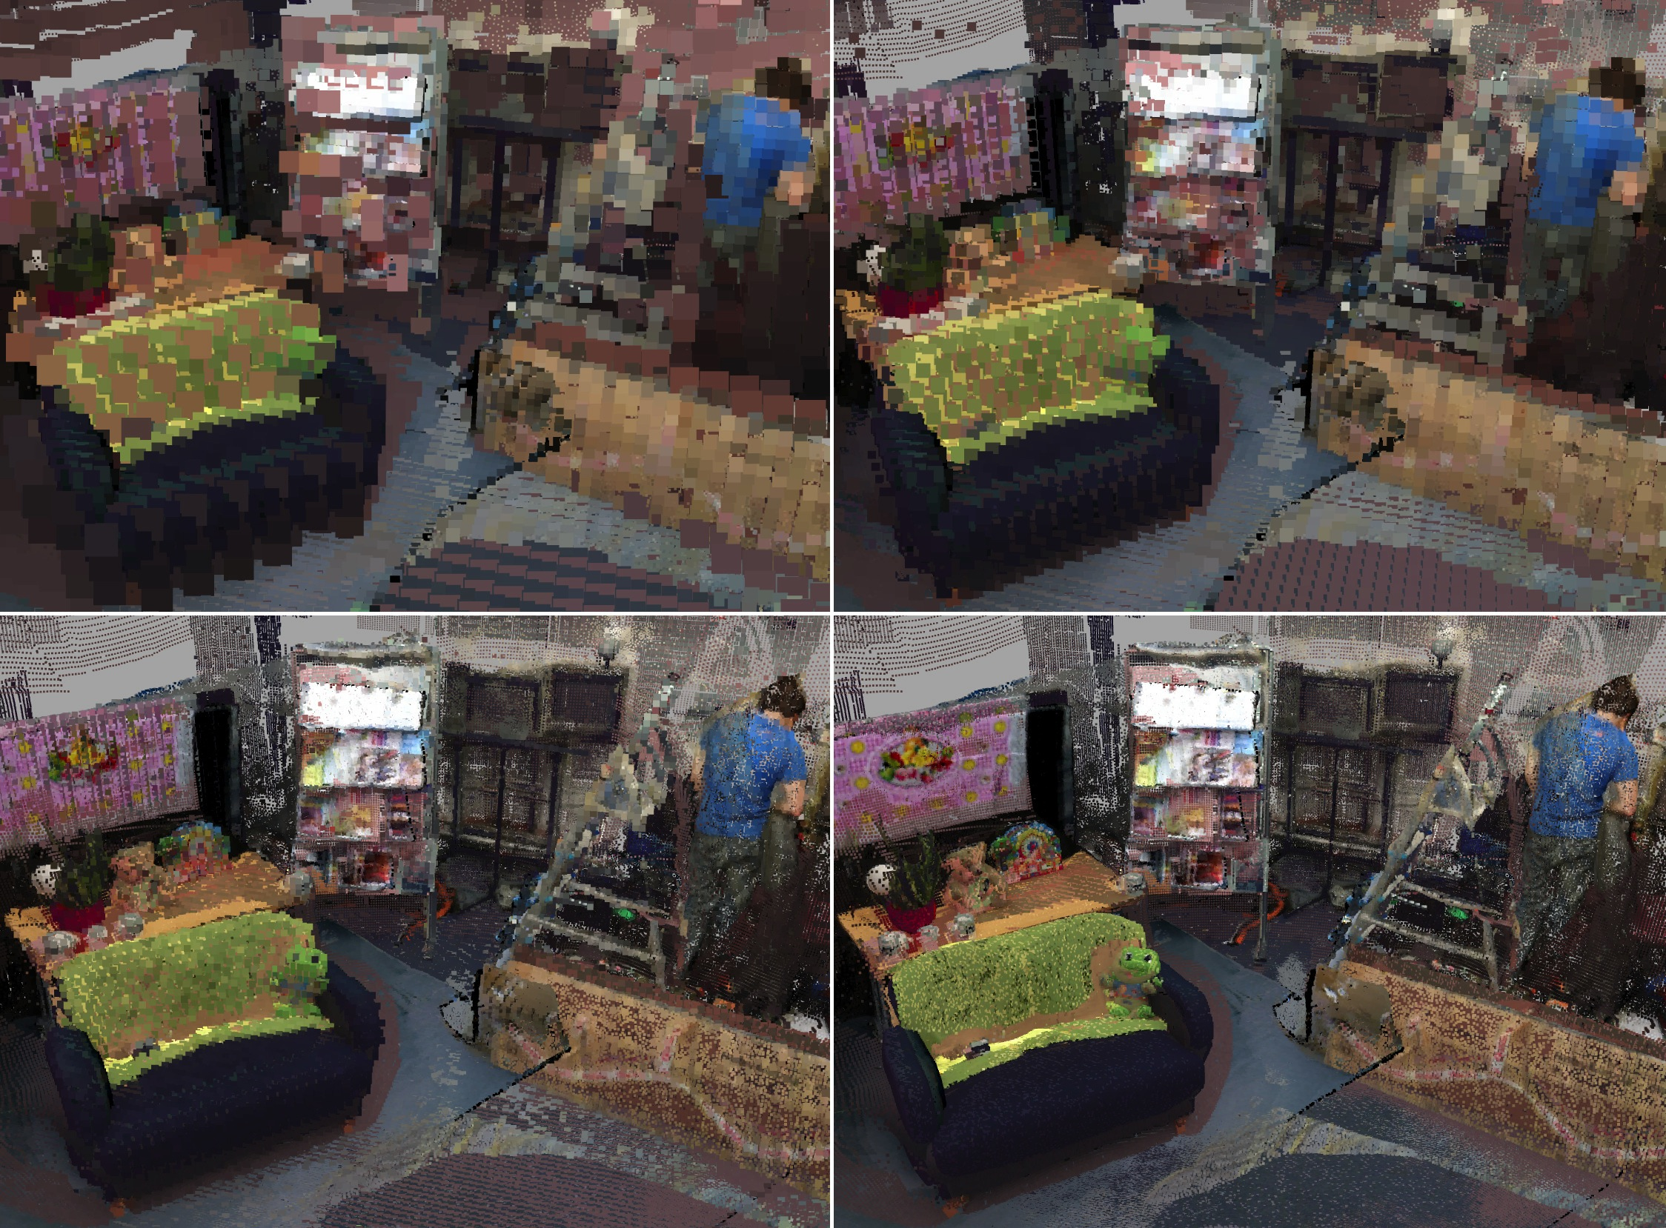
Multiresolution point clouds
Evans et al. Web-based visualisation of on-set pointcloud data.
Proc. 11th Conference on Visual Media Production (CVMP) 2014, London.

Slide 9
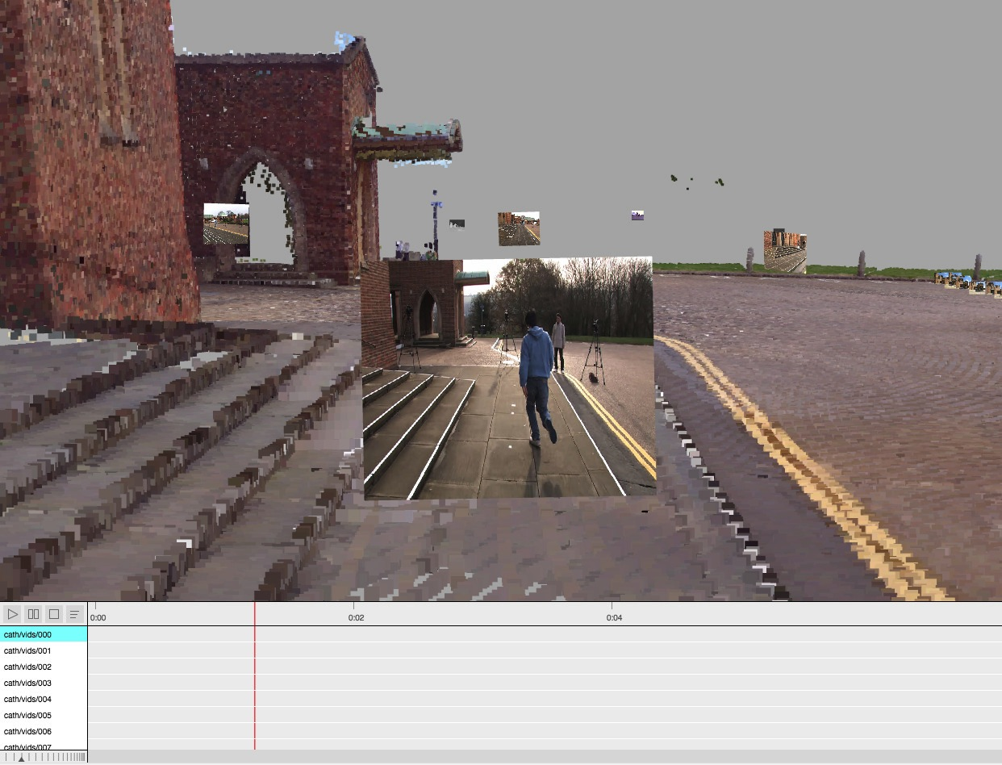
Video in a 3D scene
Witness camera video loaded as HTML5 element, converted to WebGL texture every frame, drawn on plane at location of camera

Slide 10
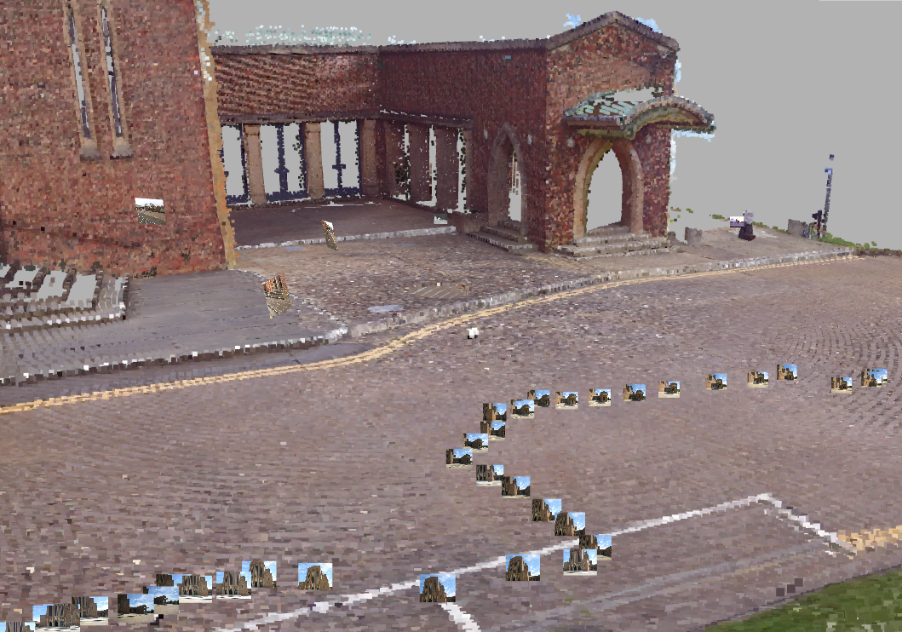
Original sensor positions
Loaded as HTML elements on top of 3D context

Slide 11
Demo

Slide 13
Current/future work
Using bounding box quantization to reduce number of bits encoding each octree node. UTF8 and delta encoding a la webgl-loader
Exploring Mesh rendering solutions
Again with BB quantization & delta encoding
OES_element_index_uint allows 32-bit index buffers
Simple progressive meshes working

Slide 14
Conclusions
The browser is an excellent context for visualisation of multimodal data (3D, video, images).
The web context leads naturally to collaborative workflows
Data distribution will always be a problem but our current work is promising in this regard

Slide 15
Thanks!
alun.evans@upf.edu
http://impart.upf.edu
http://cvssp.org/impart

