Slide 1
20th International Conference on 3D Web Technology
Webized 3D experience by HTML5 annotation in 3D Web
Daeil Seo^{1,2}, Byounghyun Yoo^{2,*}, Heedong Ko^{2,1} ¹ University of Science and Technology, Korea
² Korea Institute of Science and Technology, Korea
Heraklion, Crete, Greece
19 June 2015

Slide 2
Contents
Motivation
Previous work
Webizing 3D experience
Prototype implementation
Experimental results and Discussion
Conclusion

Slide 3
Motivation

Slide 4
Motivation
With the development of 3D Web technologies, 3D objects are now handled as HTML markup without plug-ins on web pages
However, although declarative 3D objects are physically integrated into web pages, the 3D objects still involve the same separation of the HTML element from the perspective of the 3D layout

Slide 6
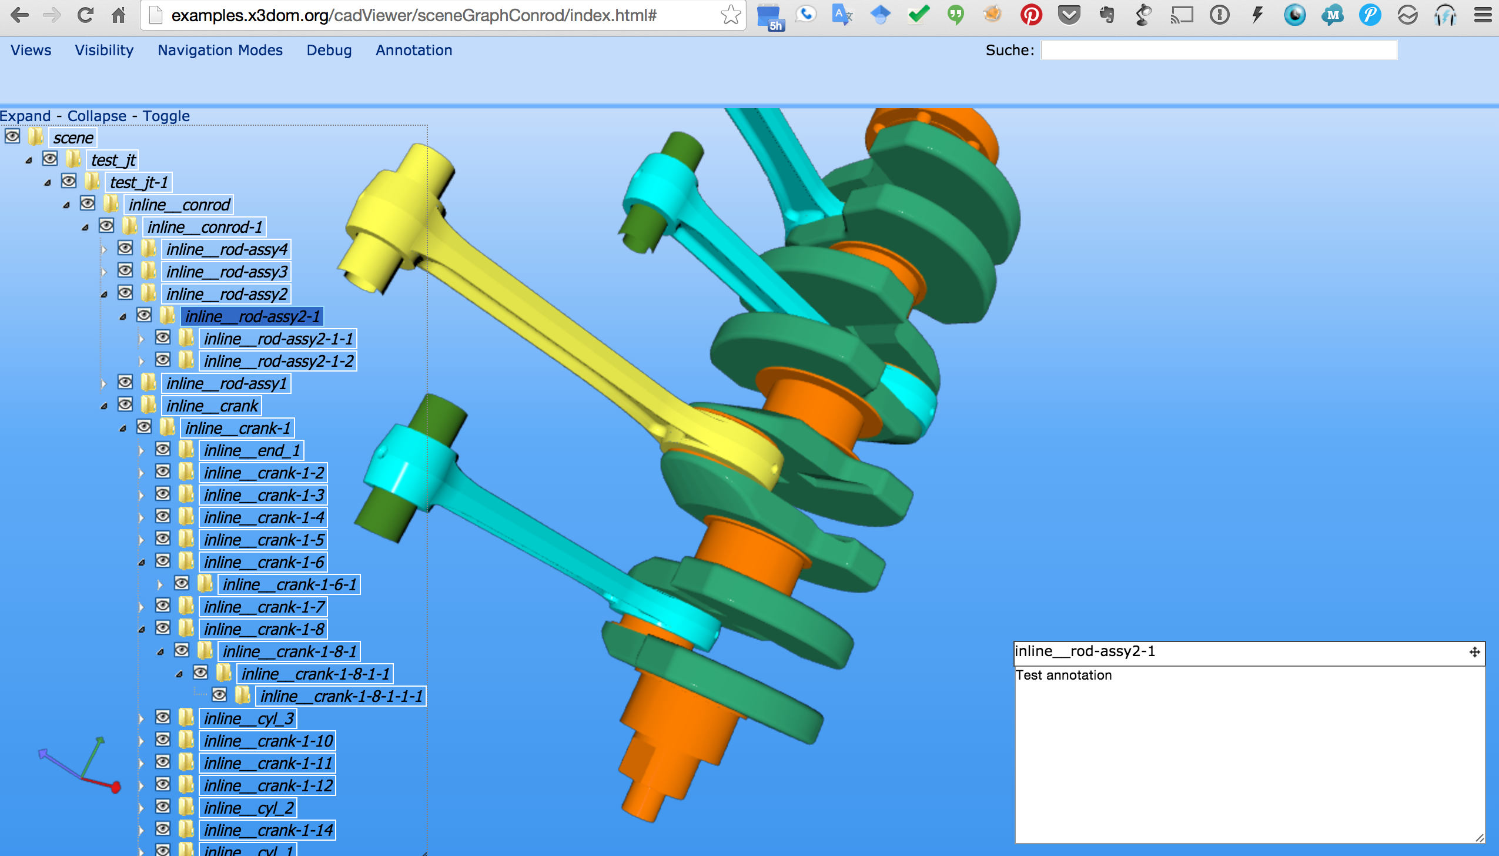

Slide 7
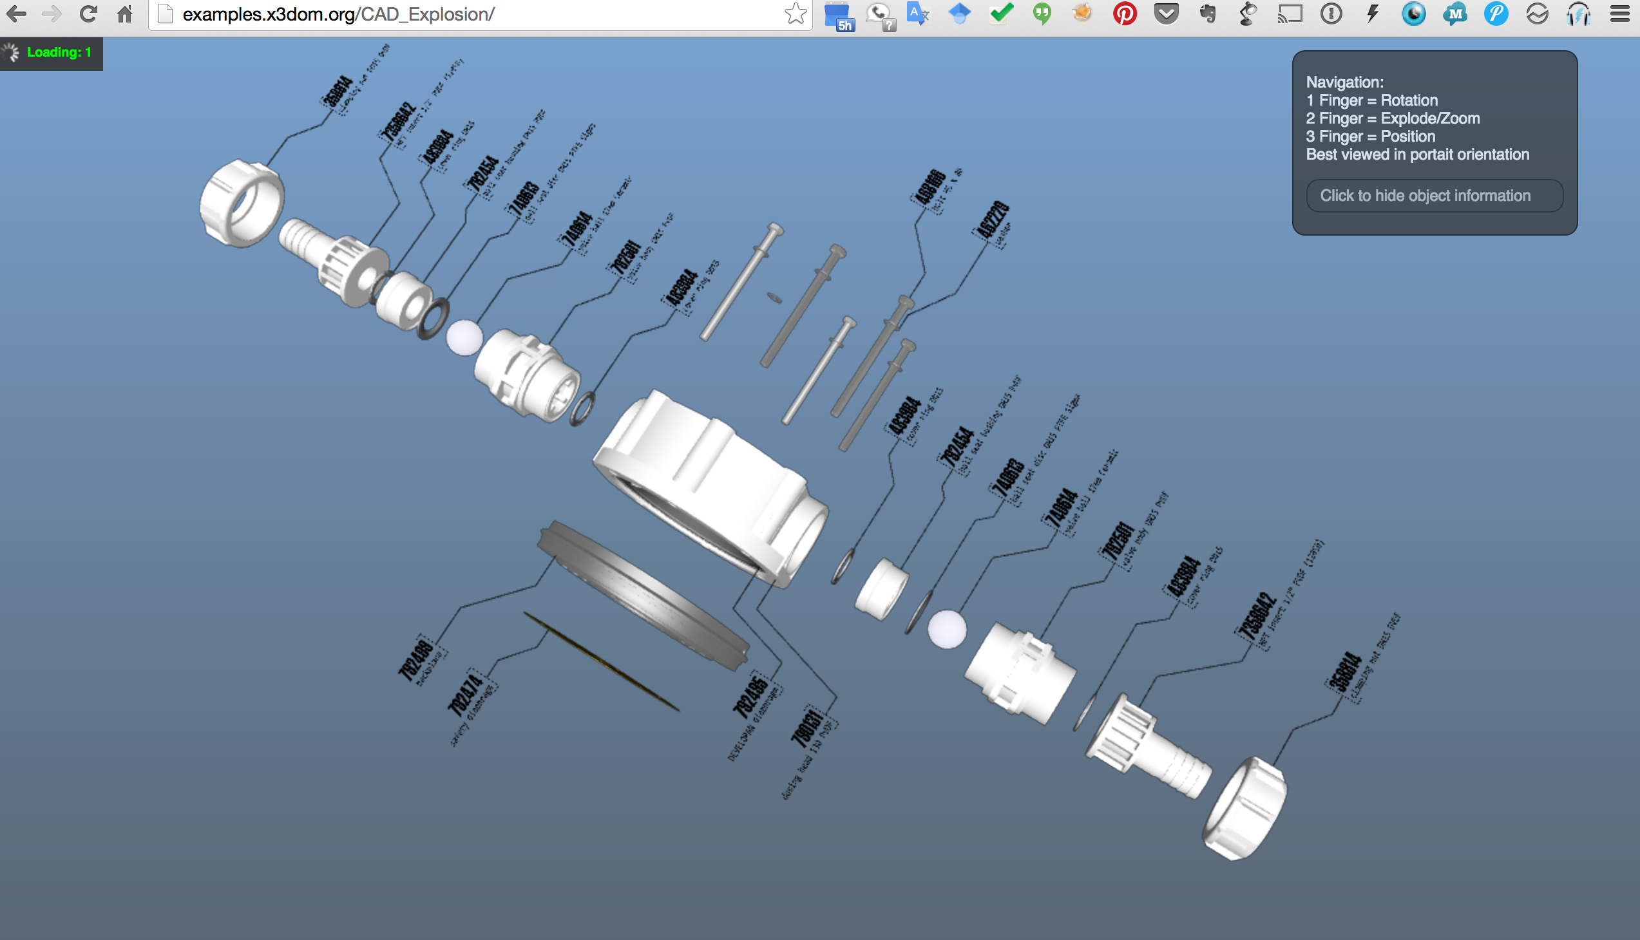

Slide 8
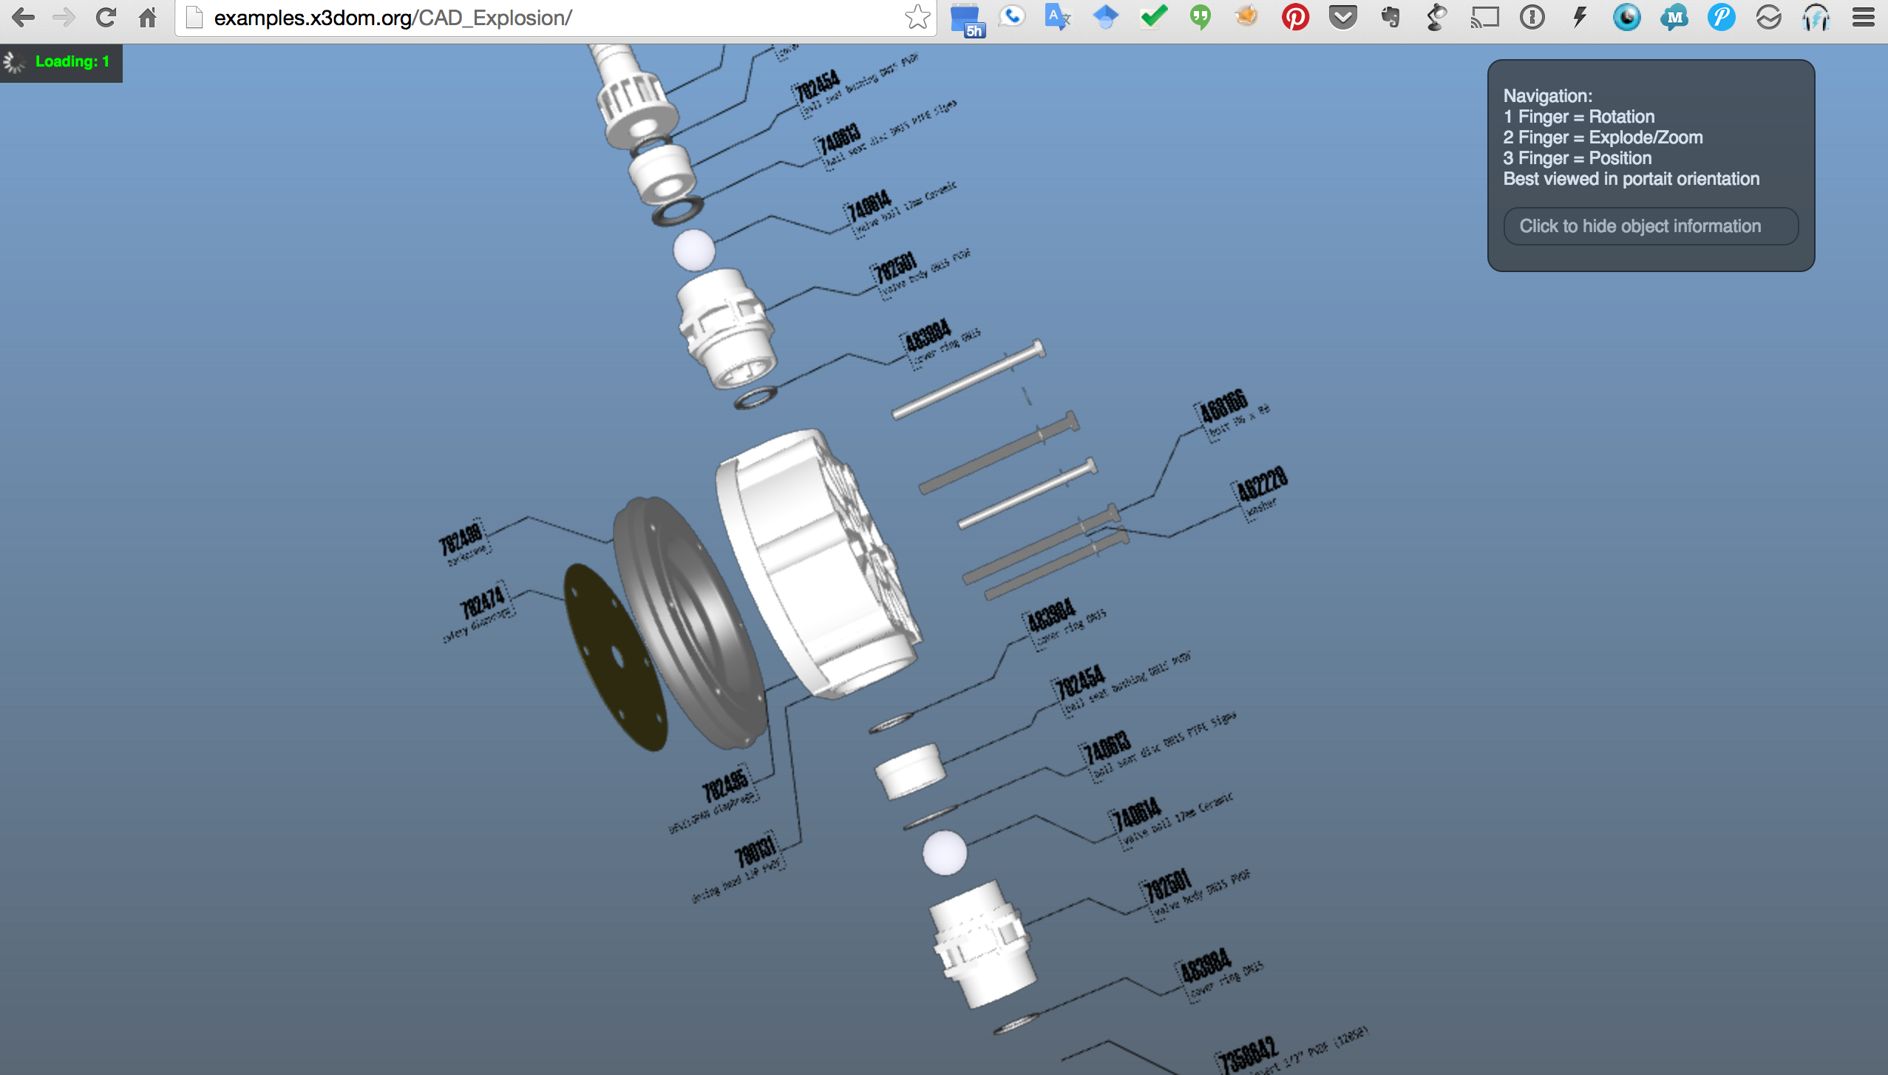

Slide 9
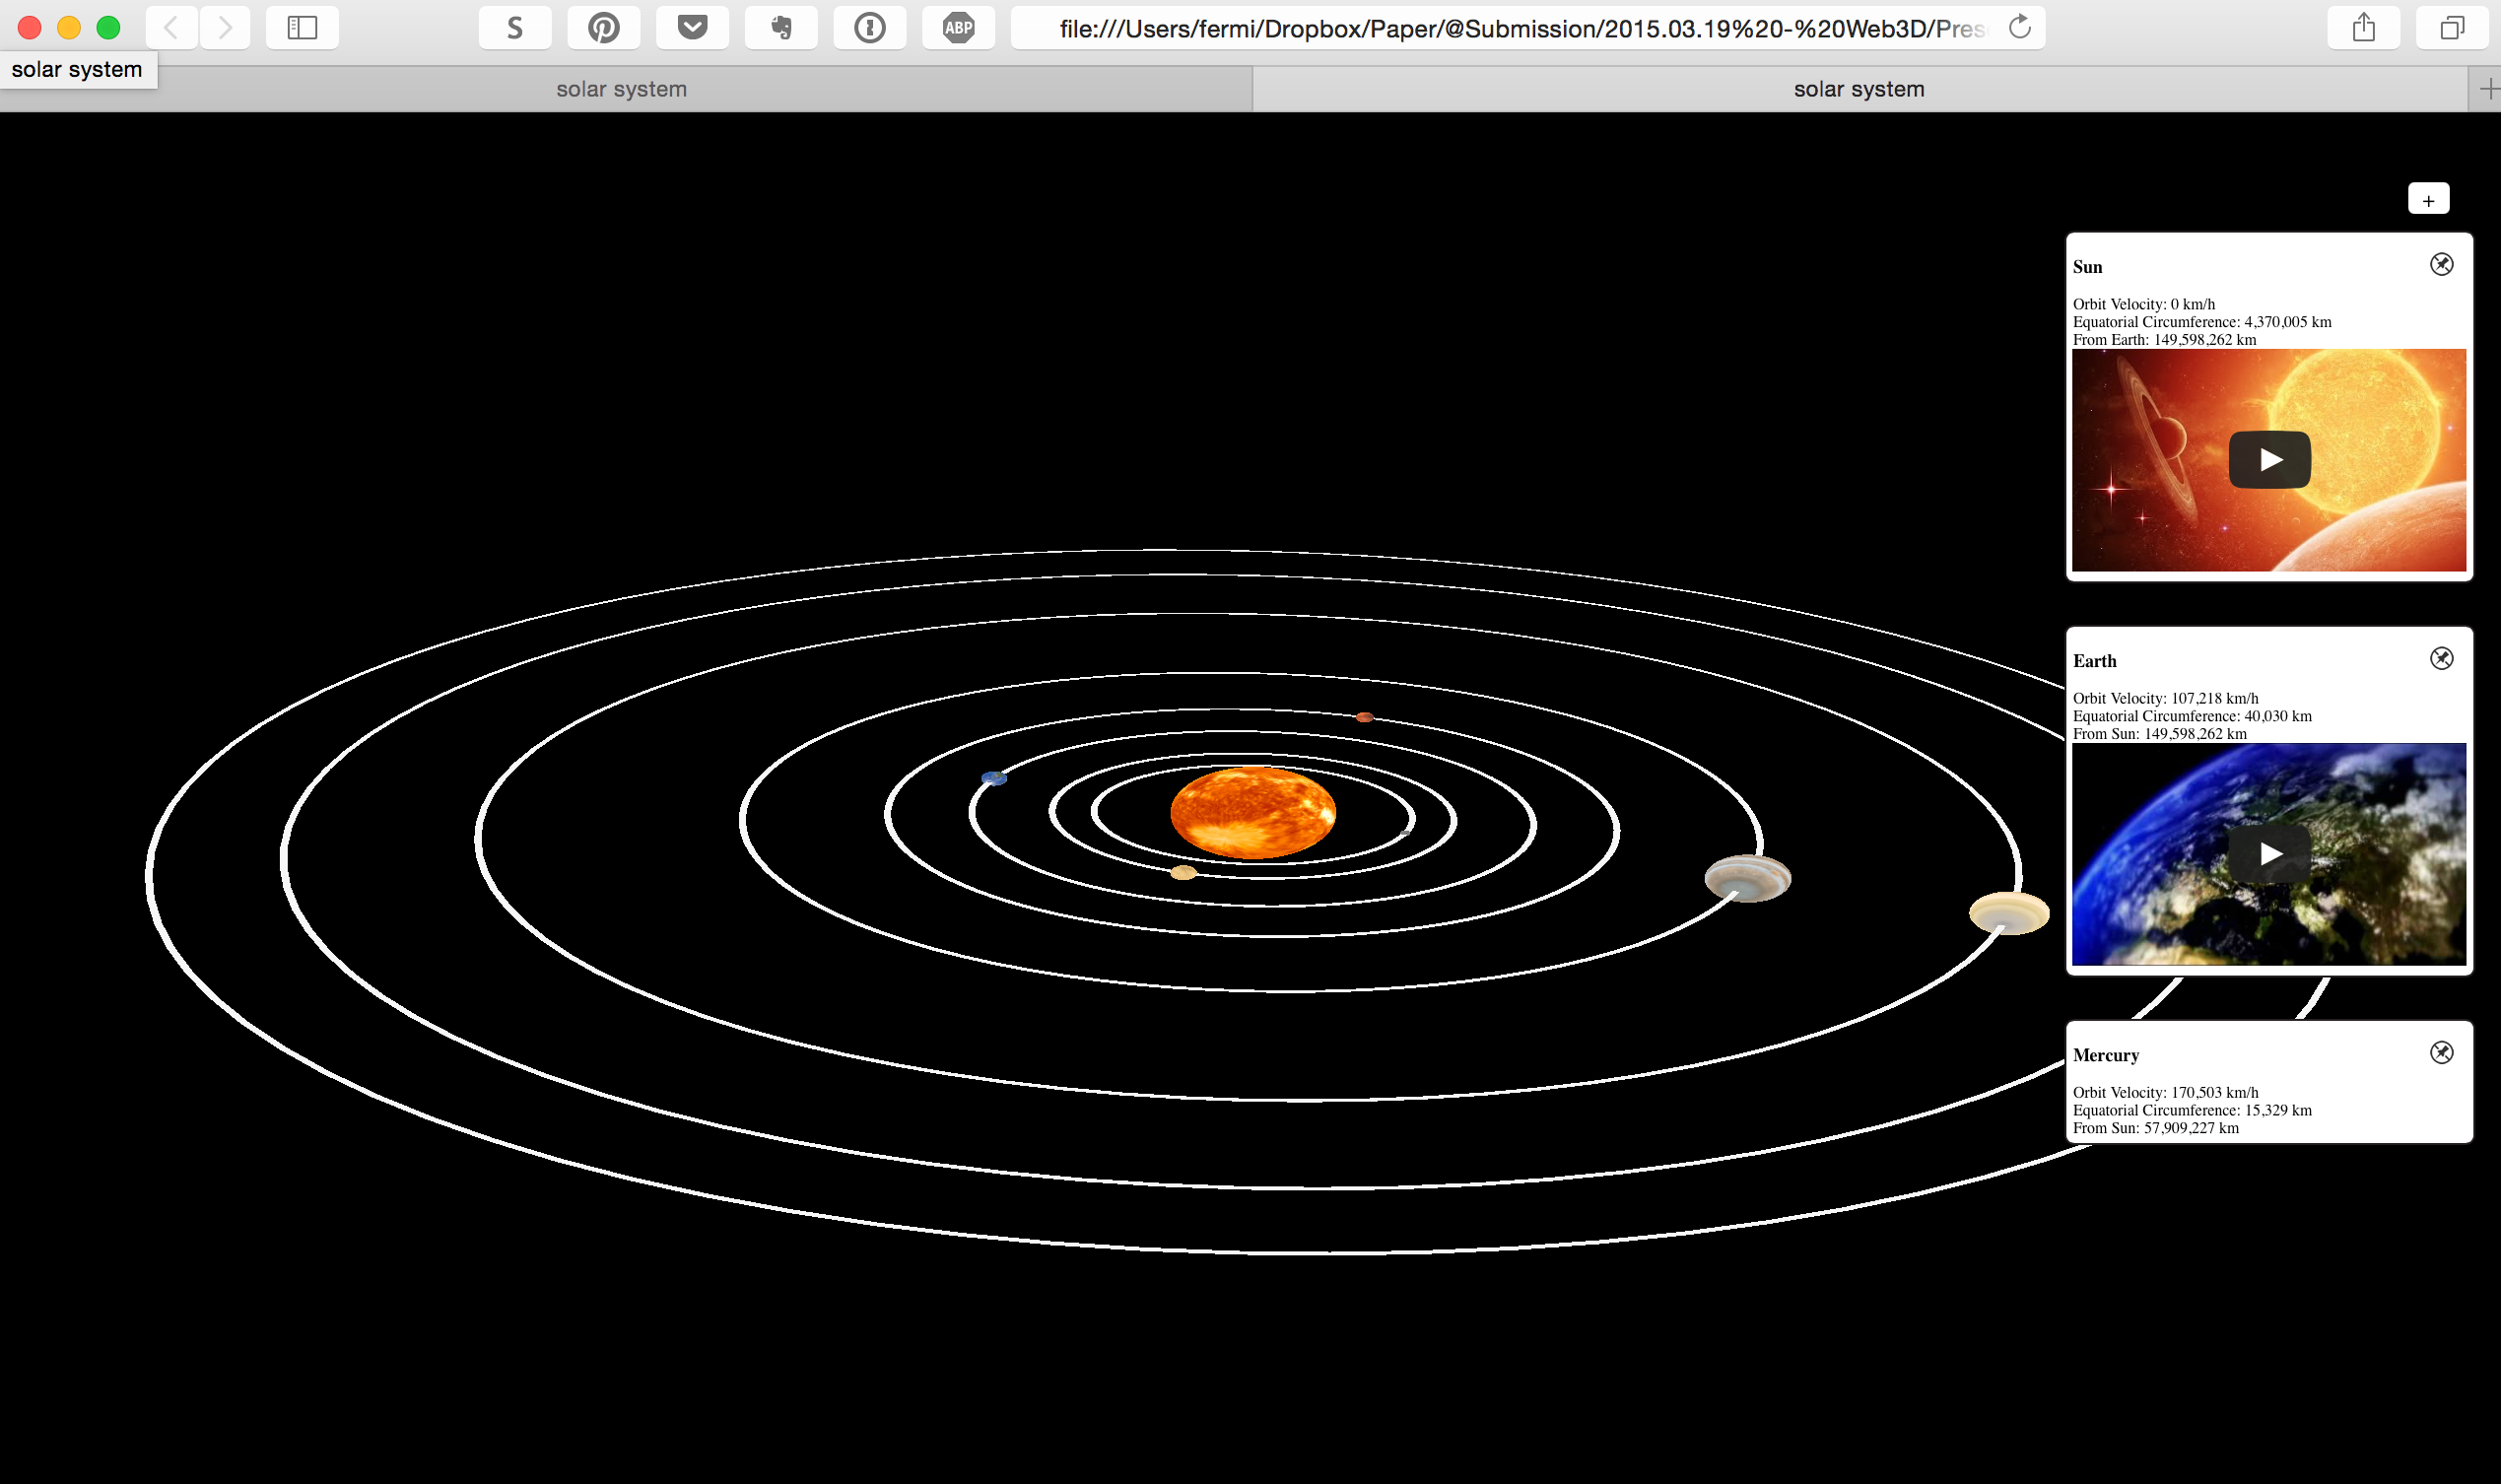

Slide 10
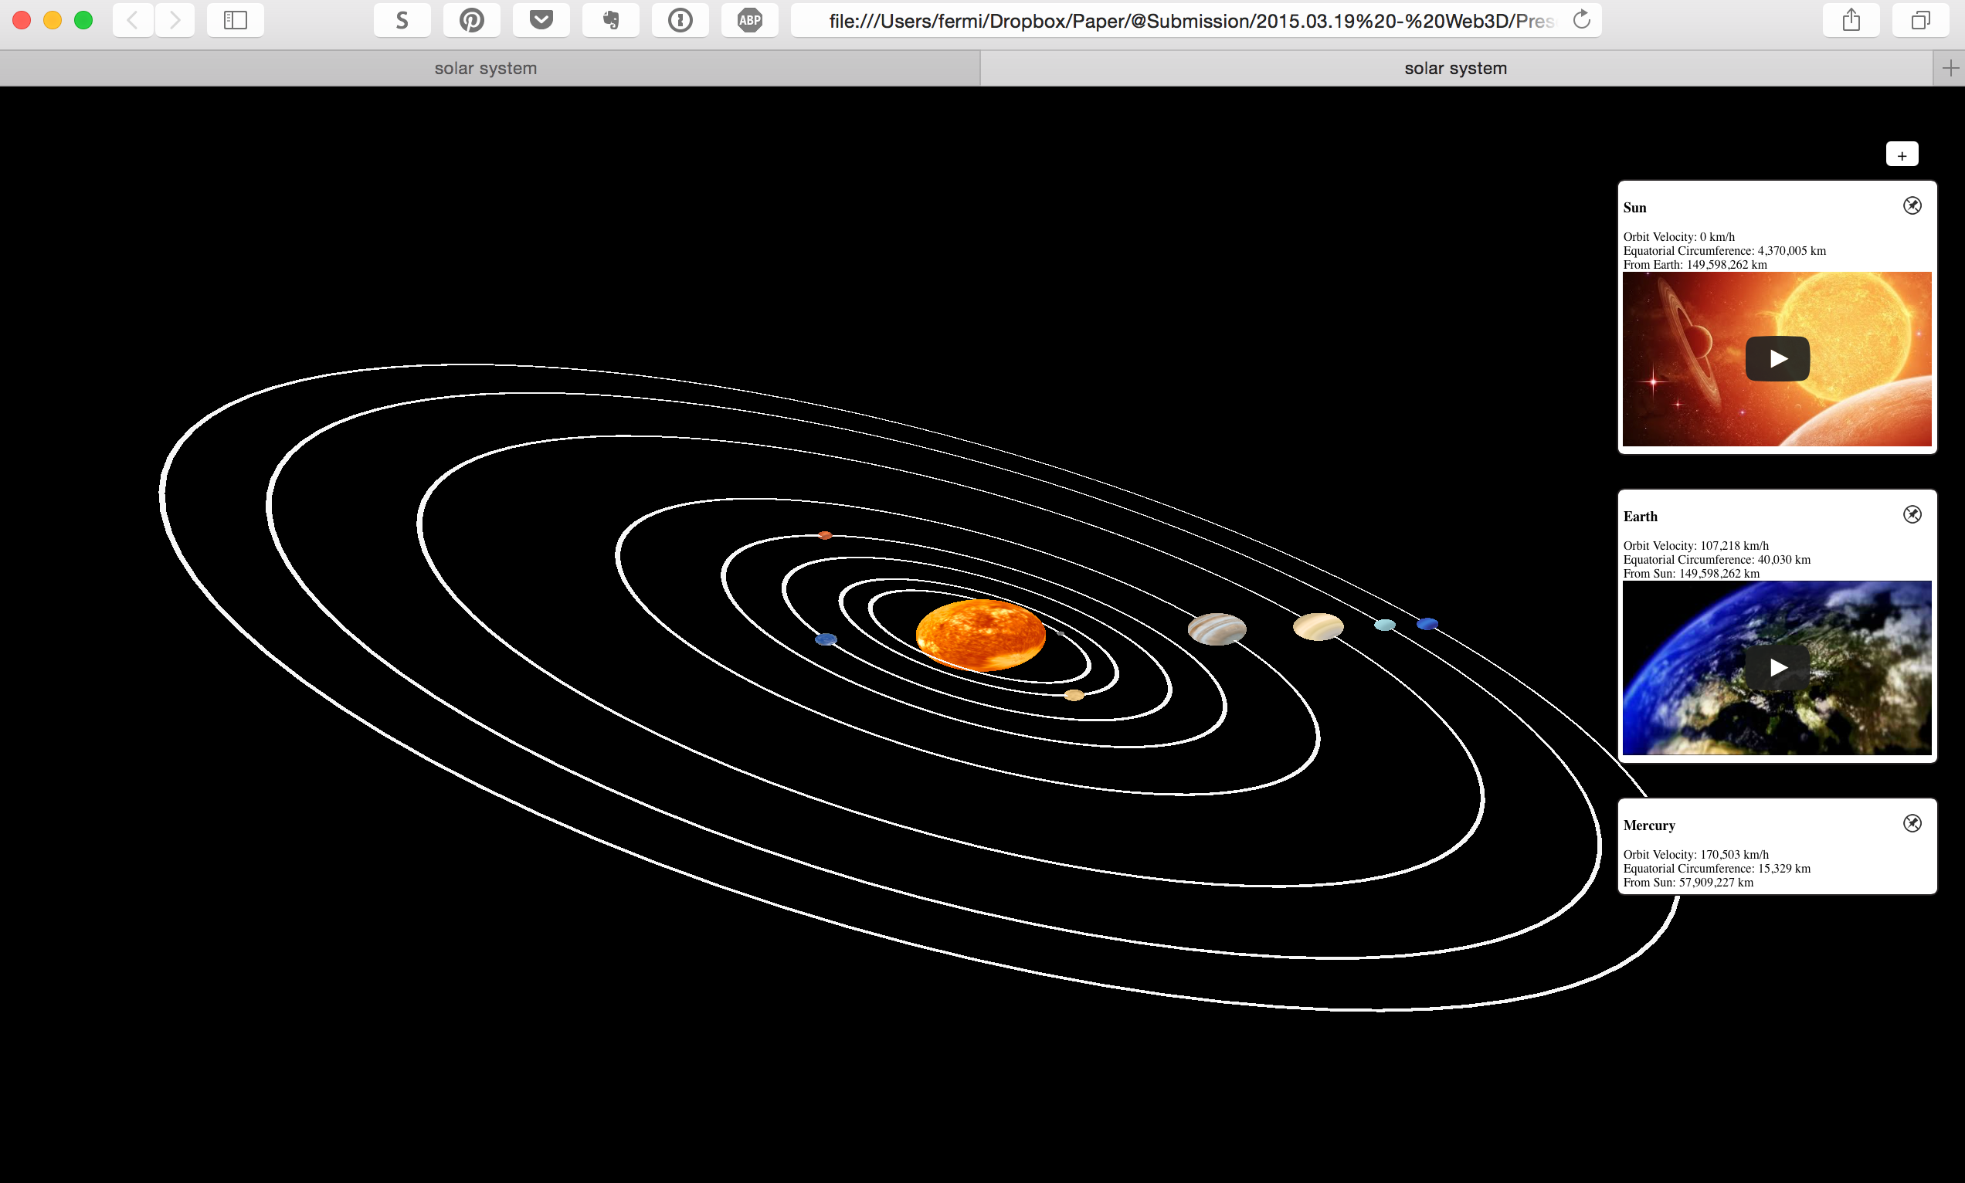

Slide 11
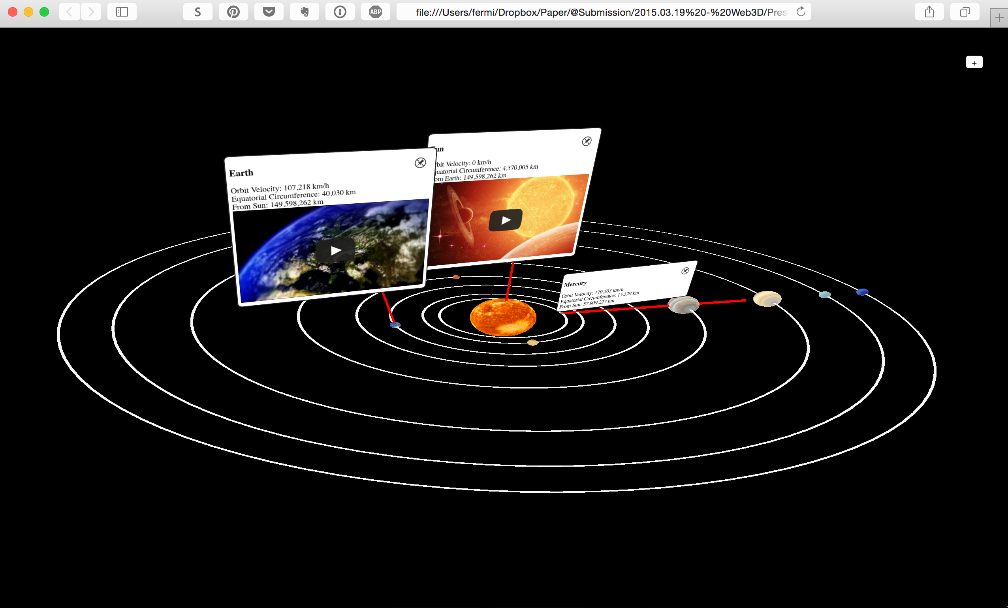

Slide 13
Previous work

Slide 14
Previous work
Integration of the 3D Web: (a) 3D object on the Web and (b) a 3D object with HTML annotations
JANKOWSKI, J. AND DECKER, S. 2013. On the design of a Dual-Mode User Interface for accessing 3D content on the World Wide Web. International Journal of Human-Computer Studies 71, 838-857.

Slide 15
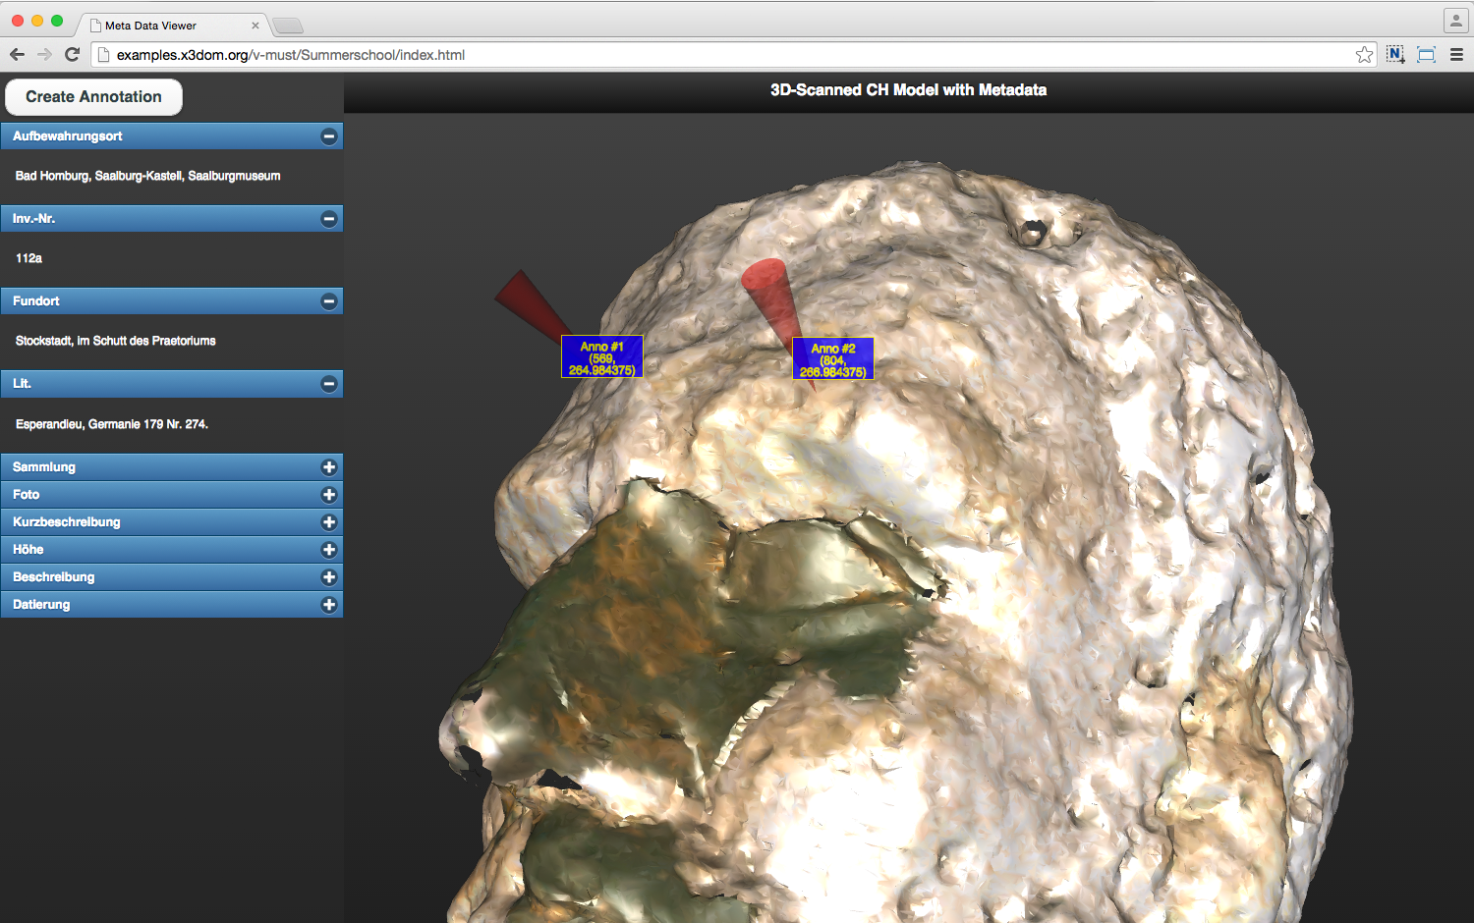
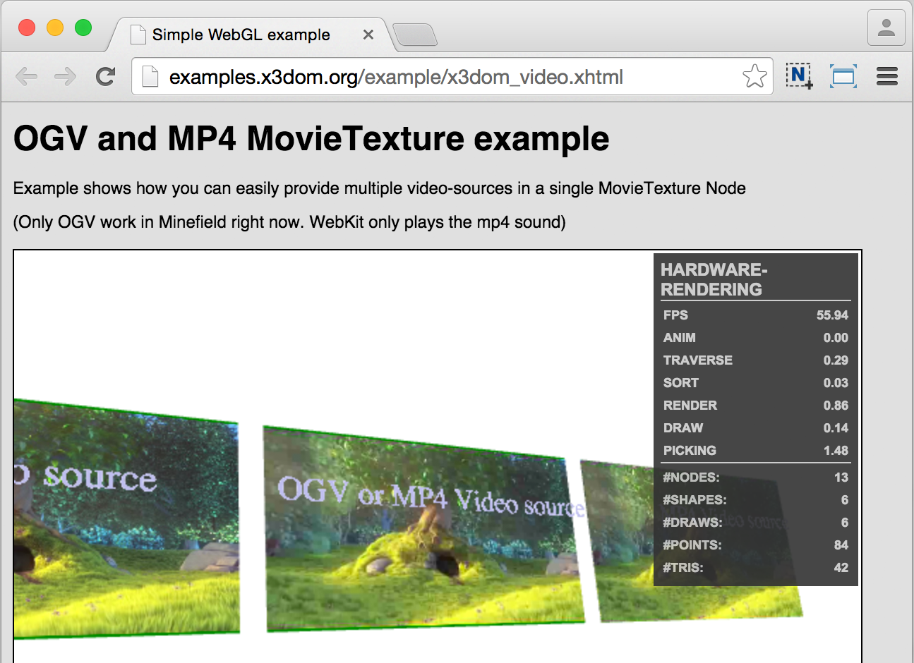
Previous work
X3DOM example of 3D-Scanned CH model with metadata
X3D MovieTexture example
http://examples.x3dom.org/v-must/Summerschool/index.html
http://examples.x3dom.org/example/x3dom_video.xhtml

Slide 16
Our approach

Slide 17
Webizing 3D experience
Webizing
A means of bootstrapping the Web using a large amount of legacy information [Berners-Lee 1998]
Our Method
Web annotations to declare the relationship between 3D target object and HTML annotation elements to share the 3D layout context on the 3D Web using web technologies
BERNERS-LEE, T. 1998. Webizing existing systems. In World Wide Web Consortium, personal notes on: Design Issues - Architectural and Philosophical Points, Last chage date: March 9, 2010.

Slide 18
3D Web annotation
 | Legacy 3D Web content | Declarative 3D | Webized HTML5 annotation
Mechanism | MIME | DOM integration | 3D context sharing
Examples | X3D | X3DOM, XML3D | Proposed
Annotation schema | ? | ? | Schema.org
Rendering model |  | Separate Canvas | Sharing 3D context of 3D scene and HTML annotation
Media type | 2D page media | 2D page media | 3D place media (CSS extension)
Limitations | Separation of 3D context between contents (3D and HTML resources) | Separation of 3D context between contents (3D and HTML resources) | Depth buffer sharing issue (not resolved yet)
Advantage |  | No-plugins | Any HTML5 resources

Slide 19
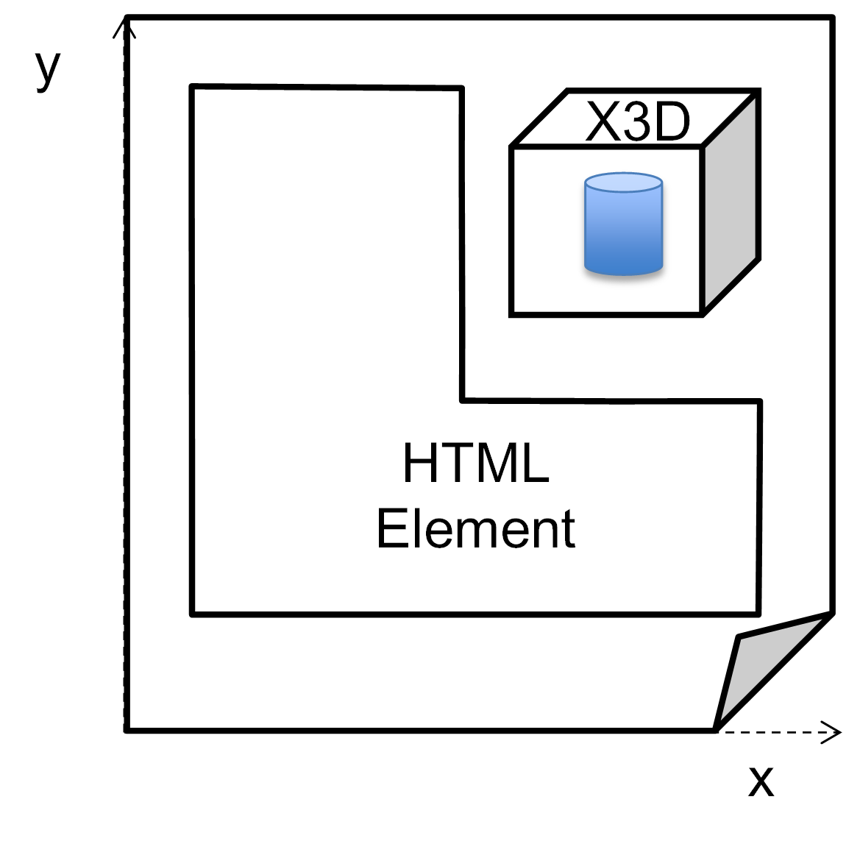
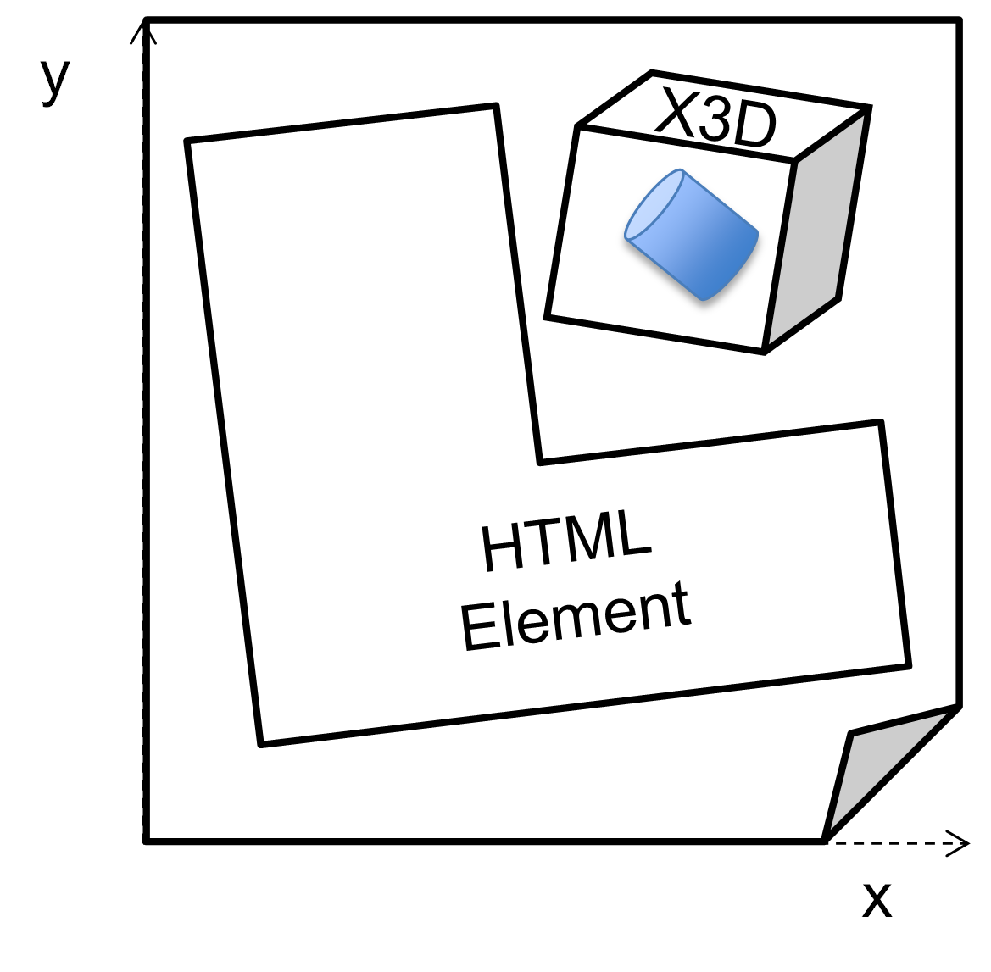
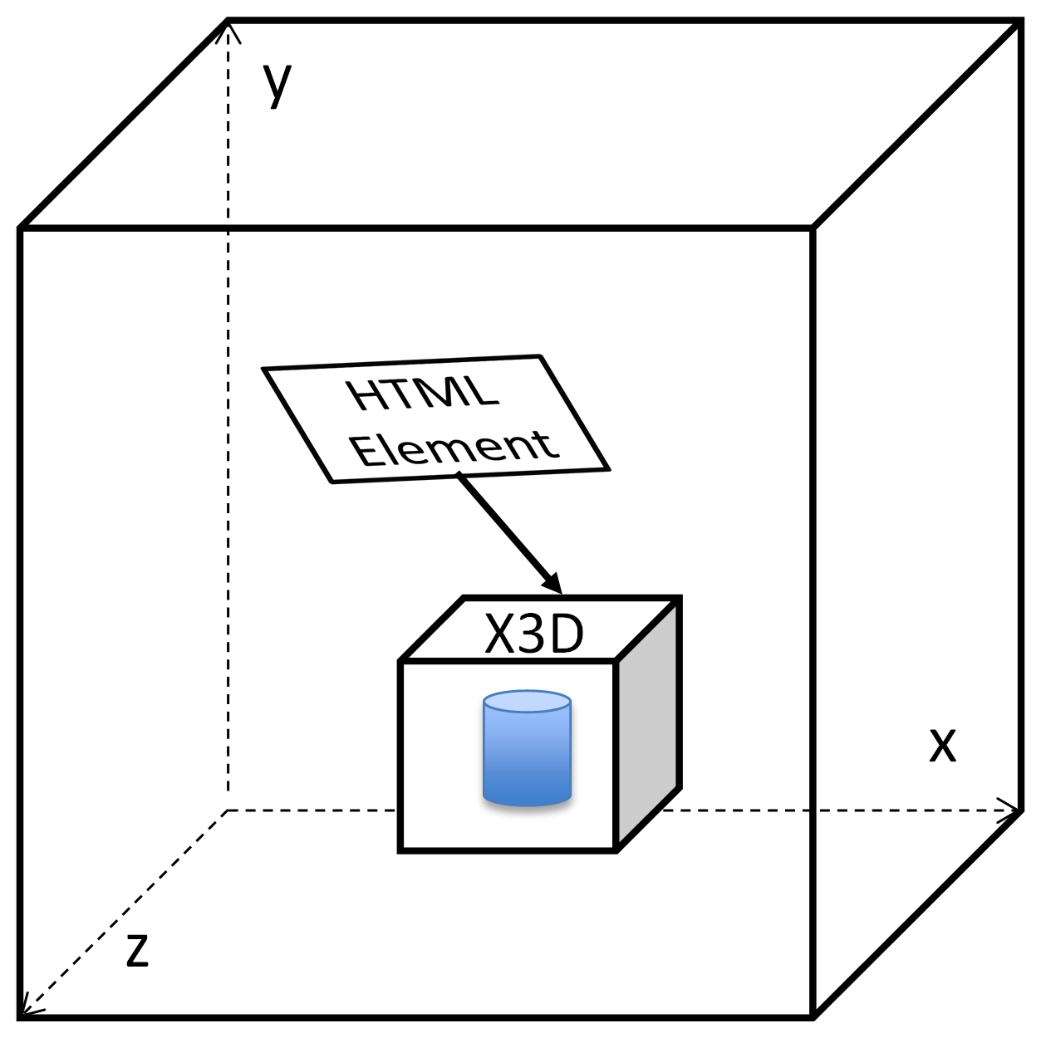
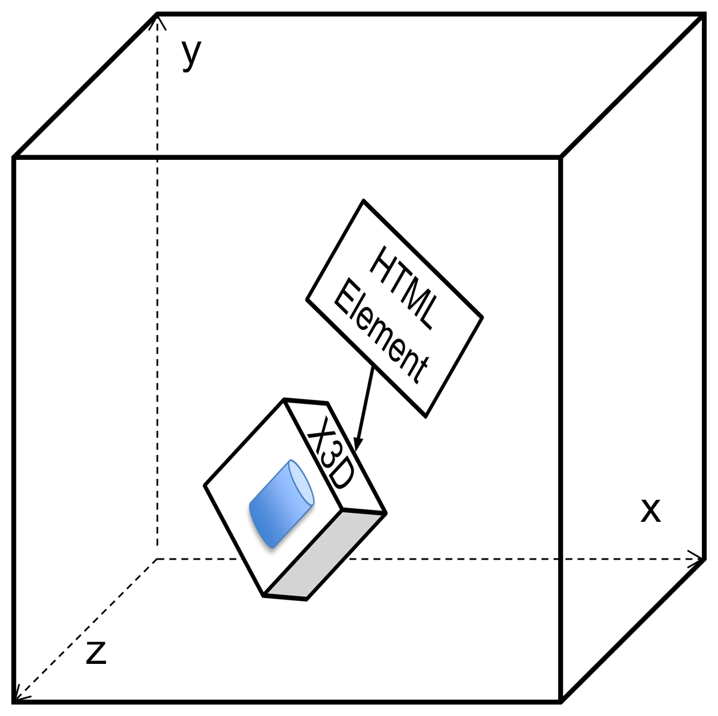
Integration of HTML and 3D Web
Previous
CSS Paged Media
2D Space
Proposed
CSS Place Media [Ahn 2014]
3D Space
Transform
AHN, S., KO, H. AND YOO, B. 2014. Webizing mobile augmented reality content. New Review of Hypermedia and Multimedia 20, 79-100.

Slide 20
Webizing 3D experience with annotation
y
y
Scene Graph Transform
User Comment
User Comment
x
x
z
z
3D Object
HTML Element
Web Annotation

Slide 21
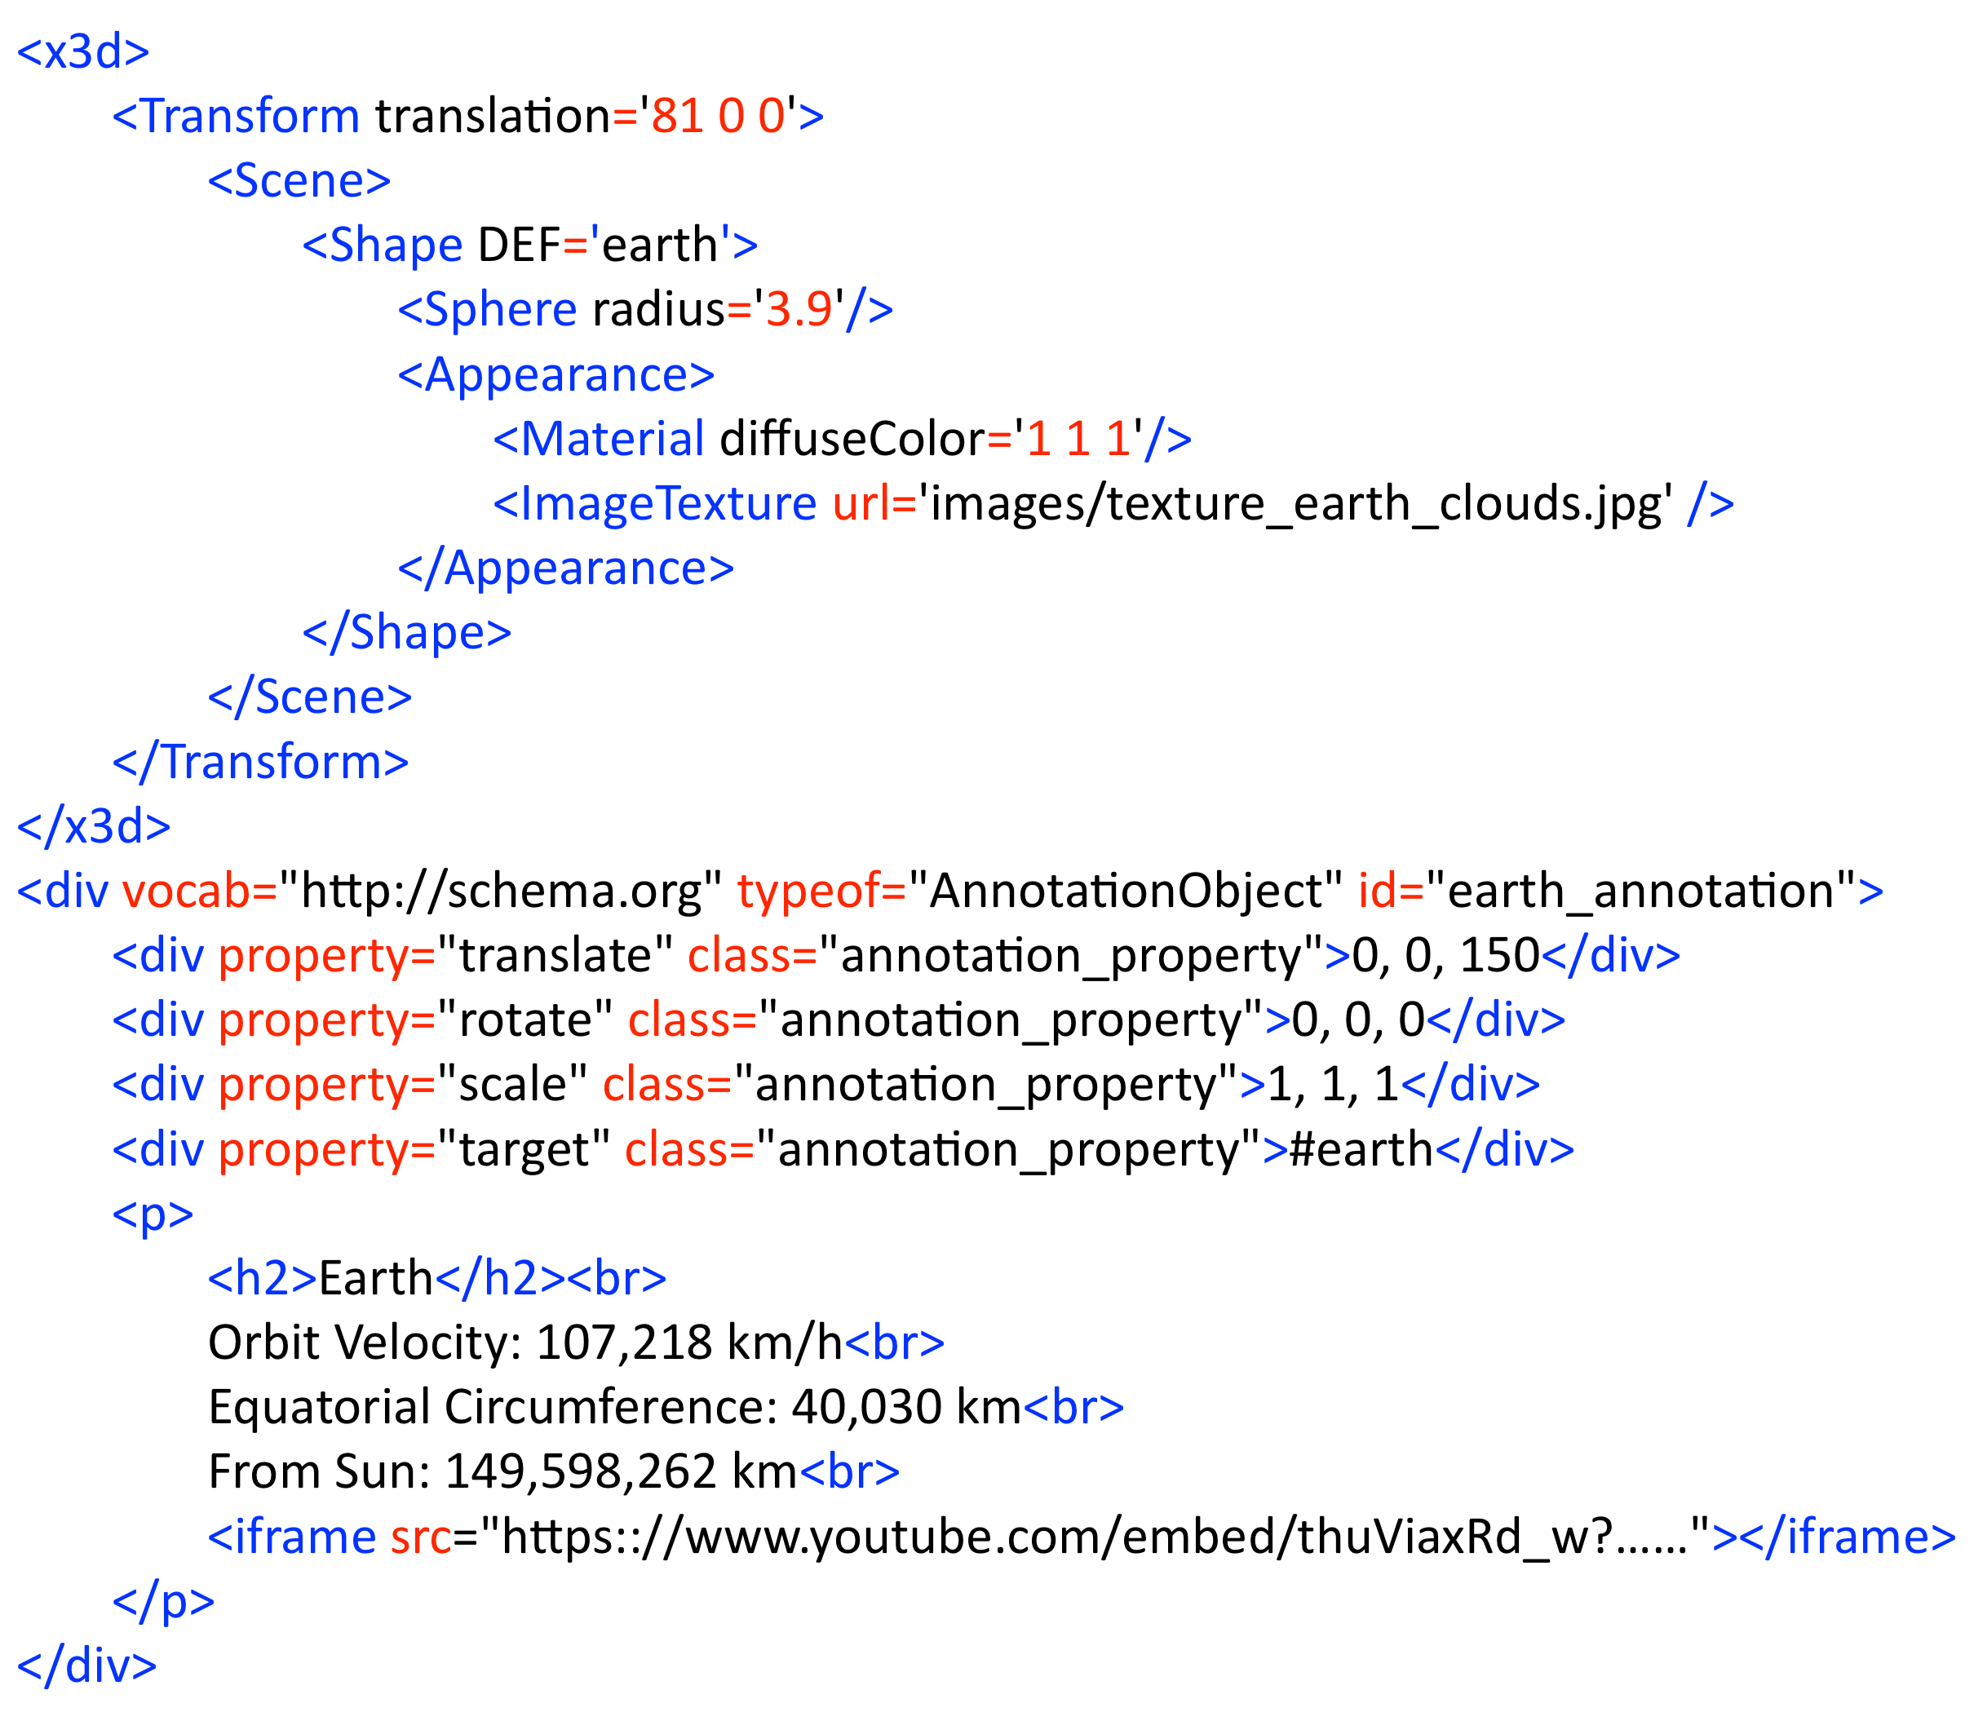
Semantic annotation on 3D Web
Webizing annotation schema for the 3D Web experience
Property | Range | Description
target | URL | 3D target object’s DEF attribute value of the annotation
translate | Integers | Defines a translation
rotate | Integers | Defines a rotation (degree)
scale | Integers | Defines a scale transformation
contentURL | URL | URL of an external web page to annotate on 3D target object

Slide 22
Prototype implementation

Slide 23
Prototype implementation
Scene Graph Renderer
X3D
Renderer
CSS 3D
Renderer
Scene Graph Integrator
Webized 3D Scene Graph
Content Store
HTTP Get
HTML
/X3D
HTML
X3D
HTML
HTML
HTML
DOM
DOM
Annotation
HTML/X3D
Web Browser
Content Store Provider

Slide 24
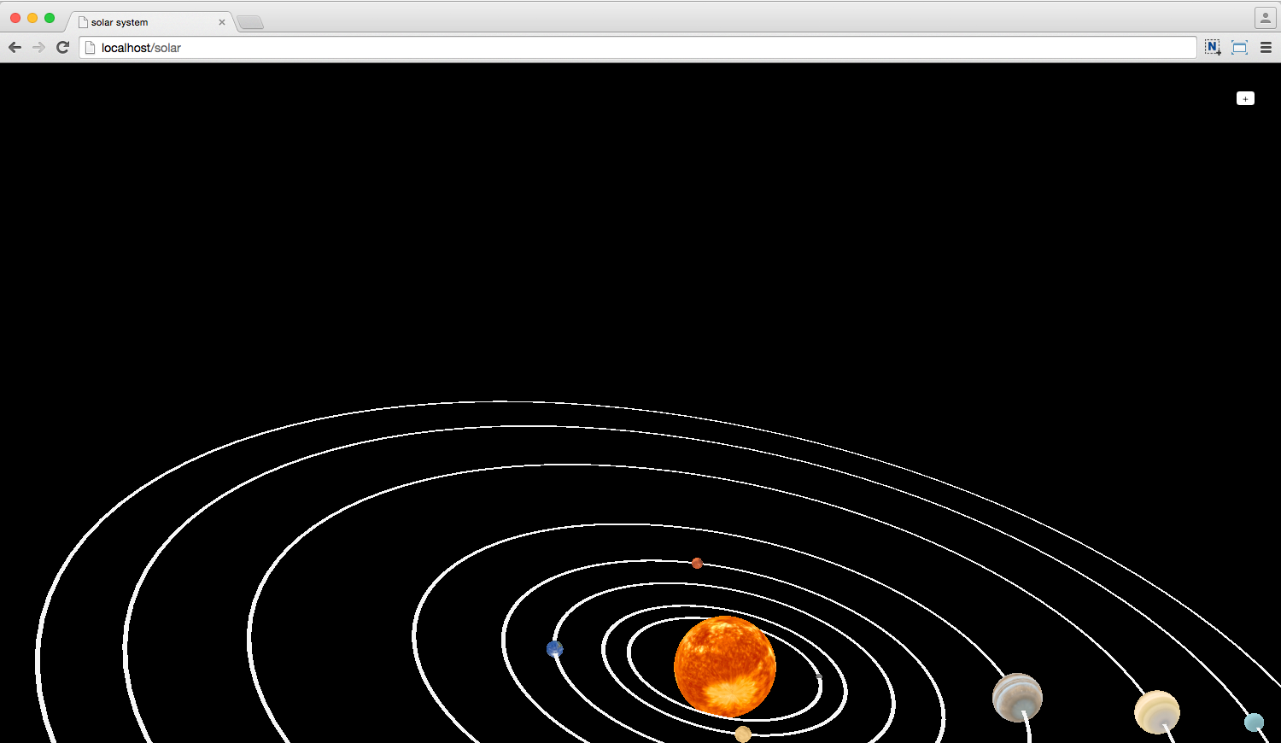
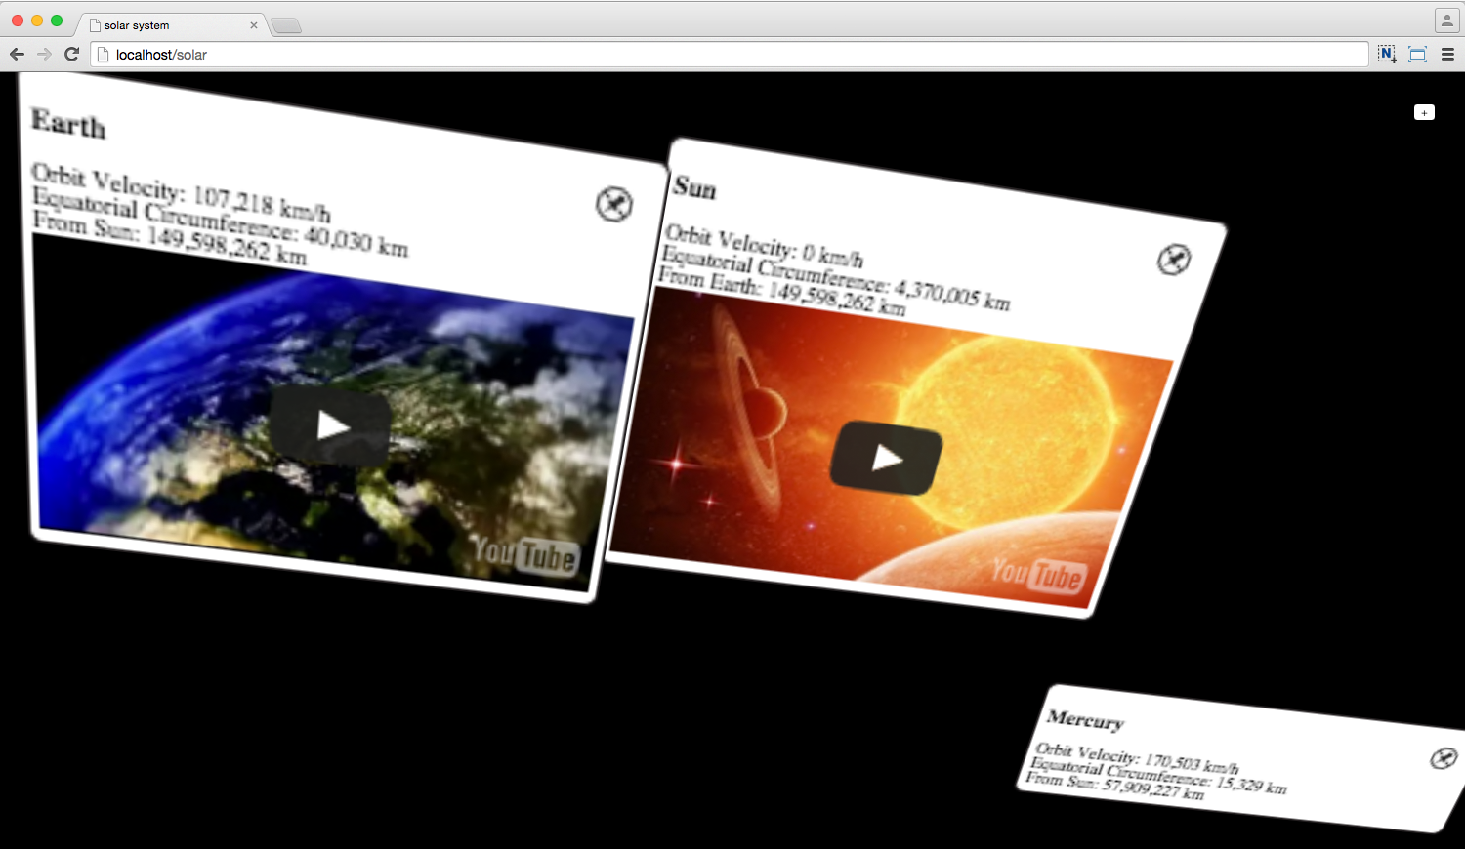
Experimental results
Separate rendering results of the 3D Web
3D object rendering on the 3D Web
Web annotation rendering on the 3D Web

Slide 25
Experimental results
3D planet objects in solar system

Slide 26
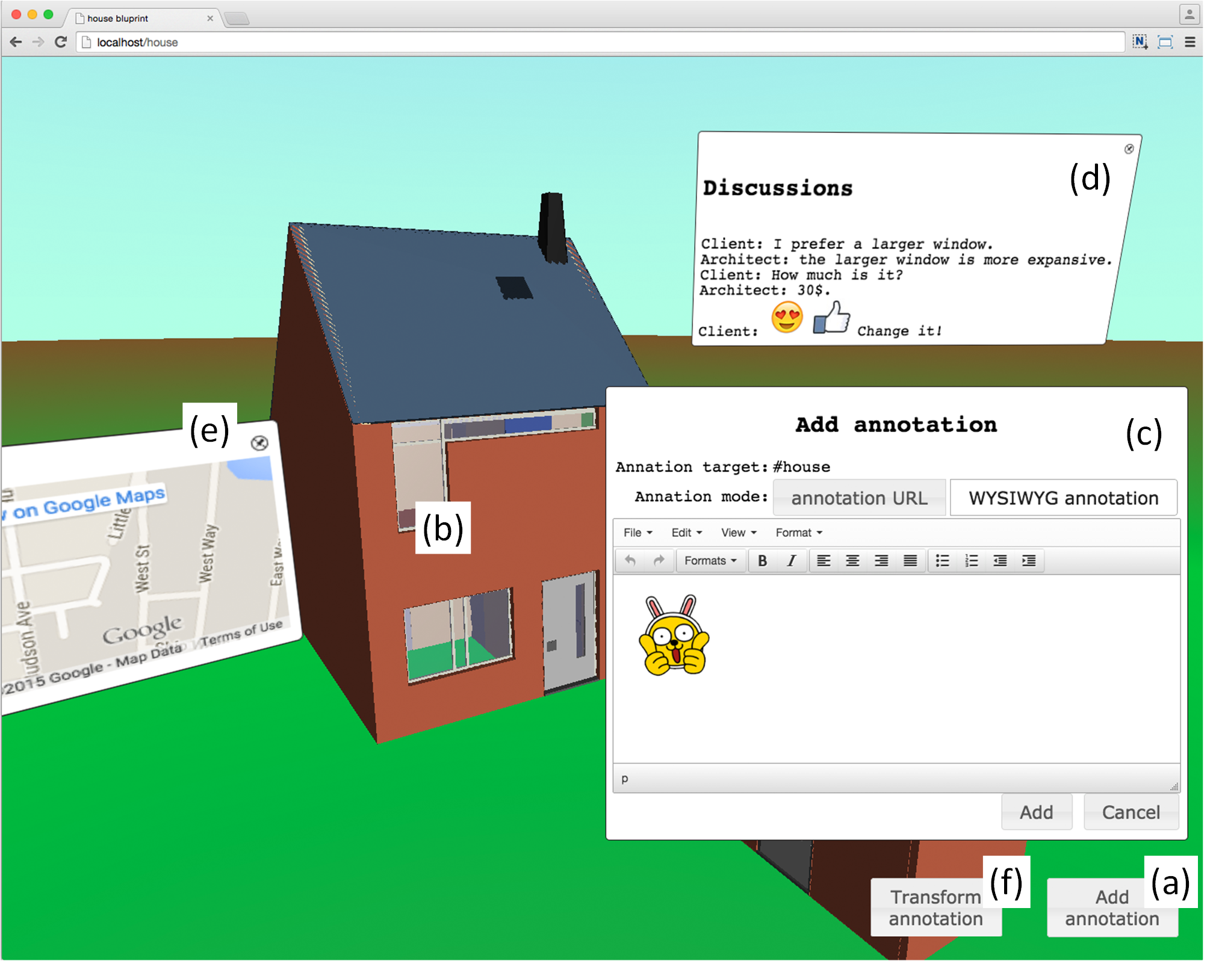
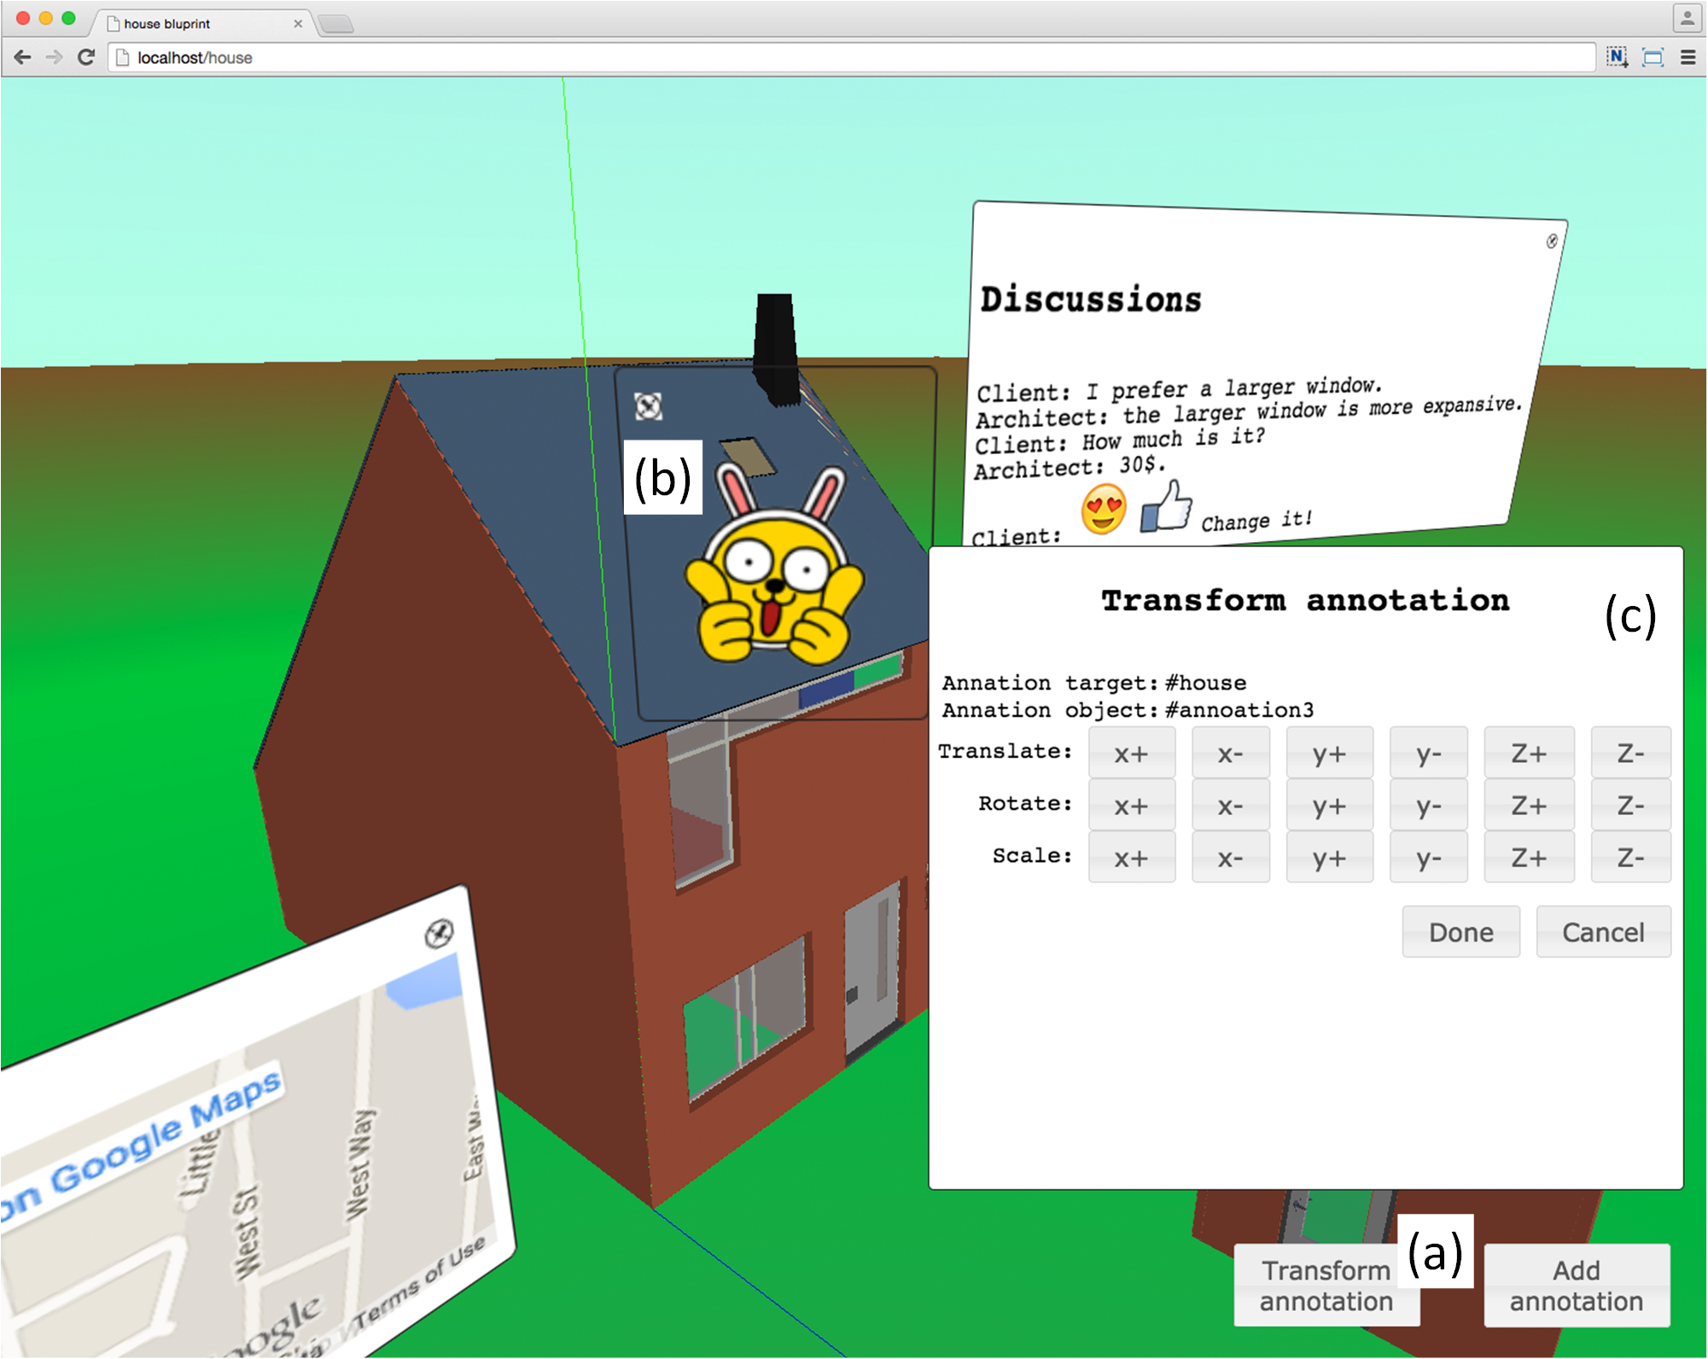
Experimental results
3D architectural CAD model of a house
User experience annotation on 3D model
Transforms web annotation of user experience on 3D model

Slide 27
Discussion and future work

Slide 28
Summary
In this study, we proposed a method for webizing 3D experience by web annotation to express user experience on 3D Web
Uses web annotation model to declare relationship between user experience and 3D objects
Renders them based on the relationship to share layout and camera perspective in 3D context
Has advantage to use existing sophisticated media and application library resources of current web technologies on the 3D Web

Slide 29
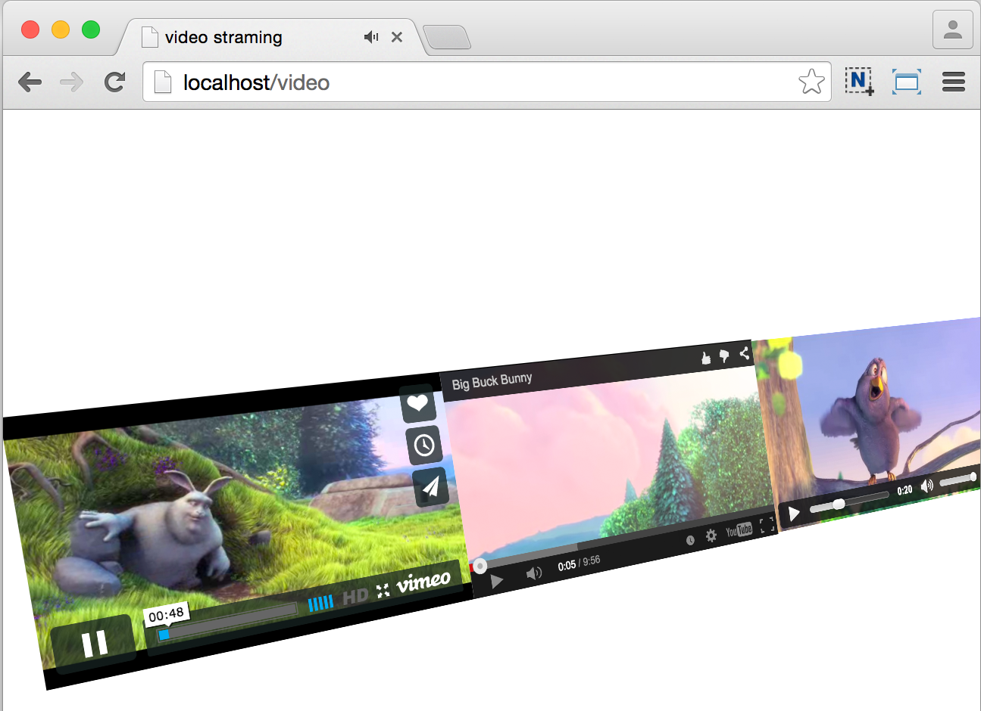
Discussion
Interaction with HTML element on 3D Web
X3D MovieTexture example
Webized annotation on the 3D Web using Video, YouTube, and video tag of HTML
http://examples.x3dom.org/example/x3dom_video.xhtml

Slide 30
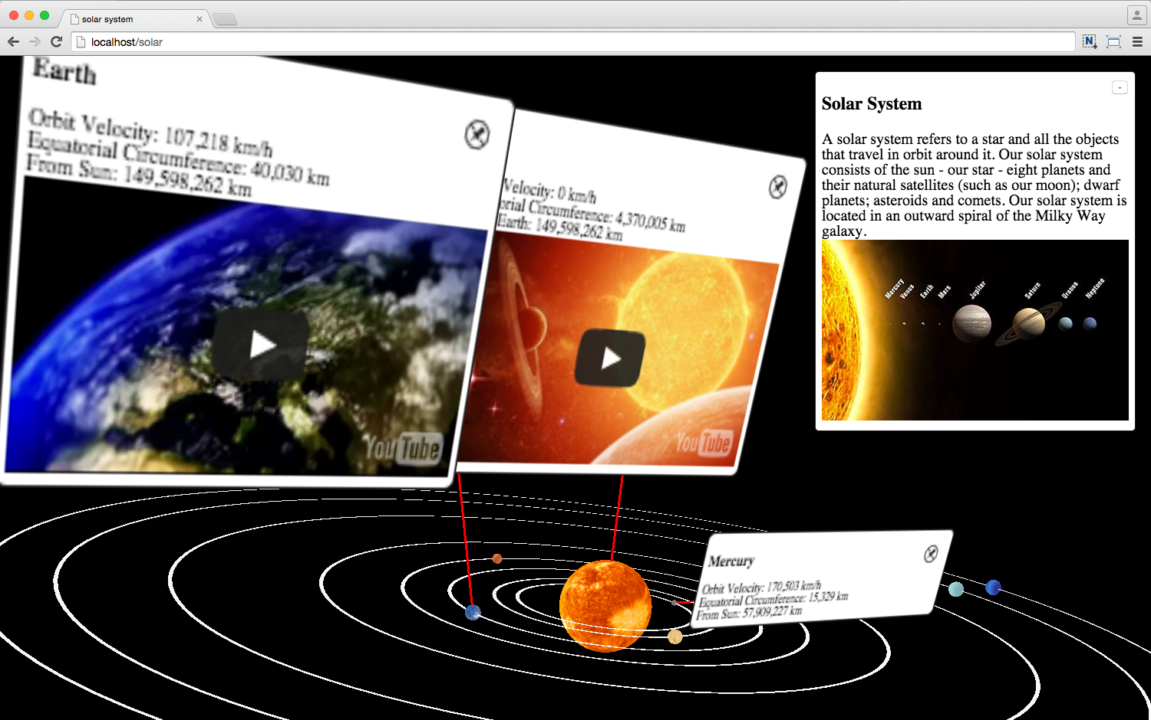
Discussion
Rendering 3D objects with annotation on 3D Web
X3DOM example of 3D-Scanned CH model with metadata
Webized annotation on the 3D Web with 2D and 3D layout annotated objects
http://examples.x3dom.org/v-must/Summerschool/index.html

Slide 31
Limitation and Future work
Limitation
Our prototype implementation is limited to sharing the context of 3D layout and the context of the annotated content
Future work
Applying our method to 3D CAD system

Slide 32
Thank you
www.byoo.net
yoo@byoo.net

Slide 35
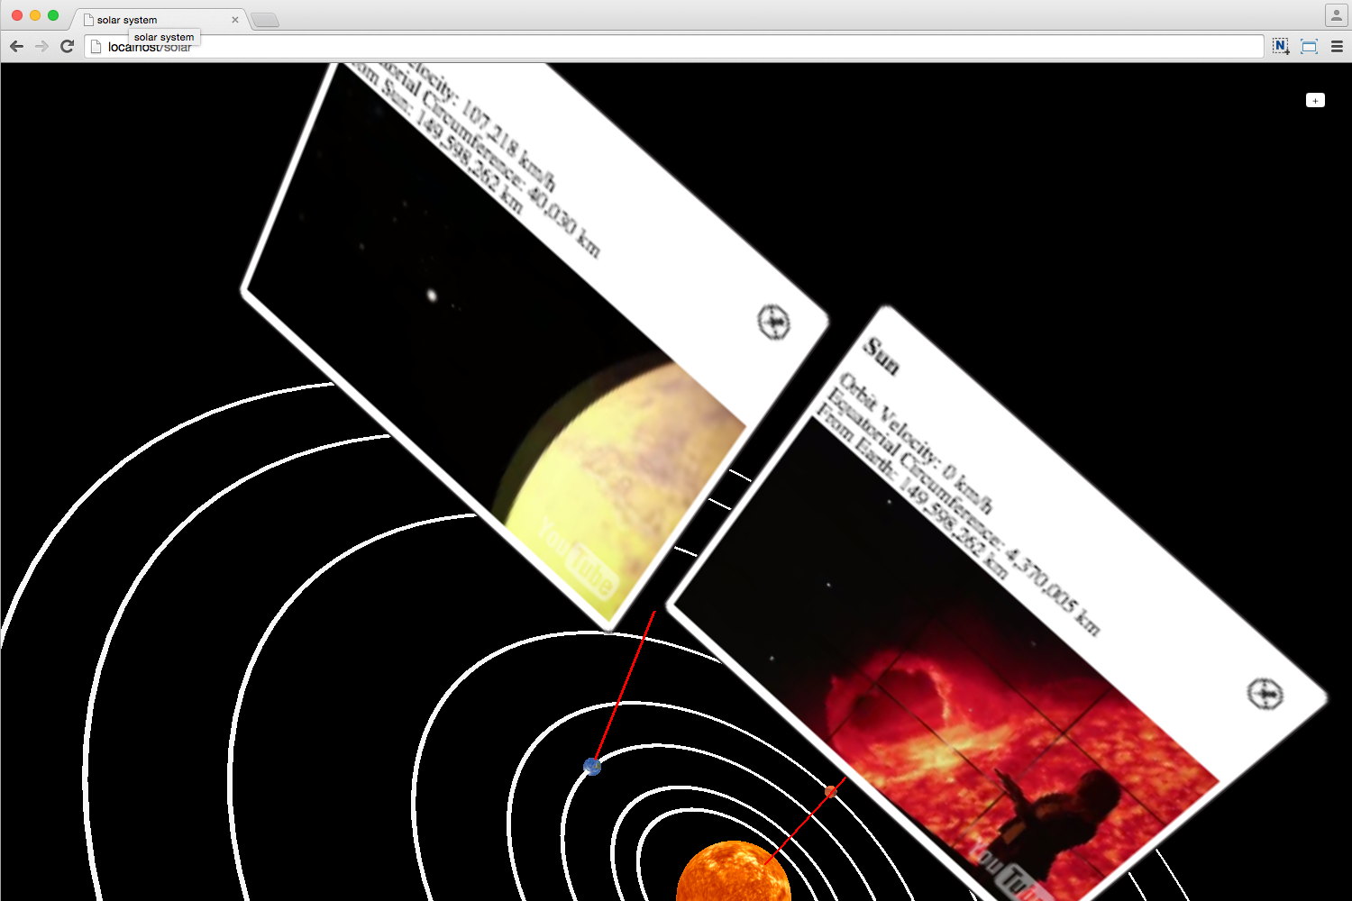
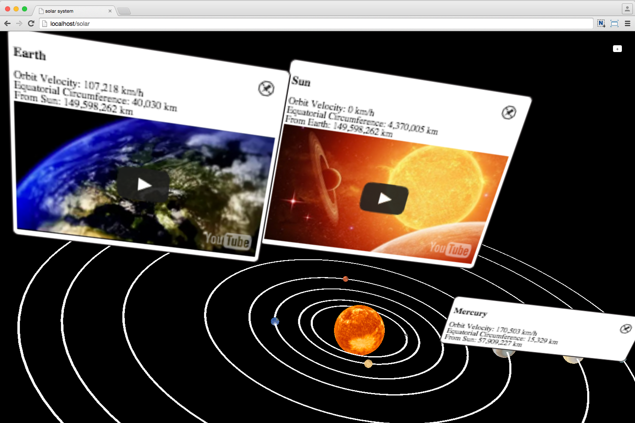
Webized 3D experience by HTML5 annotation
Web annotation example of the 3D user experience with a 3D object using HTML elements: (a) text and video streaming annotation on 3D planet objects in solar system, and (b) changing the camera perspective of solar system

Slide 36
Browser-based 3D rendering
Approach |  | Requires plugin | Part of HTML document | DOM integration | Inbuilt scene graph | Customisable pipeline | Standards-based | Web annotation*
Previous works [Evans et al. 2014] | X3D | Yes | No | No | Yes | No | Yes | No
 | X3DOM | No | Yes | Yes | Yes | No | Yes | No
 | XML3D | No | Yes | Yes | Yes | No | Partial | No
 | CSS Transform | No | Partial | Yes | No | No | Yes | No
 | Three.js | No | No | No | Yes | Yes | Partial | No
Proposed Method |  | No | Yes | Yes | Yes | No | Yes | Yes
Web annotation*: declaration of a relationship between 3D target object and HTML annotation element
[Evans et al. 2014]: EVANS, A., ROMEO, M., BAHREHMAND, A., AGENJO, J. AND BLAT, J. 2014. 3D graphics on the web: A survey. Computers & Graphics 41, 43-61.

