Slide 1

Applicability of Watermarking for Intellectual Property Rights Protection in a 3D Printing Scenario
Benoit Macq, Mireia Montañola Sales
Université catholique de Louvain (Belgium)
Patrice Rondao Alface
Bell Labs, Alcatel-Lucent (Belgium)

Slide 2
Outline
Watermarking
Traceablity issues in 3D Printing
Watermarking for IPR protection
3D Watermarking Survey in a 3D Printing Scenario
Ongoing and Future Work

Slide 3
Digital Watermarking
Technique which allows an individual to add hidden copyright notices or other verification messages to digital media. (Steganography: secret side info)
  Applications
    Copyright protection
    Authentication
    Content monitoring
    Content enrichment (data hiding)
  Requirements
    Robustness / Security
    Imperceptibility
    Capacity

Slide 4
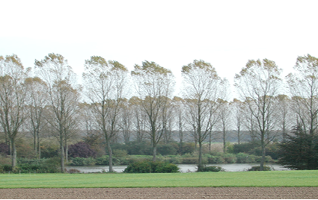
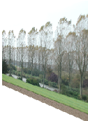
E.g.: Security Threads in Digital Cinema
Decompression
module
Compression
module
Digital
projector
Compressed
Movie Files
Central
server
STUDIO/DISTRIBUTOR
THEATRE

Slide 5
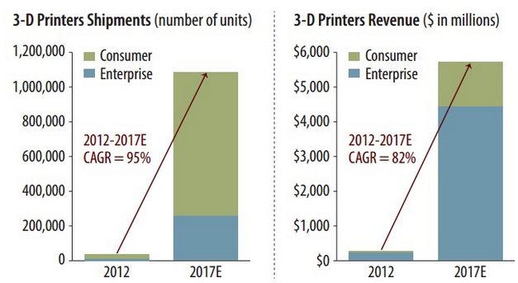
3D Printing + 3D WEB:
Rapid Growth and increasing continuum « Virtual-Real »: the same « 3-D object » can have many instances

Slide 6
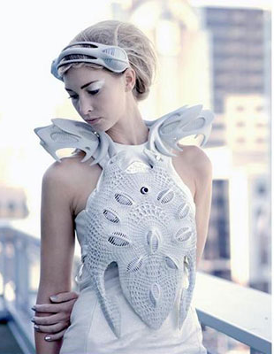
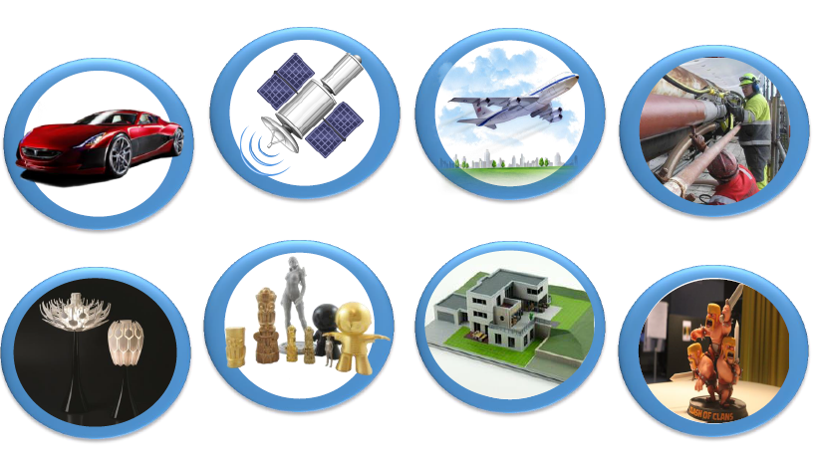
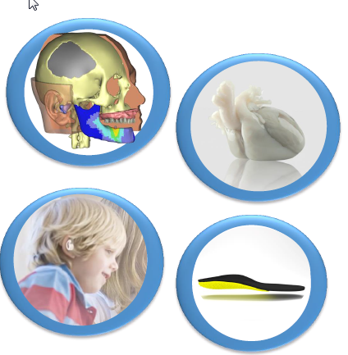
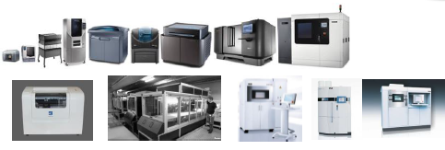

3D Printing: Applications
Needs for: protection of intangibles, authenticated objects and cross standards side information
Source: www.materialise.com
Notes:
Automotive industry, spatial applications (NASA/ESA), aircraft industry, design/furnitures, medical (implants…), user-generated 3D content…
3D printing technology depends on the application/industry area and accuracy needs

Slide 7
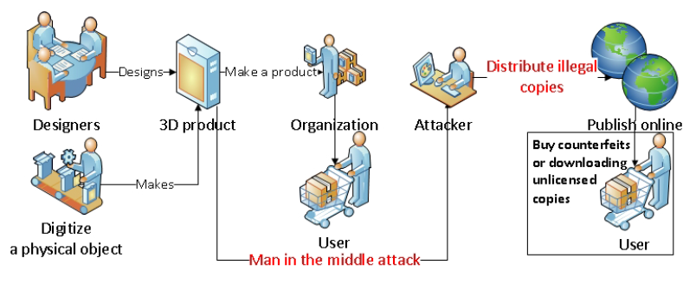
3D Printing: IPR issues (1)
Traceability and copyright enforcement
Fadhel et al. Component for 3D printing provenance framework: Security properties components for provenance framework. Internet Security WorldCIS 2014

Slide 8
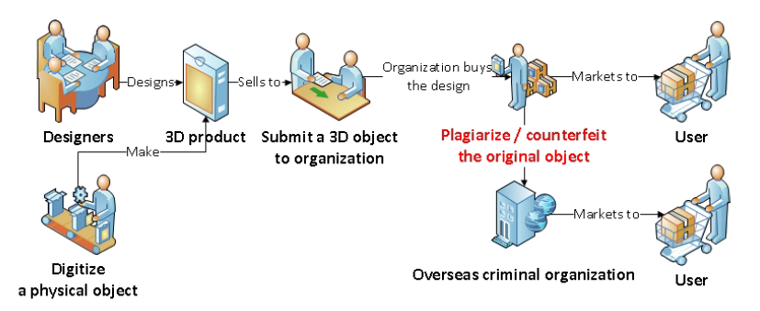
3D Printing: IPR issues (2)
Traceability and authentication
Fadhel et al. Component for 3D printing provenance framework: Security properties components for provenance framework. Internet Security WorldCIS 2014

Slide 9
3D Printing: Authentication through fragile watermarks
An object is embebed with secret test signals

Slide 10
3D Printing side information
Cross standards « readable » side-information:
  Type of materials
  Coulours
  Origin
  Any other type of info ….

Slide 11
3D Watermarking in a 3D Printing Scenario
3D watermarking hides a secret message via small robust and imperceptible perturbations on the 3D object digital surface
Surface distortion amplified for visualization

Slide 12
3D Watermarking in a 3D Printing Scenario
Simplest approach: triangle flipping
Other invariants can be modified:
geometry spectrum, wavelets, histogram of distances to the center of gravity…
c
c_{w}
a
b
a
b
1 0
1 0

Slide 13
3D Watermarking simple examples
Cayre, F., Devillers, O., Schmitt, F., Maître, H., B. Macq Watermarking 3D triangle meshes for authentication and integrity, INRIARR-5223, 2004.
Spatial technique (modify point coordinates or connectivity)
    Define a traversal with a secret key
    Imperceptible and automatic detection
    Synchronization? -> Fragile
c
a
b
1 0

Slide 14
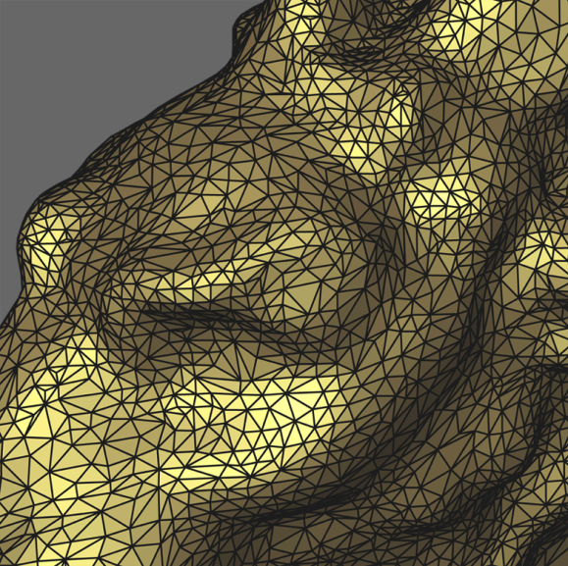
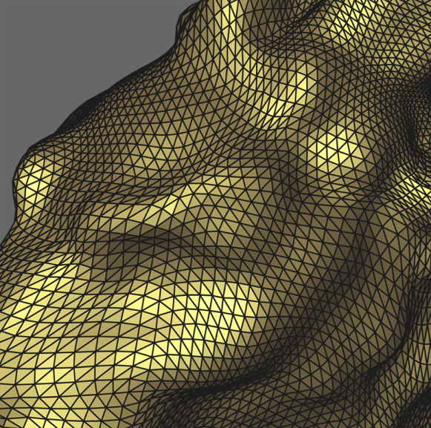
3D Shapes vs. audio, image and video
Irregular sampling and no natural sample ordering
Many possible meshes for the same shape
Piecewise-linear surface : not differentiable… curvature?
Compression standards?
Transform domains?
Wide variety of manipulations and attacks

Slide 15
3D Watermarking detection blind vs. non-blind
Non-blind detection:
Registration and re-sampling of the suspect mesh w.r.t. original mesh
Blind detection:
The original mesh is not available: robust synchronization tools are needed
⇒ Attacks?

Slide 16
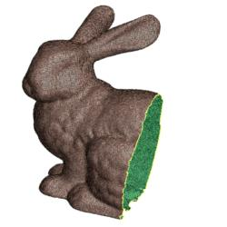
Attacks
Cropping
noise
Decimation
Smoothing
Subdivision

Slide 17
Towards Blind & Robust WM
Blind spectral watermarking scheme based on local shape “frequencies”
Re-synchronization of blind spectral watermarking schemes using umbilical points or prongs

Slide 18
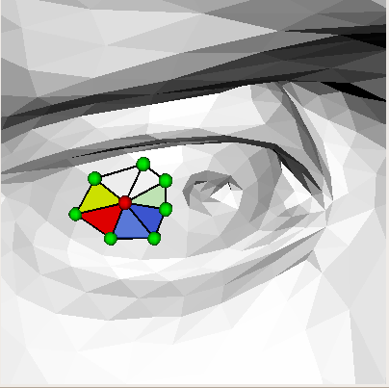
3D Shapes format
Geometry:
x y z p_{id}
0.033 0.025 -0.067 4048
0.034 0.027 -0.068 4057
0.031 0.027 -0.067 8900
Connectivity:
p₁ p₂ p₃ t_{id}
4048 4057 8900 12005
4057 4048 8910 12006

Slide 19
Spectral watermarking
  F. Cayre, P. Rondao Alface, F. Schmitt, B. Macq, and H. Maître. Application of spectral decomposition to compression and watermarking of 3d triangle mesh geometry. Image Communications, 18(4):309–319, 2003.
Spectral decomposition of 3D meshes =
projection of the mesh geometry on the eigenvectors of the Laplacian operator
Laplacian operator:
  T= I - D⁻¹ A
  I: identity matrix
  A: adjacency matrix
  A(i,j) = 1 iff points i and j are connected
  D: degree (diagonal) matrix
  D(i,i) = number of neighbors of point i

Slide 20
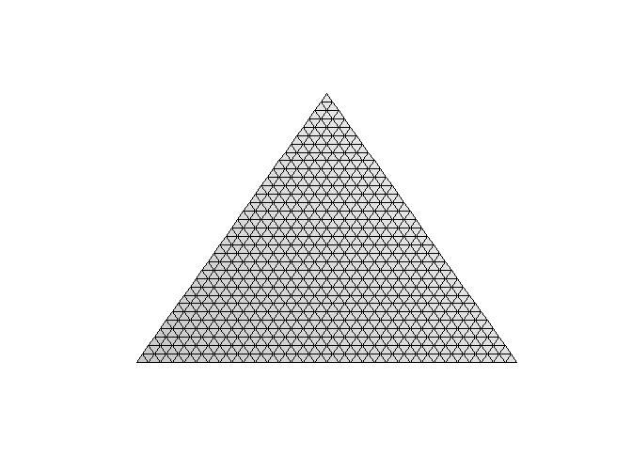

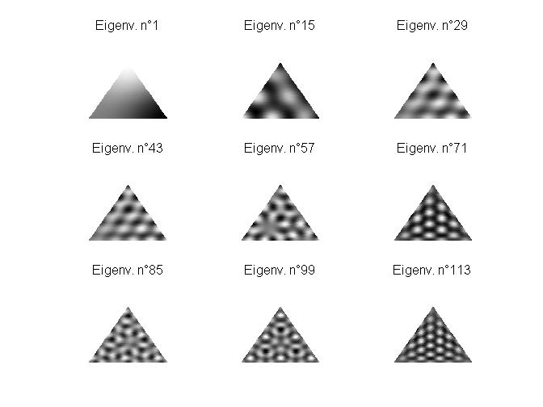
Spectral watermarking
Laplacian eigenvectors
Fiedler=2nd 3rd 4th 5th eigenv.

Slide 21
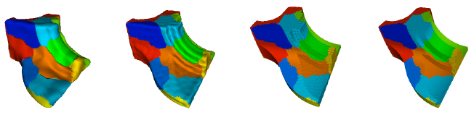
Spectral watermarking
C_{max}
1
Projection of the geometry on the eigenvectors
  X,Y,Z vectors ⇒P,Q,R vectors
Partition (connectivity/graph partitioning)
Watermarking: bit embedding by flipping (PQR)_{i} triplets:
  C_{min}=min(P_{i},Q_{,i},R_{i})
  C_{max}=max(P_{i},Q_{,i},R_{i})
  C_{inter}=median(P_{i},Q_{,i},R_{i})
  i=i₀,…,n
  (frequency increasing order)
Force:
  specified by i₀
C_{inter}
0
C_{min}
5% 15% 60% 80%

Slide 22
Spectral watermarking
C_{max}
1
Projection of the geometry on the eigenvectors
  X,Y,Z vectors ⇒P,Q,R vectors
Partition (connectivity/graph partitioning)
Watermarking: bit embedding by flipping (PQR)_{i} triplets:
  C_{min}=min(P_{i},Q_{,i},R_{i})
  C_{max}=max(P_{i},Q_{,i},R_{i})
  C_{inter}=median(P_{i},Q_{,i},R_{i})
  i=i₀,…,n
  (frequency increasing order)
Force:
  specified by i₀
C_{inter_W}
0
C_{min}

Slide 23
Spectral watermarking

Slide 24
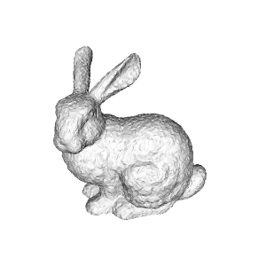
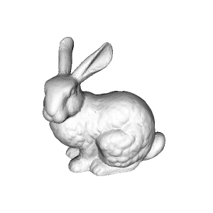
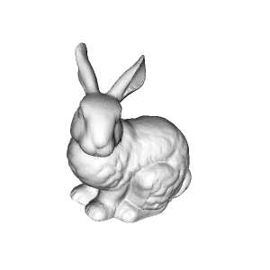
Spectral watermarking
Robustness
Fragility
  Connectivity attacks
  Cropping
Computational cost
Noise 40%
Smoothing 20
RST ok

Slide 25
Re-synchronization with umbilical points
P. Rondao Alface, B. Macq. Blind Watermarking of 3D Meshes Using Robust Feature Points Detection, International Conference on Image Processing (ICIP05), Genova, Italy, 11-14 September 2005.
Scheme:
  Detection of umbilical points
  Partition
    Geodesic Voronoi diagram
    Dual geodesic Delaunay triangulation
    Geodesic distance approx. by Dijkstra or spherical wavefronts
  Remeshing with regular connectivity
  Spectral watermark embedding
  Re-projection on the original connectivity

Slide 26
Re-synchronization with umbilical points
Curvature tensor estimation
T(v)=
Estimation on points is then interpolated on faces
Neighborhood B = geodesic circle, radius s
s determines the scale of the estimation
s is a percentage of the bounding box diagonal

Slide 27
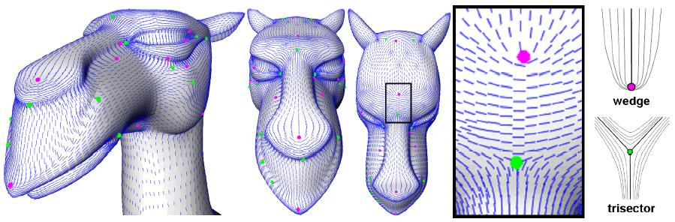
Re-synchronization with umbilical points
Umbilical points are
  Iso-curvature points
  Singularities of the curvature tensor field topology
  Wedges/tri-sectors
Noise and numerical instabilities / scale

Slide 28
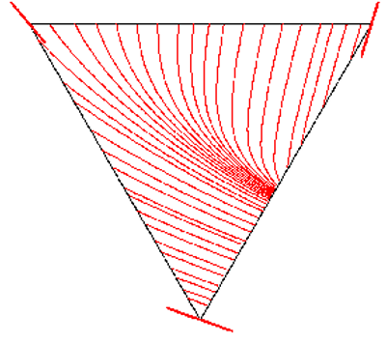
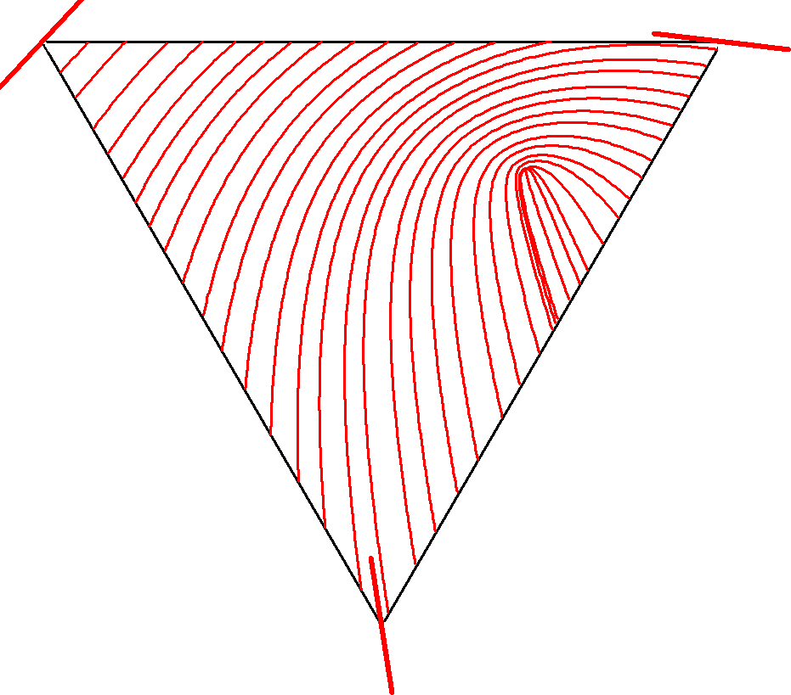
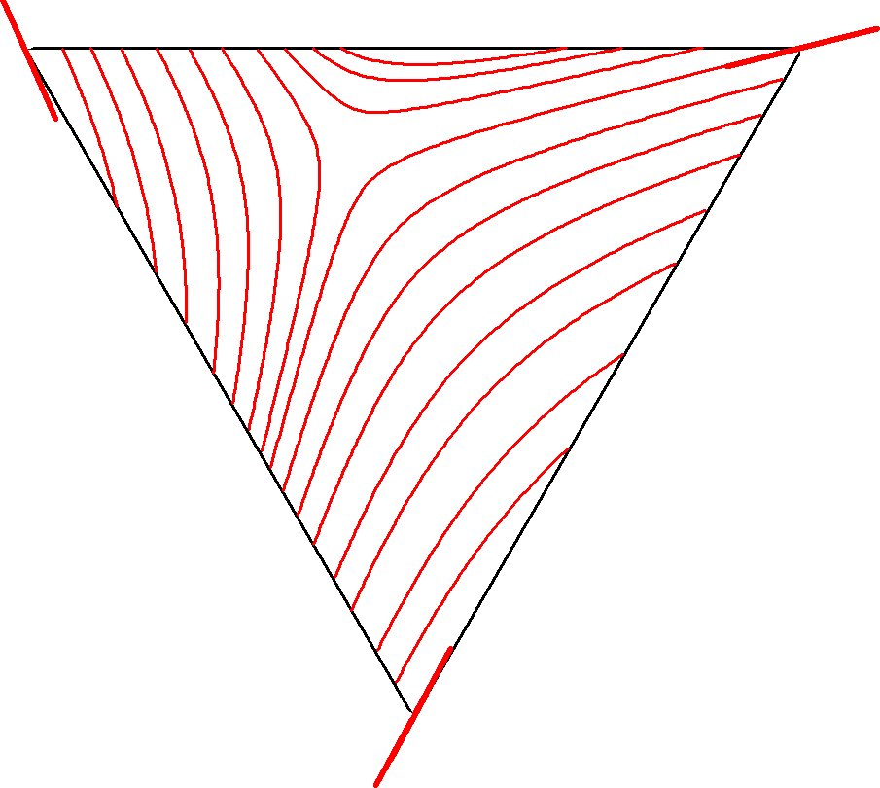
Re-synchronization with umbilical points
In each triangle, the existence and position of an umbilical point are ruled by a simple cubic equation
No umbilical point
wedge
trisector

Slide 29
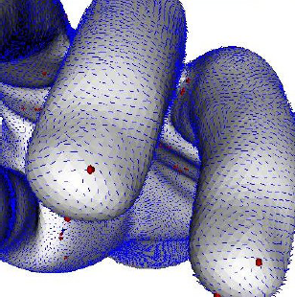
Re-synchronization with umbilical points
Multi-scale selection
Scale s
One scale
Multi-scale

Slide 30
Re-synchronization with umbilical points
Delaunay triangulation and remeshing steps
  Use of a harmonic parameterization
Spectral WM.

Slide 31
Re-synchronization with umbilical points
Results
Spectral Wm is now robust to connectivity & sampling attacks
However,
  Only free-form surfaces
  Bad shaped patches due to distribution of umbilical points
  Not robust against cropping

Slide 32
Local spatial wm. using prongs
Patrice Rondao Alface, Benoit M. Macq, François Cayre: Blind and Robust Watermarking of 3D Models: How to Withstand the Cropping Attack? IEEE International Conference on Image Processing (5), ICIP’07, pp. 465-468, 2007.
Last contribution:
  How to resist to cropping and resampling attacks for a blind wm. scheme?
Cropping
  Meaningful attack?
  Connectivity
  Segmentation
  Features and protrusion
Protrusion function

Slide 33
Local spatial wm. using prongs
Defining a local neighborhood for embedding
  Neighborhood (patch) is a geodesic circle
  Radius (R) of the patch inferior to the half distance (R_{g}) to the nearest prong
  Star shape patch condition (R_{s})
  ⇒ R = min(R_{g}, R_{s})
Robust to cropping

Slide 34
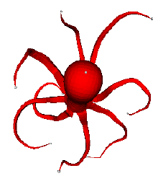
Local spatial wm. using prongs
Finding prongs:
  Maxima of the protrusion function
    p is a prong if
      Protrusion(p)>Protrusion(p_{i}) with p_{i} in the 10-nearest neighbors
      p belongs to the convex hull
      p is not on a boundary or edge
Convex hull

Slide 35
Local spatial wm. using prongs
Patch radial watermarking
  Robust center of gravity (cog)
  Histogram of distances to the cog
  Point density matters

Slide 36
Spectral Watermarking
Partition and distortion

Slide 37
Local spatial wm. using prongs
Watermark embedding
  In each histogram bin:
    Move the density mean
      to the right for 1 (+1)
      To the left for 0 (-1)
    By changing distances by well-chosen powers
Watermark decoding
  Simply read the bits by finding the position of the density mean

Slide 38
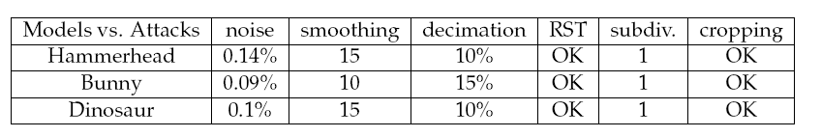
Local spatial wm. using prongs
Results
  Lower robustness to resampling and geometric attacks than spectral schemes
  But robustness to cropping is achieved if at least 2 prongs are recovered
  Limitations:
    Prong robustness depends on local geometry
    Shape must present prongs

Slide 39
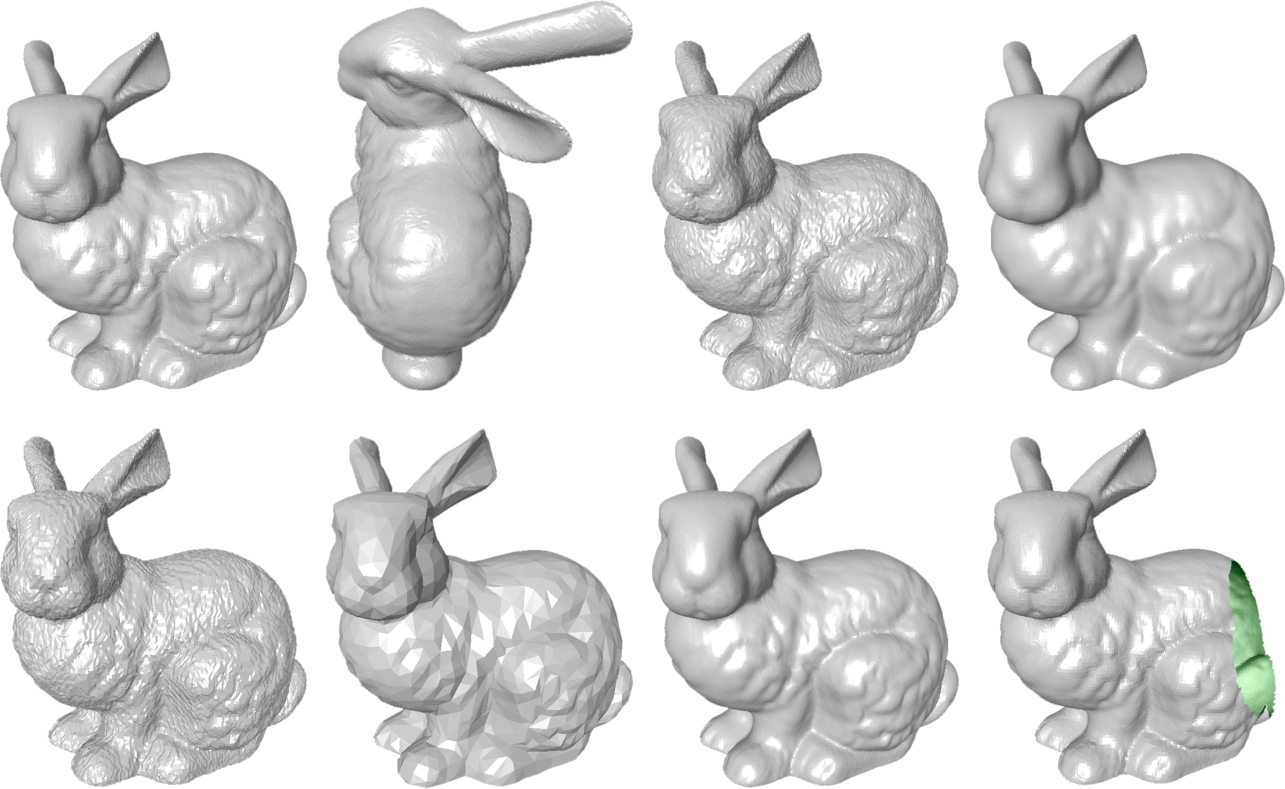
Robustness
Watermarking Attacks
original rotation/scaling noise addition smoothing
quantization decimation/subsampling subdivision/upsampling cropping

Slide 40
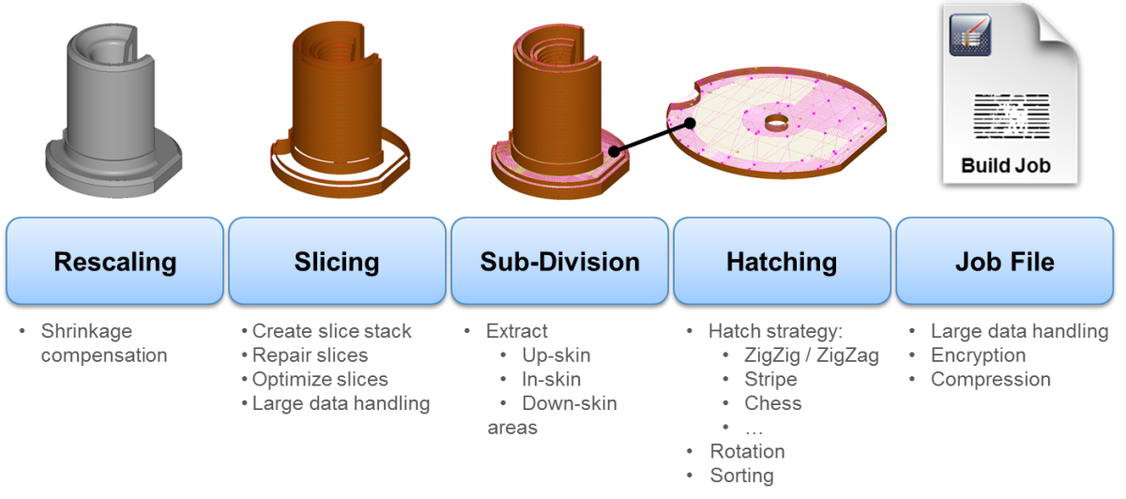
3D Print and Scan Model
STL format conversion – Printing process - Scanning
STL format conversion
Quantization, Decimation, Subsampling
Rotation, Scaling, Slicing

Slide 41
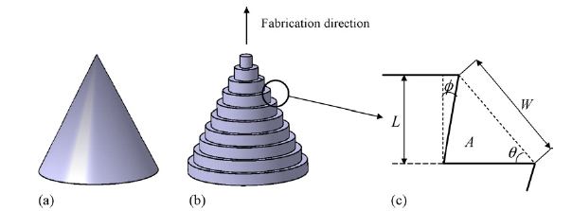
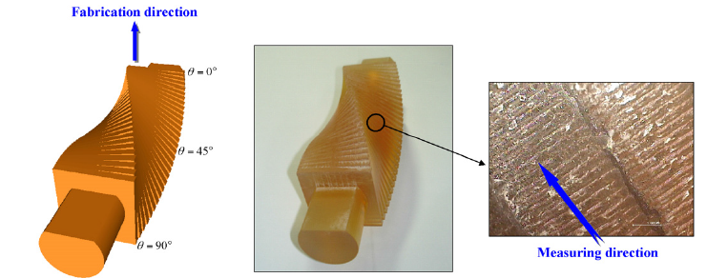
3D Print and Scan Model
STL format conversion – Printing process - Scanning
Printing Process
Surface Roughness
Point position Noise Addition
Post-Processing Smoothing
roughness

Slide 42
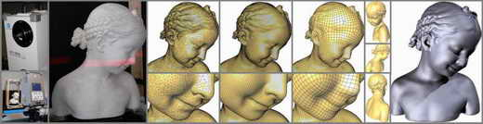
3D Print and Scan Model
STL format conversion – Printing process - Scanning
Scanning (total 3D surface or View+Depth/Kinect )
Cropping, Re-sampling, Connectivity
Surface points position accuracy
(quantization and noise)

Slide 43
3D Watermarking Survey in a 3D Printing Scenario
Robustness
Requires to withstand combinations of all usually tested watermarking attacks with various amplitudes
Imperceptibility
Watermarking induced surface modifications should neither be visible nor impair the functional usage of the printed 3D object
Blind Detection
The original digital mesh should not be made available for watermarking detection as it endangers traceability

Slide 44
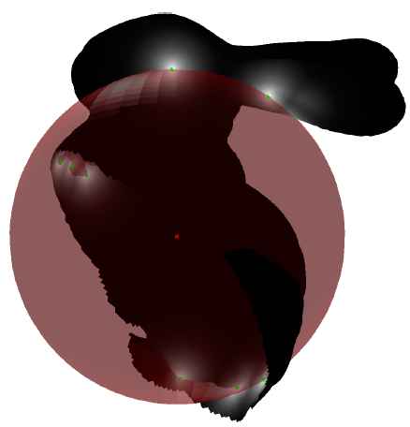
Candidate 3D Watermarking Schemes: 3D Scan
Feature-based Synchronization approaches
  Secure Landmarks: feature points are « secret »:
  detected based on the secret key and the center of gravity of the mesh and spherical patterns
  Watermark Embedding based on a Constrained Optimization Framework also based on the distances to the center of gravity
  Good Robustness and enhanced security
Xavier, R. N., Doërr, G., & Alliez, P. Anti-Cropping Blind Resynchronization for 3D Watermarking. In IEEE International Conference on Acoustic, Speech Signal Processing (ICASSP).

Slide 45
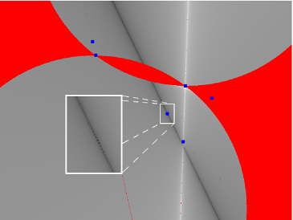
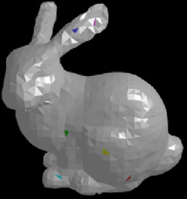
Candidate 3D Watermarking Schemes: 2D Views?
Embedding in 3D and Decoding in 2D Views
  Exploits perspective invariants
  Embeds data in 6 interest points on a mesh and retrieves them on any 2D view if all 6 points are visible
  Low cost detection (one picture is sufficient)
  But limited capacity and low robustness
Yagiz Yasaroglu, A. Aydin Alatan: Optimal Data Embedding in 3D Models for Extraction from 2D Views Using Perspective Invariants, in Digital Forensics and Watermarking (2012)

Slide 46
Ongoing and Future Work
From a qualitative Print and Scan Model to a quantitative model based on experiments on a additive manufacturing technology
Test Robustness of Features during the Print and Scan process: prongs and secret landmarks
Evaluate imperceptibility requirements
Interaction with standards (compression, X3D, …)

