Slide 1
Remote Visualization of Dynamic Molecular Data using WebGL
Finian Mwalongo, Michael Krone, Michael Becher, Guido Reina, Thomas Ertl
20th International Conference on 3D Web Technology | Heraklion, Greece | June 19, 2015

Slide 2
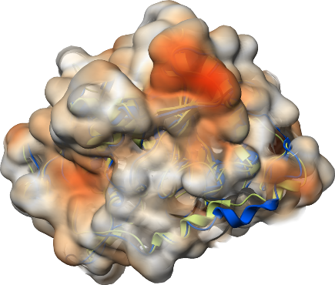
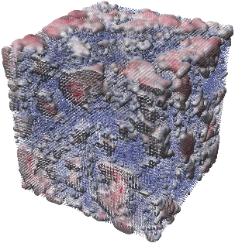
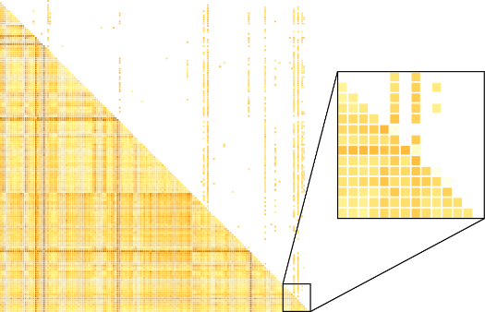
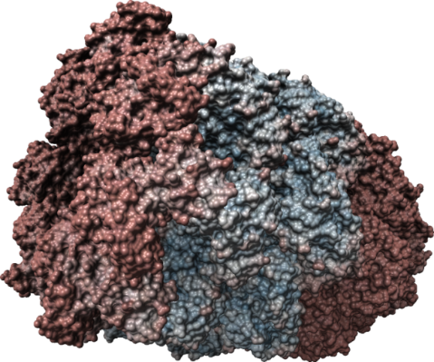
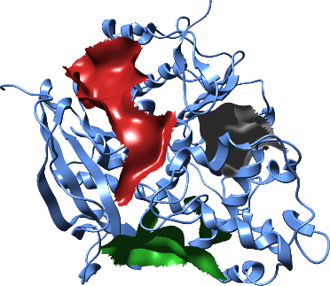
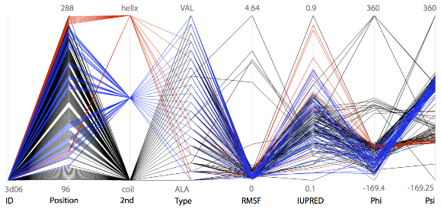
Motivation
Remote visualization
Dynamic molecular simulation data
Support for mobile devices
E.g smartphones, tablets & laptops
Web-frontend for MegaMol
Grottel, Krone, Müller, Reina, Ertl, “MegaMol - A Prototyping Framework for Particle-based Visualization,” IEEE Transactions on Visualization and Computer Graphics 21 (2), S. 201-214 (2015).

Slide 3
Existing tools
Available web-based tools offer little support for dynamic data
Based on browser plugin-ins (e.g. Java Applets & Flash)
Limited to small molecules (e.g. JSmol)
Traditional 3D rendering using triangulated objects
Costly to obtain smooth surfaces
Lower visual quality compared to implicit surface ray casting

Slide 4
Our solution
Web-based visualization application
Based on WebGL + HTML5 standards (no plugins)
Visualize large dynamic molecular data at interactive frame rates
GPU-based ray casting offering faster rendering and higher visual quality
vs.

Slide 5
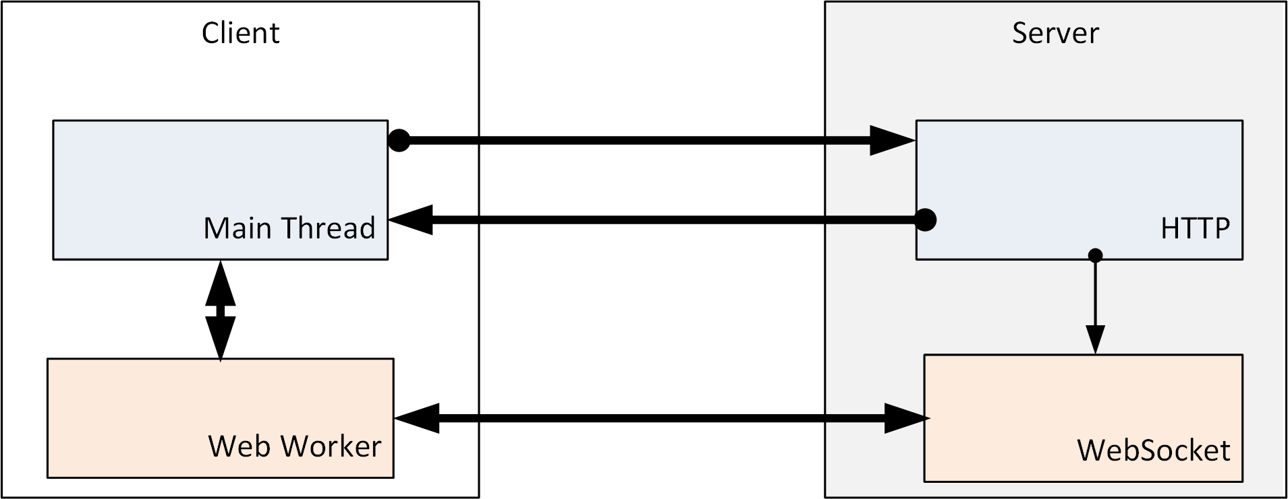
Architecture
1
(rendering)
3
html/js/shaders
4
2
5
data transfer
data fetching & rendering decoupled (WebWorker)
Persistent client-server connection (WebSockets)
Efficient binary data transfer (Typed Arrays)
Zero copy between main thread & WebWorker (Transferable objects)

Slide 6
Data Structures and Memory Layout
Minimized data for fast client-server transfer
GPU-friendly data structures (direct upload to GPU/VBO)
Notes:
BoundingBox: 4 floats (center XYZ, longest edge);
SphereCount: 1 unsigned int;
SphereData: SphereCount x 7 floats (center XYZ, radius, color RGB);
VertexCount: 1 unsigned int;
VertexData: VertexCount x 9 floats (position XYZ, color RGB, normal nXnY nZ);
TriangleCount: 1 unsigned int;
VertexIndices: TriangleCount x 3 unsigned int.

Slide 7
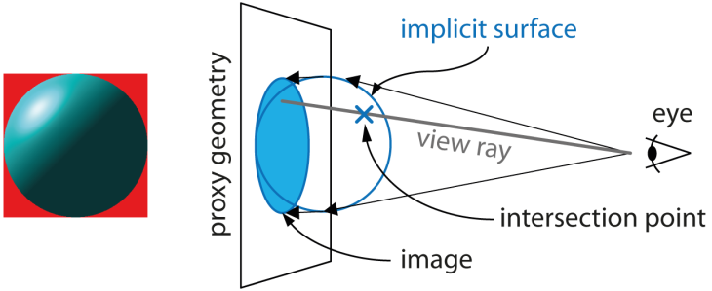
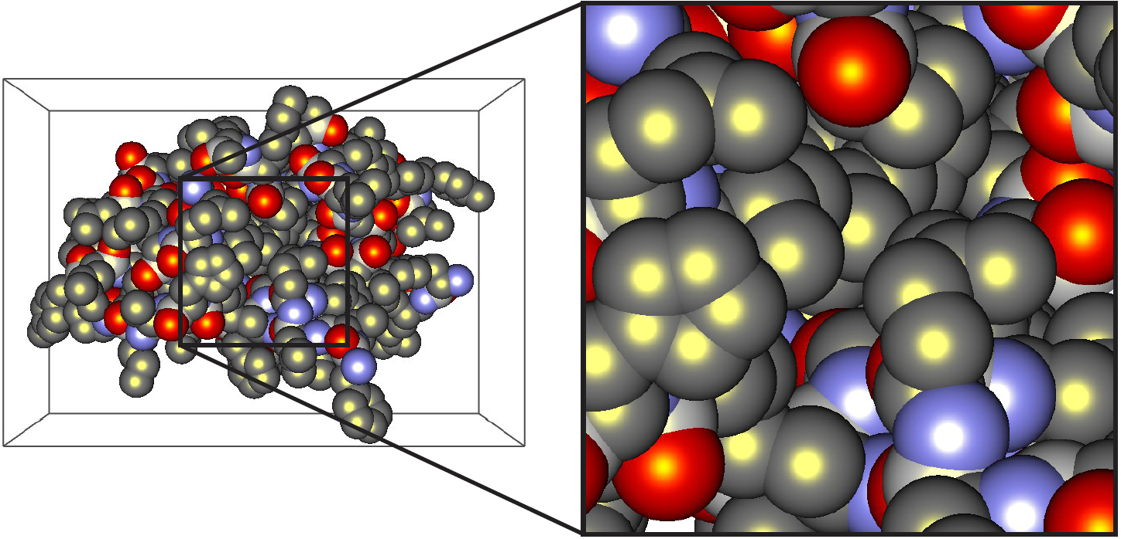
Rendering (Ray casting)
Vertex Shader
Transform the proxy geometry (quad) to always face the camera
Fragment Shader
Compute viewing ray (from eye position to fragment center)
Do ray-sphere intersection and shade closest intersected point
Write the depth value (gl_FragDepthEXT) using EXT_frag_depth extension

Slide 8
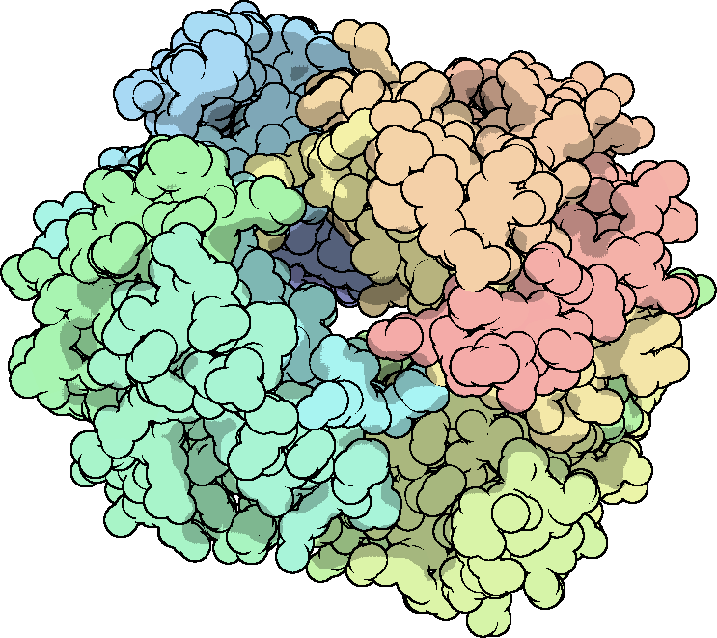
Deferred Shading
Compute shading only for visible fragments
Store color, normal & depth per fragment in FBOs
Needs WEBGL_draw_buffers extension
Screen-Space Ambient Occlusion (SSAO) [1]
Compute occlusion factor & do Gaussian blur
Toon Shading [2]
Compute depth gradient
[1] (Kajalin, 2009), [2] (Saito and Takahashi, 1990)

Slide 9
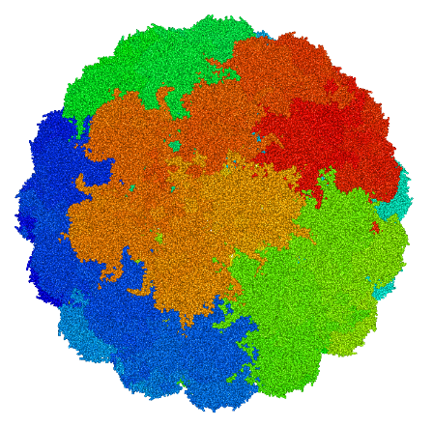
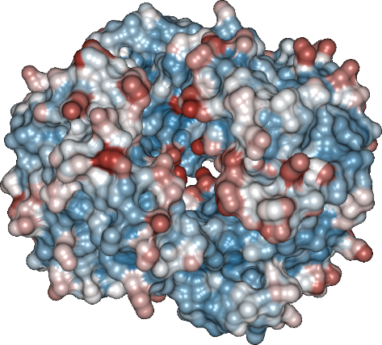
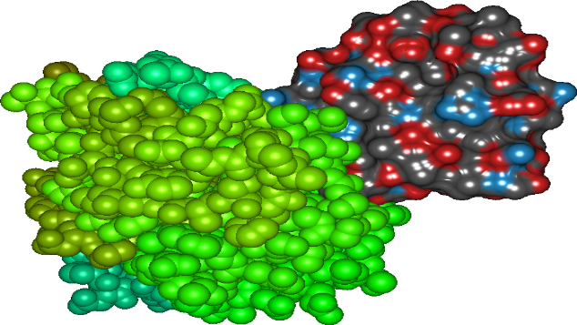
Results
1,920 atoms (receptor) +
18,920 triangles (ligand)
→ 136,434 triangles
→ 1.3 million atoms

Slide 10
Results (video clip)

Slide 11
Results – Performance(data transfer)
Server: Intel i7-2600 (3.4 GHz), 8 GB RAM
Client (laptop): Intel i7-3520M (2.9 GHz), 8 GB RAM, GeForce GT 640M LE
Chrome v.41.0, WebGL 1.0 (ANGLE – D3D11), 1280 x 720 pixels
Network: LAN (GBit), WiFi (65 Mbps)
Molecule name | #Atoms | LAN | WiFi | Memory
 |  | Transfer (ms) | Transfer (ms)
Lipase simulation | 6,626 | 15.94 | 45.11 | 0.2 MB
Lipase+solvent sim. | 38,789 | 55.89 | 234.66 | 1.1 MB
Mottle virus sim. | 214,440 | 234.94 | 1,212.3 | 6.0 MB
Papillomavirus | 1,356,840 | 2,121.9 | 6,976.4 | 38.0 MB

Slide 12
Results – Performance (rendering)
Server: Intel i7-2600 (3.4 GHz), 8 GB RAM
Clients:
PC: Intel i7-2600 (3.4 GHz), 16 GB RAM, GeForce GTX660 Ti
Laptop: Intel i7-3520M (2.9 GHz), 8 GB RAM, GeForce GT 640M LE
Chrome v.41.0, WebGL 1.0 (ANGLE – D3D11), 1280 x 720 pixels
Molecule name | #Atoms | PC | Laptop |  | Memory
 |  | LAN | LAN | WiFi
Lipase simulation | 6,626 | ~59 fps | ~60 fps | ~60 fps | 0.2 MB
Lipase+solvent sim. | 38,789 | ~58 fps | ~52 fps | ~60 fps | 1.1 MB
Mottle virus sim. | 214,440 | ~45 fps | ~11 fps | ~40 fps | 6.0 MB
Papillomavirus | 1,356,840 | ~39 fps | ~4 fps | ~15 fps | 38.0 MB

Slide 13
Future Work
Goal: Cloud-based collaborative molecular visualization service
Extend server application
Scalability & Concurrency
Efficient compression for transferred data
Evaluate video-streaming for remote visualization
Visualization Service
Experimental data
Simulation
Analysis
Sensor data

Slide 14
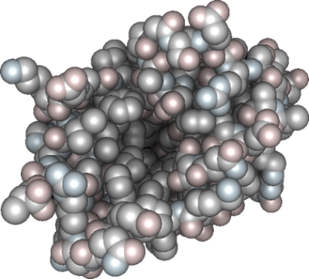
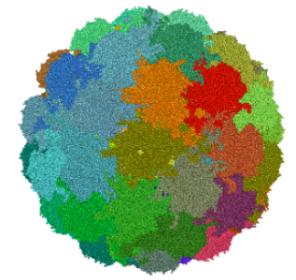
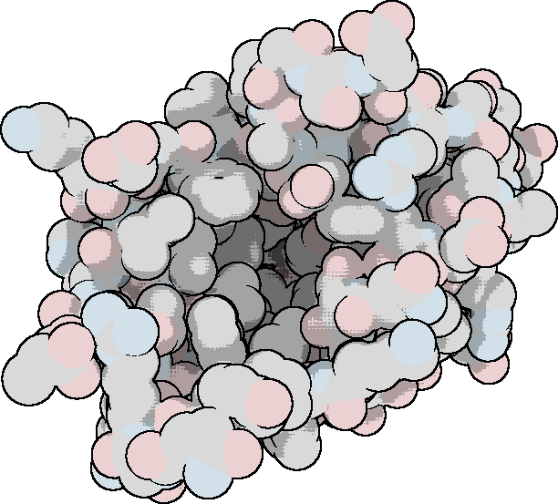
Summary & Conclusion
Web-based visualization of large dynamic datasets feasible at interactive frame rates:
WebGL (with extensions)
WebSockets + WebWorkers + TypedArrays
Offload demanding computations to a server
e.g. CUDA computations (not possible on all clients)
Potential for web-based collaborative visualization tools
Growing WebGL support
Real-time Web Technologies (e.g. WebRTC)
Improved performance of JavaScript Engines

Slide 15
Thank you!
Questions?

Slide 16
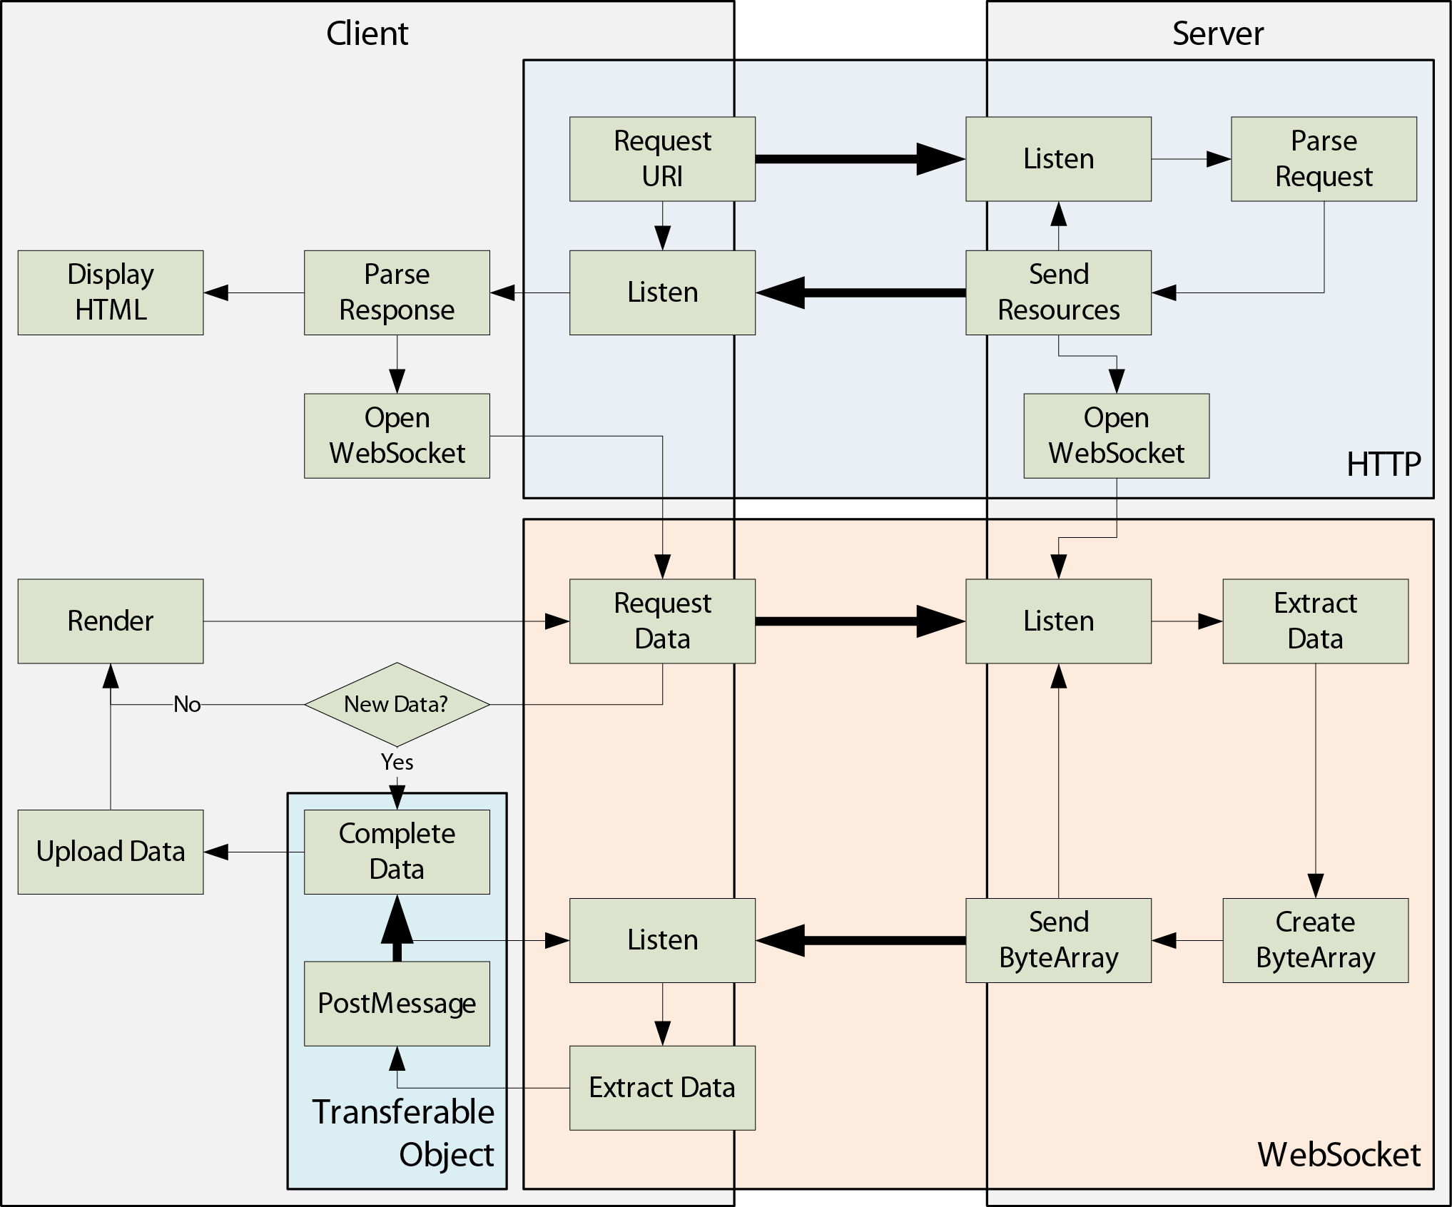
Detailed application architecture
Data flow
Control flow

