Slide 1
Patient Specific 3D Surfaces for Interactive Medical Planning and Training
Felix G. Hamza-Lup, Ph.D.
Associate Professor Computer Science
and Information Technology
Armstrong State University
Savannah GA, USA
20th International Conference on 3D Web Technology (Web3D 2015), June 18-21, Heraklion, Crete, Greece

Slide 2
Outline
Background and Motivation
Related work;
Surface Scanning – Technology
3DRTT
Proposed Scanning System
Configuration Scenarios
Accuracy Assessment
Data Processing and Optimization
20th International Conference on 3D Web Technology (Web3D 2015), June 18-21, Heraklion, Crete, Greece

Slide 3
Background (1)
Radiotherapy is a complex procedure for cancer treatment commonly administered in conjunction with other forms of cancer management like surgery and chemotherapy.
50-60% of cancer patients are treated with radiation at different stages (www.radiologyinfo.org)
20th International Conference on 3D Web Technology (Web3D 2015), June 18-21, Heraklion, Crete, Greece

Slide 4
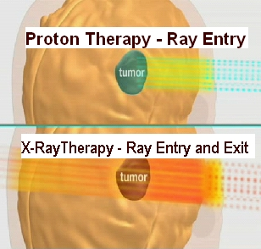
Background (2)
External beam radiotherapy systems:
X-Ray Therapy (XRT)
Proton Therapy (PT)
20th International Conference on 3D Web Technology (Web3D 2015), June 18-21, Heraklion, Crete, Greece

Slide 5
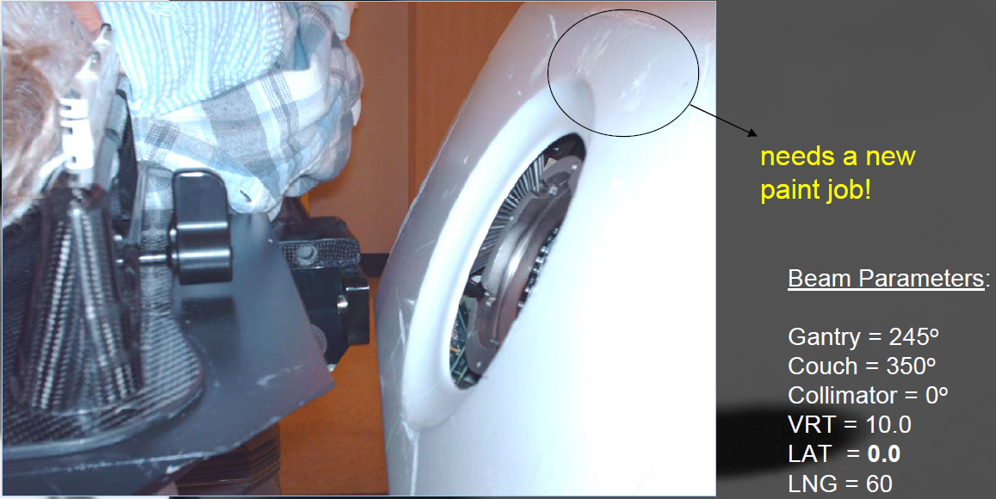
Motivation (1)
Accurately predicting and preventing collisions among different hardware system components and the patient to avoid re-planning

Slide 6
Motivation (2)
Simulation tool for realistic representation of the treatment room with as much detail and resolution as possible
Interactivity for configuration and visualization of different systems components (table, collimator, devices, beams etc…)
Simple, web-enabled interface to facilitate collaboration and reduce overhead and cognitive load
Uses:
Clinical – planning phase
Teaching
Patient education
20th International Conference on 3D Web Technology (Web3D 2015), June 18-21, Heraklion, Crete, Greece

Slide 7
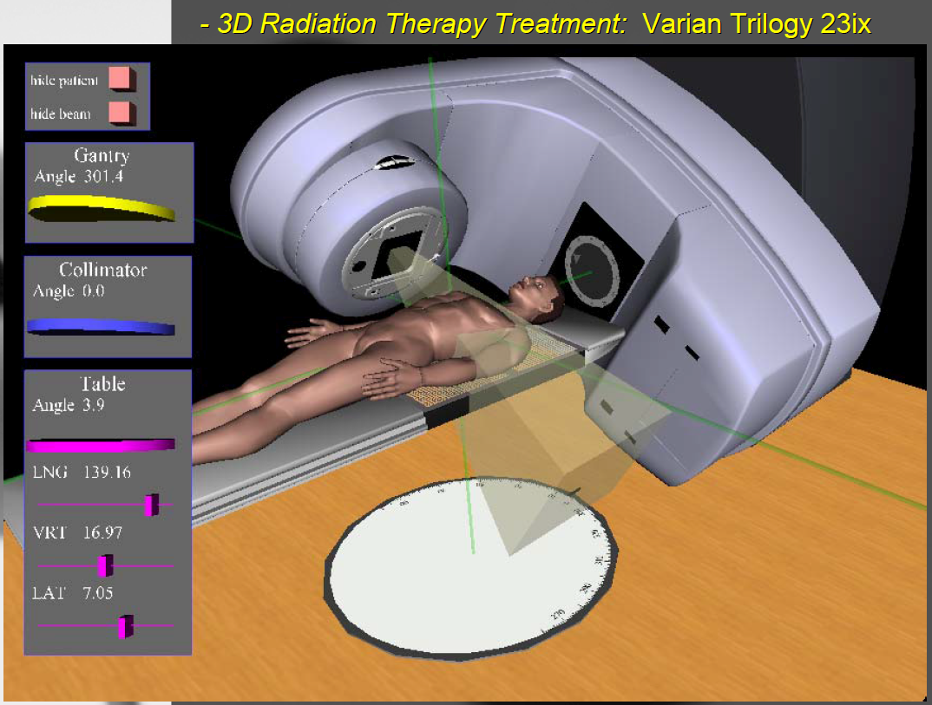
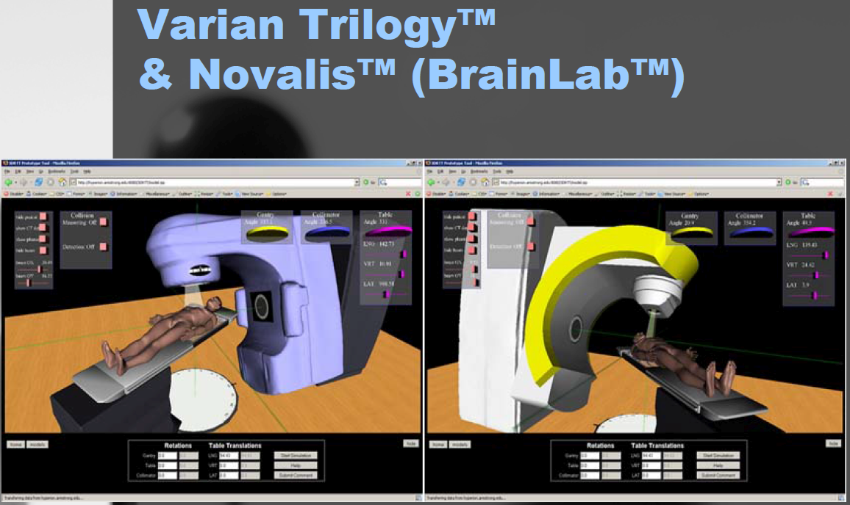
Related Work – 3DRTT
X-Ray Therapy Simulator (2007-2014)
Accurate hardware models but
Generic patient model
http://3drtt.org/

Slide 8
Related Work – 3D scanning
We want:
Real-time 3D patient models
&
Inexpensive/reconfigurable solution
Hardware and Software …
Name | Operating range | Frame Speed | Accuracy | Scanner Type
Kinect ($250) | [0.4 ,4] m* | 30Hz | 3mm @ 1.0m# | NCA Structured Light
Kinect v2 ($200) | [0.5, 4.5] m* | 30Hz | 1mm @ 1m# | NCA Time of Flight
Sense ($500) | [0.4 ,3.5] m* | 30Hz | 1mm @ 0.5m$ | NCA Structured Light
SCANIFY ($1500) | [0.35, 0.45] m | 10Hz | 350 microns$ | NCP Stereoscopic and photometric
David SLS-2 ($3000) | [0.4, ∞) m | 30Hz | <1% of length$ | NCA Structured Light
* Accuracy is reduced with distance. $ Advertised accuracy # Reduced field-of-view. See section 3.3.
20th International Conference on 3D Web Technology (Web3D 2015), June 18-21, Heraklion, Crete, Greece

Slide 9
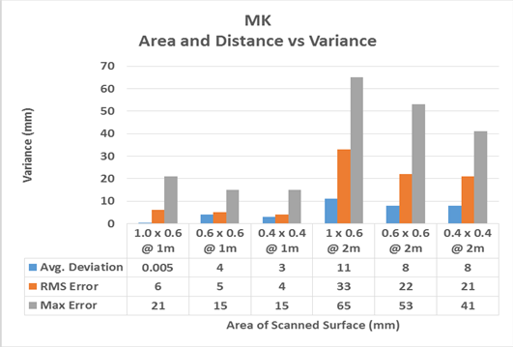
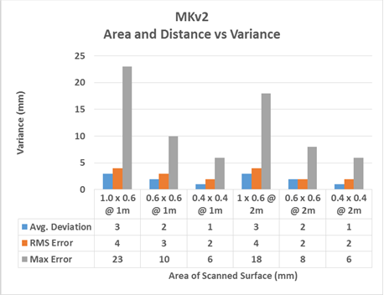
Proposed Scanning System
Accuracy of MK vs MKv2:

Slide 10
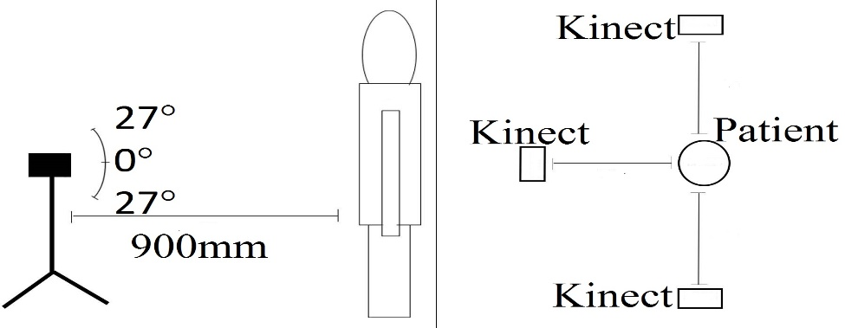
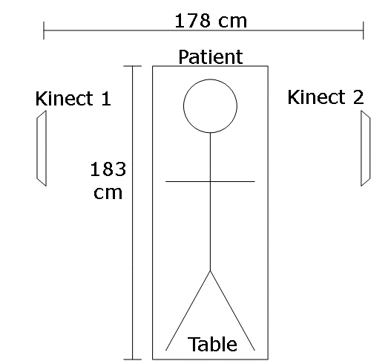
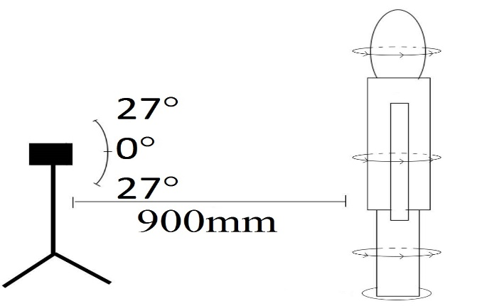
Proposed Scanning System
Based on Microsoft Kinect (v2)
Configuration scenarios:

Slide 11
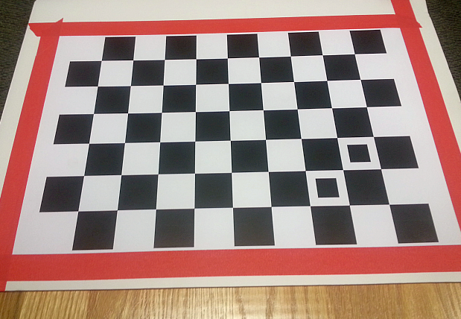
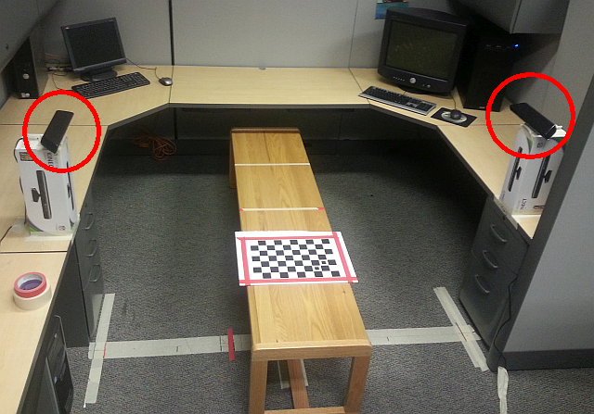
IR Camera Calibration
Calibration procedure (Kahlesz et al. [2007]. )
In practice must be done one time – since the treatment system is based on optical precision tables.
20th International Conference on 3D Web Technology (Web3D 2015), June 18-21, Heraklion, Crete, Greece

Slide 12
Data Processing and Optimization (1)
Polygonal Mesh Optimization
Point clouds are processed using the Poisson Surface Reconstruction (PSR) algorithm [Kazdan and Hoppe 2013]
We remove inaccurate vertices by assigning a quality value based on the Hausdorff distance [Cignoni et al. 1998] between points on the mesh and points on the original point cloud.
Quality map of a mesh generated with a single MK. Blue <1 mm, Green < 3 mm, Red <5 mm
Data gaps in the point cloud

Slide 13
Data Processing and Optimization (2)
Compression - X3D Binary Format
We reduce the file size of the model by switching to the X3D compressed binary format (X3Db) [X3DB 2015] (80% reduction => 3 MB S-reps).
Improve initial 3D models download time
Potential for 3D libraries of complex cases/ treatment scenarios
20th International Conference on 3D Web Technology (Web3D 2015), June 18-21, Heraklion, Crete, Greece

Slide 14
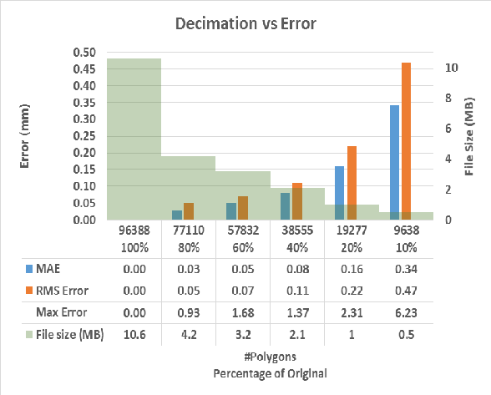
Data Processing and Optimization (3)
Decimation vs. Accuracy – Tradeoffs
Tested patient S-rep that was 10.568 MB in size containing 96,388 polygons
Decimated iteratively to 80%, 60%, 40%, 20%, and 10% of the original number of polygons
Conclusion:
5-10 scans depending on the length and width of the patient, but could still be automated, quick, and offer a maximum error as low as 10.2 mm.

Slide 15
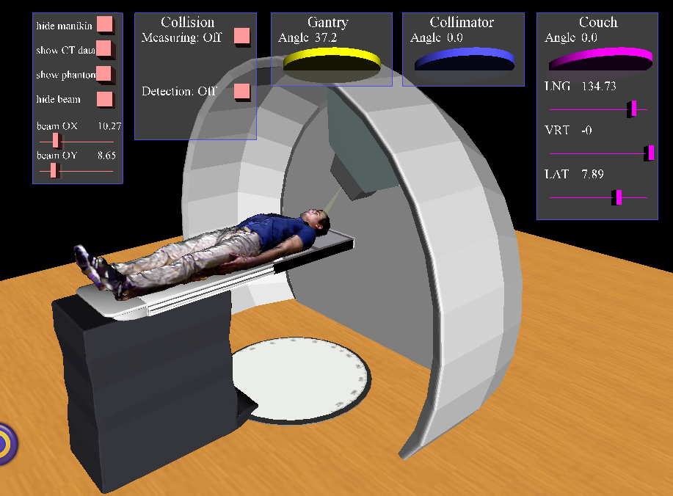
Results
X-Ray Therapy with Real Patient S-reps
Proton Therapy with Real Patient S-reps

Slide 16
Acknowledgements
Co-authors
Research Assistant, Shane Farrar, Armstrong State University, USA
Research Assistant, Erik Leon, Armstrong State University, USA
Research collaborator
Omar Zeidan, Ph.D., DABR, Chief, Proton Therapy Physics at UF Health Cancer Center, Orlando
Questions about the project:
Felix.Hamza-Lup@armstrong.edu
http://felixlup.net
http://3drtt/org
20th International Conference on 3D Web Technology (Web3D 2015), June 18-21, Heraklion, Crete, Greece

