Slide 1
Semantic Query-based Generation of Customized 3D Scenes
Web3D 2015 – The 20th International Conference on 3D Web Technology
June 18-21 – Heraklion, Crete, Greece
Krzysztof Walczak, Jakub Flotyński
Department of Information Technology
Poznań University of Economics, Poland
[walczak, flotynski]@kti.ue.poznan.pl

Slide 2
Presentation Outline
Motivations for semantic modelling of 3D content
The SEMIC approach
Query-based content customization
Examples
Implementation
Conclusions and future works

Slide 3
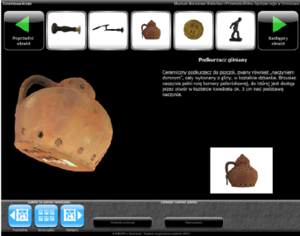
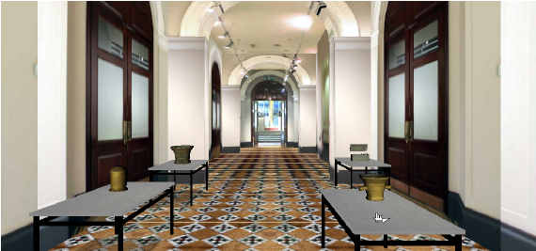
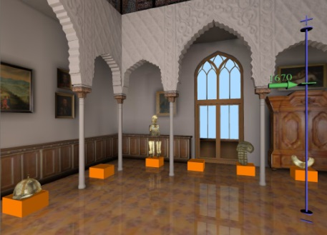
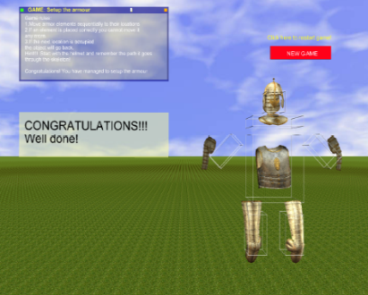
Interactive 3D Web Content
Opportunities for widespread use of 3D content
Increasing performance and versatility of hardware
Cheap 3D accelerators and displays
Rapid growth in the network bandwidth
Numerous domains
Cultural heritage, education, medicine, tourism, e-commerce, …
More complex than other types of media
Geometry, structure, space, appearance, animation, behaviour

Slide 4
3D Content Creation Challenge
Creation of interactive 3D content is difficult
High complexity of content
Requires proper tools and experience
Multitude of content presentation platforms
Expensive and time-consuming
Applicability of ready-to-use 3D content is limited
Personalization – visualization, teaching, cultural heritage, medicine
Adaptation – different presentation platforms and contexts
Content creation and customization performed by domain experts or end users
Efficient methods of creation and customization of 3D content are required!

Slide 5
Creation and Customization of 3D Content
Solutions simplifying 3D content creation/customization
Specialized tools and applications
High-level languages and frameworks
Templates, parameterization, components
Limited possibilities of facilitating content creation/customization

Slide 6
Problem statement
Lack of solutions for flexible on-demand content creation/customization including explicit and implicit management of different aspects of 3D content at different levels of abstraction

Slide 7
Semantic Modeling of 3D Content
Extension and generalization of the previous approaches
Declarative and knowledge-based content creation at arbitrarily chosen (conceptual) level of abstraction
Content representation independent of particular presentation platforms
Simplified content management (indexing, searching and analysing of content components)

Slide 8
The SEMIC Approach
Content models
Steps
Content representations
Semantic Content Model
Creation of a generalized content representation
Semantic
3D meta-scene
Semantic Content Customization Patterns
Query-based content generation
Customized content representation
3D Content Representation Language
Building a final content representation
Final content representation
Content presentation

Slide 9
The SEMIC Approach
Content models
Steps
Content representations
Semantic Content Model
Creation of a generalized content representation
Semantic
3D meta-scene
Semantic Content Customization Patterns
Query-based content generation
Customized content representation
3D Content Representation Language
Building a final content representation
Final content representation
Content presentation

Slide 10
Semantic Content Model
Semantic Content Model
Semantic Content Representation
Domain-specific ontology
Conceptual Content Representation
Content creation
Semantic Mapping Model (SMM)
Representation Mapping
Multi-layered Semantic Content Model (ML-SCM)
Concrete Content Representation

Slide 11
Ontology Mapping Semantic Mapping Model
Enables presentation of domain-specific concepts by mapping them to concrete elements (ML-SCM)
Includes generic concepts for wrapping domain-specific ontologies
Presentable objects
Properties
Descriptors
Relations
Domain-specific Ontology
Semantic Mapping Model (SMM)
Multi-layered Content Model
(ML-SCM)

Slide 12
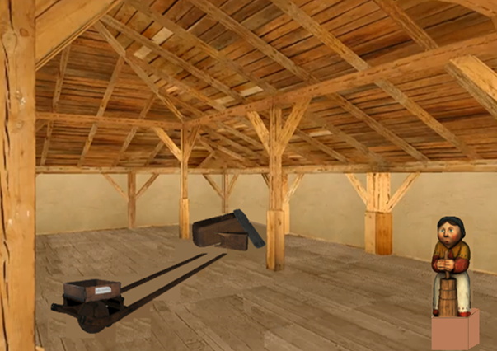
Ontology Mapping Presentable Objects
Represent primary (independent) entities of a scene at a conceptual level of abstraction
Artefacts in a virtual museum exhibition
Avatars in a game
Cars in a car show
…
Super-classes of domain-specific classes with independent representations
Reflected by geometrical and structural 3D content -specific classes
cart
granary
stand
statuette

Slide 13
Ontology Mapping Properties
Represent conceptual features of presentable objects, e.g., material, colour, shininess, etc.
Super-properties of domain-specific properties
Reflected by 3D content-specific properties describing
Geometry
Structure
Space
Appearance
Animation
stand.colour=‘beige’
granary.madeOf=‘wood’
statuette.texture=
’pict.png’

Slide 14
Ontology Mapping Descriptors
Containers collecting multiple properties
Descriptive classes – containers for properties with values fixed for a whole class of presentable objects
Descriptive individuals – containers for properties with values variable within a group of objects
RotatingObject
TexturedObject
PlasticObject

Slide 15
Ontology Mapping Relations
Represent dependencies between properties of different presentable objects, e.g., relative location
Super-classes of
Domain-specific properties (binary relations)
Domain-specific classes (n-ary relations)
Reflected by 3D content-specific properties
cart.isInside=granary
statuette.standsOn=stand

Slide 16
The SEMIC Approach
Content models
Steps
Content representations
Semantic Content Model
Creation of a generalized content representation
Semantic
3D meta-scene
Semantic Content Customization Patterns
Query-based content generation
Customized content representation
3D Content Representation Language
Building a final content representation
Final content representation
Content presentation

Slide 17
Semantic 3D Meta-scene
Semantic 3D meta-scene – a customizable 3D content representation (knowledge base) generated within the SCM:
Flexible – represents 3D content at both low and high levels of abstraction
Generalized – represents a super-set of the presentable content
Abstract – does not need to specify all elements that are required for final content presentation
Extensible – new elements may be added to a meta-scene to create the final 3D scene

Slide 18
Semantic Content Query
Semantic Content Query – a knowledge base compliant with the semantic web standards and built according to Semantic Content Customization Patterns:
content selection
content projection
content extension
content composition

Slide 19
Content Customization Patterns Selection
Indication of POs, which are to be included in the generated scene
Individual selector – explicit selection of POs
Class selector – implicit selection of POs
Sub-class selector – all POs that belong to a class
Restriction selector – selecting POs with a common feature
Selector rule – semantically complex queries
Complex class selector – set operators (intersection, difference)

Slide 20
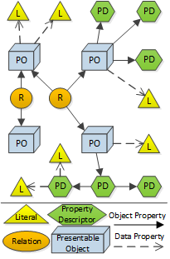
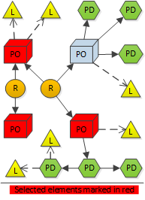
Content Customization Patterns Selection

Slide 21
Content Customization Patterns Projection
Indication of desirable features or behavior of POs that are to be presented in the generated scene
Sub-projector – presenting a particular property/binary RL (or properties/binary RLs with a common root concept) for all POs included in the generated scene
Super-projector – explicit choice of a property/binary RL for specific POs
Conditional projector – selection by rules

Slide 22
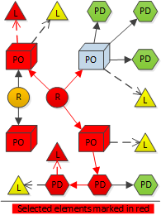
Content Customization Patterns Selection + Projection

Slide 23
Content Customization Patterns Extension and Composition
Introduction of new content elements that are responsible for new features or behavior of the selected POs
Content extension – introduction of new properties for describing selected POs
Content composition – introduction of new RLs for combining selected POs by specifying mutual dependencies
Explicit and implicit content extension and composition

Slide 24
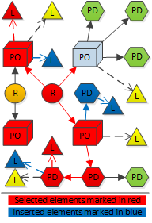
Content Customization Patterns Extension

Slide 25
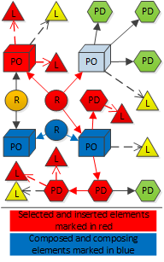
Content Customization Patterns Composition

Slide 26
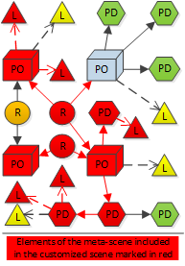
Content Customization Patterns Selection + Projection + Extension + Composition

Slide 27
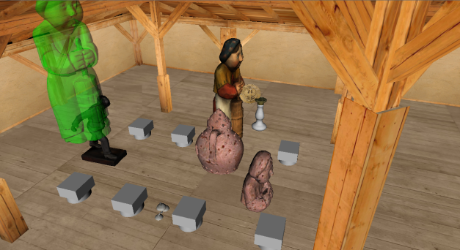
Example 1 – 3D meta-scene
{cpr:granary,...,cpr:badge} rdf:type cro:Mesh3D
{cpr:clayWoman,cpr:glassyWoman} rdf:type cro:Mesh3D ;
cro:material {ms:clayMaterial,ms:glassMaterial}.
{ms:clayMaterial,ms:glassMaterial} rdf:type {cro:TextureMaterial,cro:ColorMaterial} ;
{cro:texture,cro:color} {"clay.png","green"} ;
cro:transparency {0,0.7}.
cpr:paintedWoman rdf:type cro:Mesh3D ;
cro:material ms:paintedWomanMaterial.
ms:paintedWomanMaterial rdf:type cro:TextureMaterial ... .
{cpr:clayWoman,...,cpr:badge} cro:sensor {ms:touchSensor1,...,ms:touchSensor8}
{cpr:stand1,...,cpr:stand8}
rdf:type cro:StructuralComponent ;
cro:includes {ms:cylinder1,...,ms:cylinder8} , {ms:box1,...,ms:box8}.
{ms:cylinder1,...,ms:cylinder8,ms:box1,...,ms:box8}
rdf:type {cro:Cylinder,cro:Box} ;
cro:size {ms:size1,...,ms:size16} ;
cro:position {ms:pos1,...,ms:pos16}.
{ms:size1,...,ms:size16}
rdf:type cro:Vector ;
cro:x "..." ;
cro:y "..." ;
cro:z "...".
{ms:pos1,...,ms:pos16}
rdf:type cro:Vector ; ... .
{cpr:stand1,...,cpr:stand8} cro:position {ms:stand1Pos,...,ms:stand8Pos}.
{ms:stand1Pos,...,ms:stand8Pos}
rdf:type cro:Vector ;... .
cpr:granary cro:includes {cpr:clayWoman,...,cpr:badge} , {cpr:stand1,...,cpr:stand8}.

Slide 28
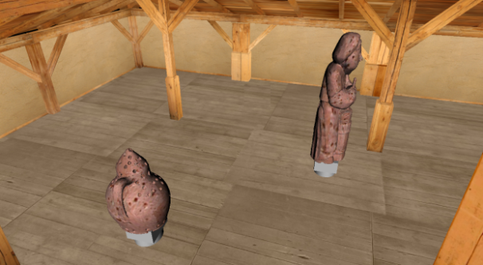
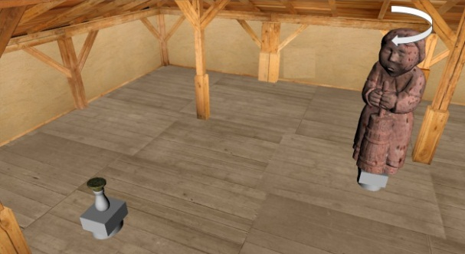
Example 1 – Customization
Customized 3D scenes
3D meta-scene

Slide 29
Query 1 – Assign every artifact to a stand
dso:granary rdf:type GlobalSelector.
dso:Property rdfs:subPropertyOf GlobalProjector.
q:standsOn(A, B) :- dso:Artifact(A), dso:Stand(B), q:notOnOthers(A), q:nothingOnIt(B).
q:notOnOthers(A) :- q:standsOn(A, B), !, fail().
q:notOnOthers(A).
q:nothingOnIt(B) :- q:standsOn(A, B), !, fail().
q:nothingOnIt(B).
x(A, AX) :- q:standsOn(A, B), x(B, BX), AX = BX.
z(A, AZ) :- q:standsOn(A, B), z(B, BZ), AZ = BZ.
y(A, AY) :- q:standsOn(A, B), y(B, BY),
height(B, BHeight), height(A, AHeight),
AY = BY+(AHeight+BHeight)/2.

Slide 30
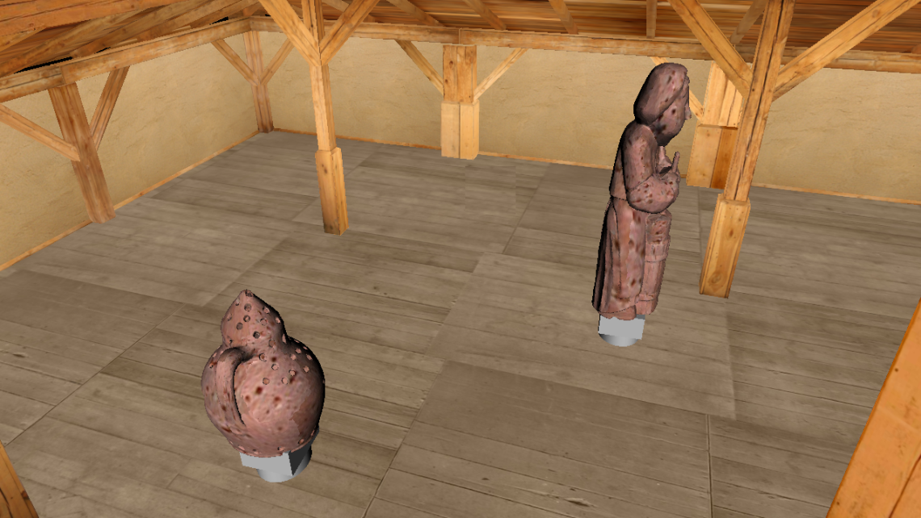
Query 2 – Select only clay artifacts and their stands
q:ClayObject
rdf:type owl:Class ;
rdfs:subClassOf GlobalSelector.
owl:equivalentClass
[ rdf:type owl:Restriction ;
owl:onProperty dso:madeOf ;
owl:hasValue "clay" ] ;
q:isStandFor rdf:type rdf:Property ;
owl:inverseOf dso:standsOn.
q:SelectedStand
rdf:type owl:Class ;
rdfs:subClassOf GlobalSelector.
owl:equivalentClass
[ rdf:type owl:Restriction ;
owl:onProperty q:isStandFor ;
owl:someValuesFrom q:ClayObject ] ;
dso:standsOn rdfs:subPropertyOf GlobalProjector.
dso:madeOf rdfs:subPropertyOf GlobalProjector.

Slide 31
Query 3 – Select artifacts with maximal distance and add interaction
dso:Property rdfs:subPropertyOf GlobalProjector.
q:remote(A, B) :-
x(A, AX), x(B, BX), z(A, ZX), z(B, ZX),
Distance^2 = (AX-BX)^2 + (AZ-BZ)^2,
maximal(Distance^2).
GlobalSelector(A) :- q:remote(A, B).
q:ClayObject rdfs:subClassOf
[ rdf:type owl:Restriction ;
owl:onProperty sensor ;
owl:onClass q:TouchSensor ;
owl:qualifiedCardinality 1 ].
q:TouchSensor rdf:type owl:Class ;
rdfs:subClassOf TouchSensor ,
[ rdf:type owl:Restriction ;
owl:onProperty activates ;
owl:onClass q:RotatingInterpolator ;
owl:qualifiedCardinality 1 ].
q:TimeSensor rdf:type owl:Class ;
rdfs:subClassOf TimeSensor,
[ rdf:type owl:Restriction ;
owl:onProperty interval ;
owl:hasValue 3 ].
q:RotatingInterpolator rdf:type owl:Class ;
rdfs:subClassOf OrientationInterpolator ,
[ rdf:type owl:Restriction ;
owl:onProperty key ;
owl:hasValue "0 1.5 3" ] ,
[ rdf:type owl:Restriction ;
owl:onProperty keyValue ;
owl:hasValue"0 0 0 0 3.14 0 0 0 0"],
[ rdf:type owl:Restriction ;
owl:onProperty controller ;
owl:onClass q:TimeSensor ;
owl:qualifiedCardinality 1 ].

Slide 32
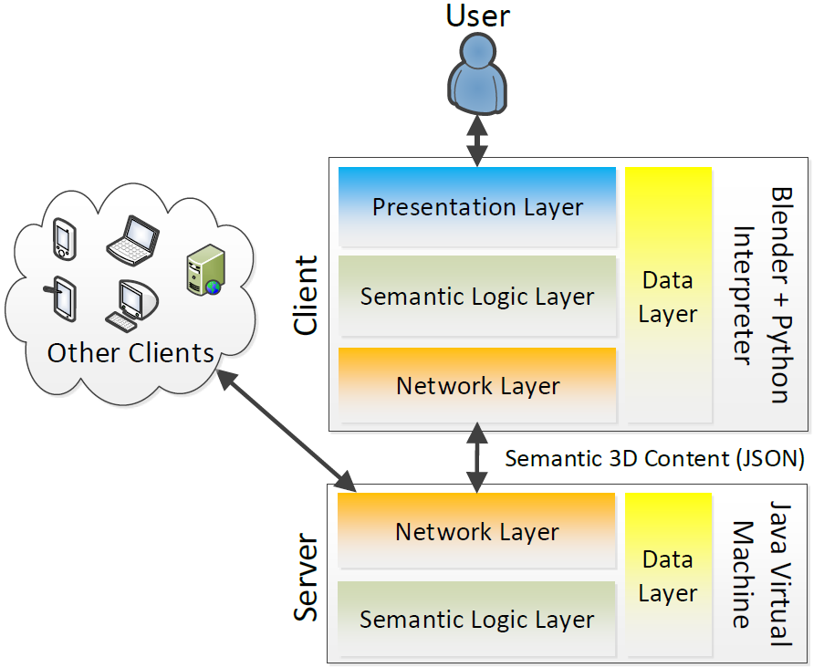
Implementation System architecture

Slide 33
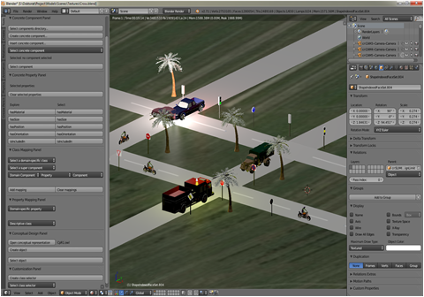
Implementation Client – Content authoring

Slide 34
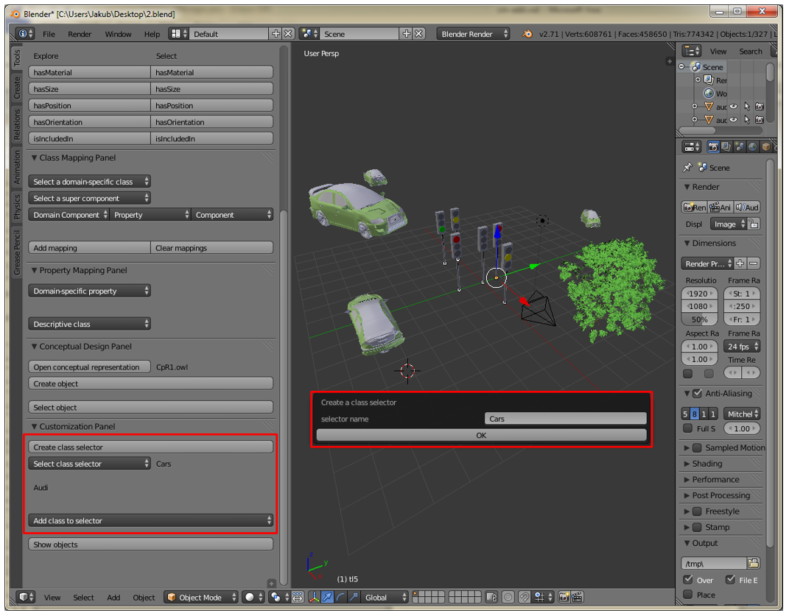
Implementation Client – Scene generation

Slide 35
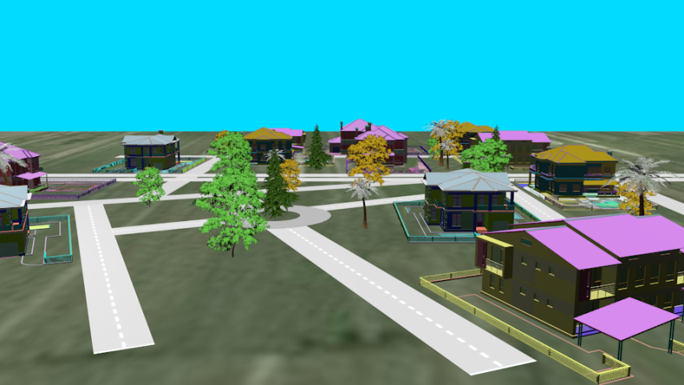
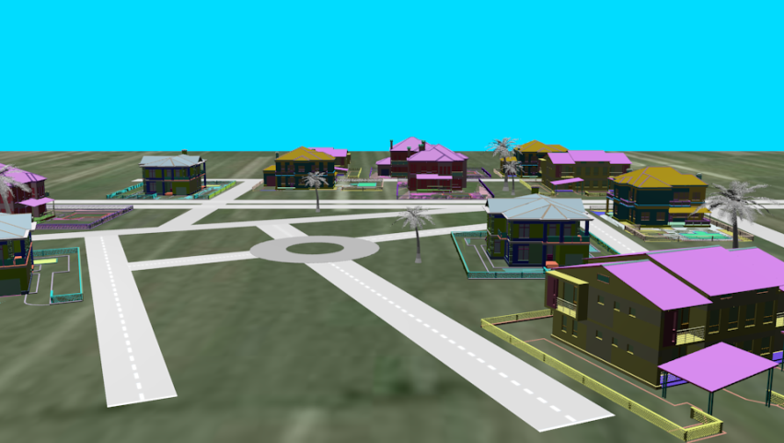
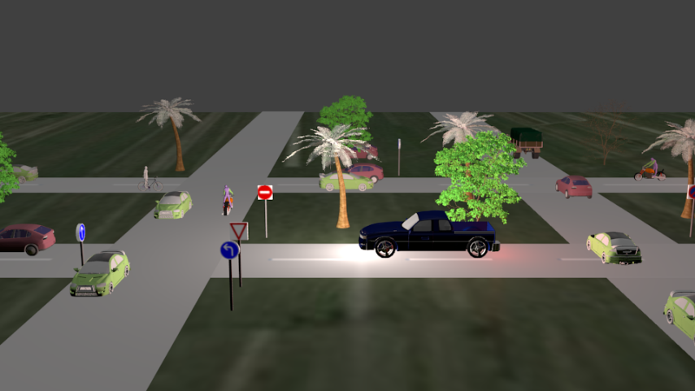
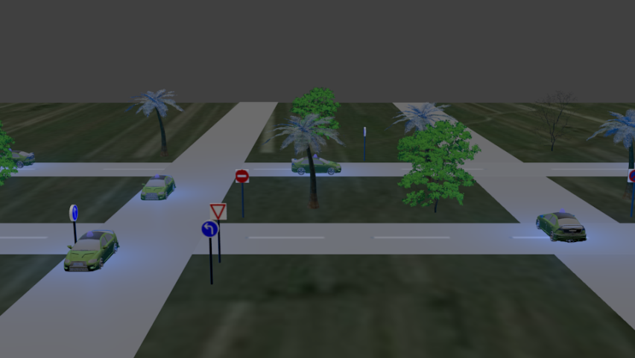
Example 2 – City models
3D meta-scenes
Customized 3D scenes
Only palm trees
Only privileged cars

Slide 36
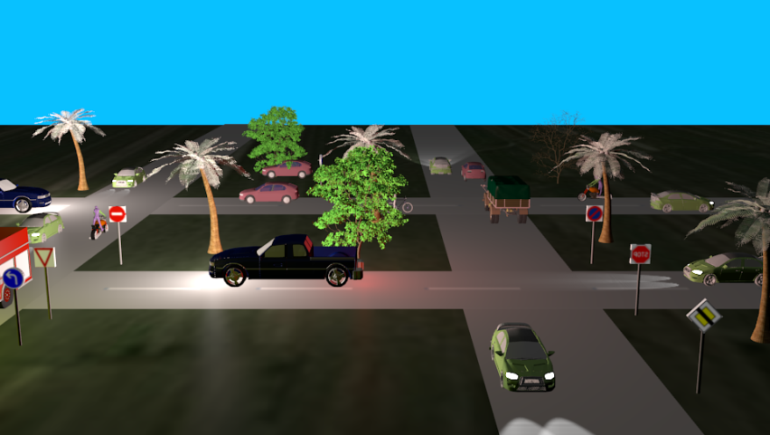
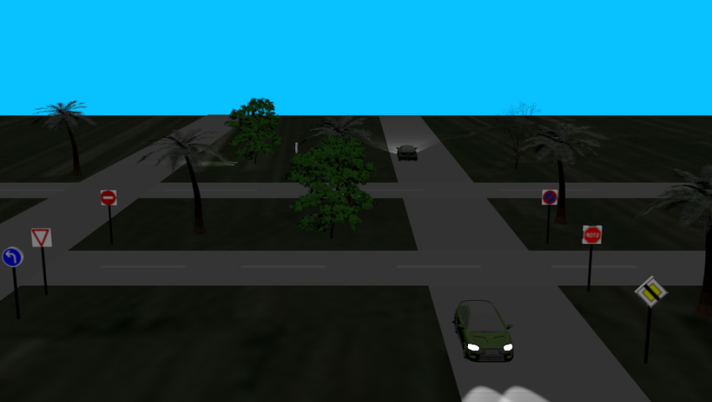
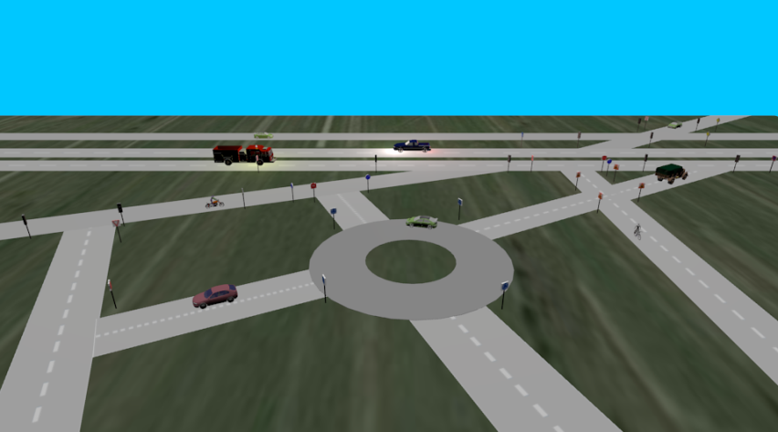
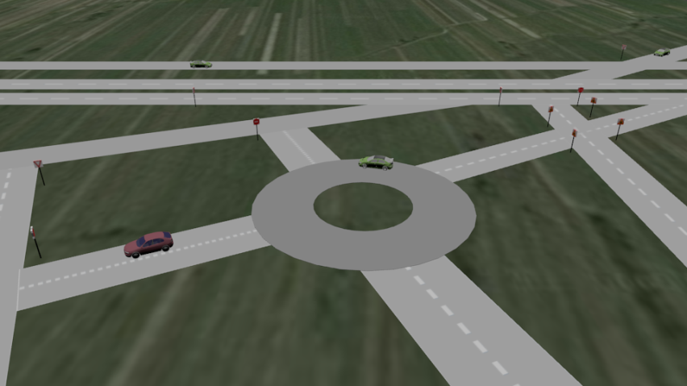
Example 2 – City models
3D meta-scenes
Customized 3D scenes
Only cars with high beam
Only warning and prohibition signs and passenger cars

Slide 37
Conclusions and Future Works
Advantages of the presented approach
Complex content customization mechanisms
Operation of a high-level of abstraction
Use of indirect knowledge
Platform- and standard- independence
Compliance with the semantic web standards
Future works
Implementation of remaining content generation patterns in the authoring tool
Evaluation in terms of size and complexity of 3D content
On-demand generation of rule-based descriptions of content behavior
Support for the four-dimensional space (including time)
Support for context – personalization and adaptation of 3D content

Slide 38
Semantic Query-based Generation of Customized 3D Scenes
Thank you for your attention
Krzysztof Walczak, Jakub Flotyński
Department of Information Technology
Poznań University of Economics, Poland
[walczak, flotynski]@kti.ue.poznan.pl

