Slide 1
WebGL virtual globe for efficient forest production planning in
mountainous area
Federico Prandi
Fondazione Graphitech

Slide 2
Outlook
Introduction
Goal
System Architecture
Technology overview and features
3D web client Live demo

Slide 3
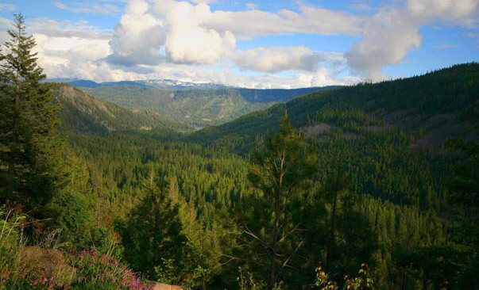
Introduction
Forest in mountainous areas are the 23% of the total Earth

Slide 4
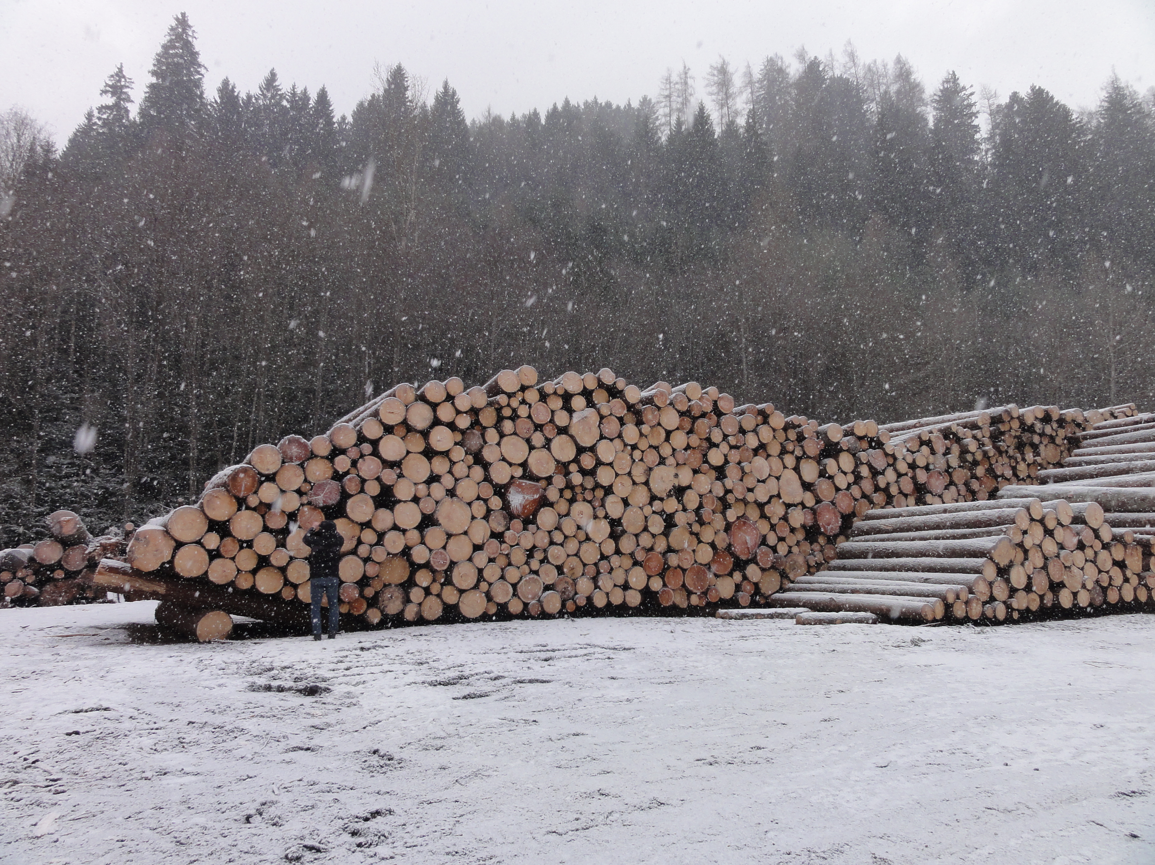
Introduction
SLOPE project aims to optimize forest production building a 3D forest model to support the entire wood
process, from tree RFID tagging to cut and debranched logs ready for the sawmills

Slide 5
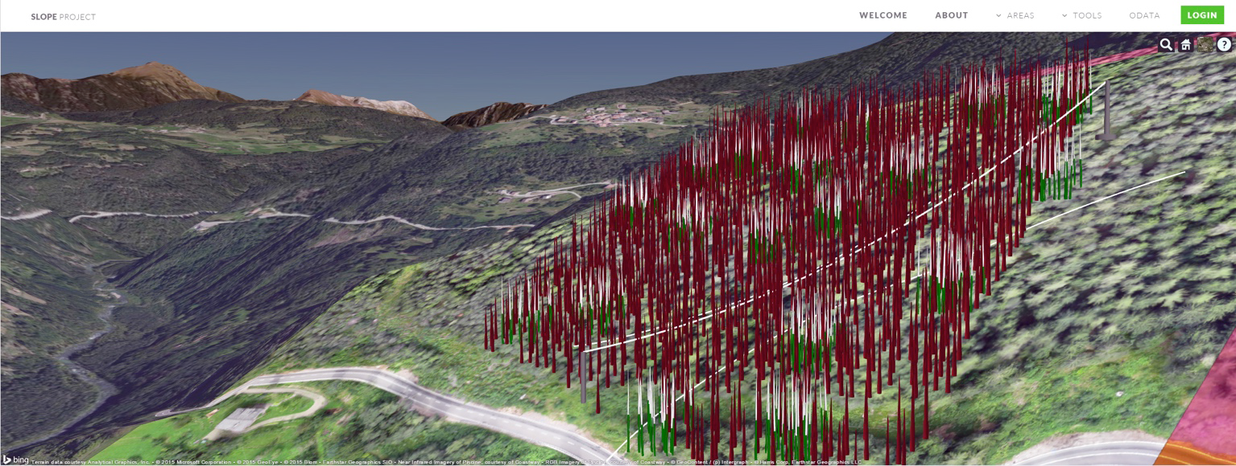
Goal
Develop methodologies and tools to fully describe terrain and stand characteristics, in order to evaluate the accessibility for and efficiency of harvesting technologies in mountain forests.

Slide 6
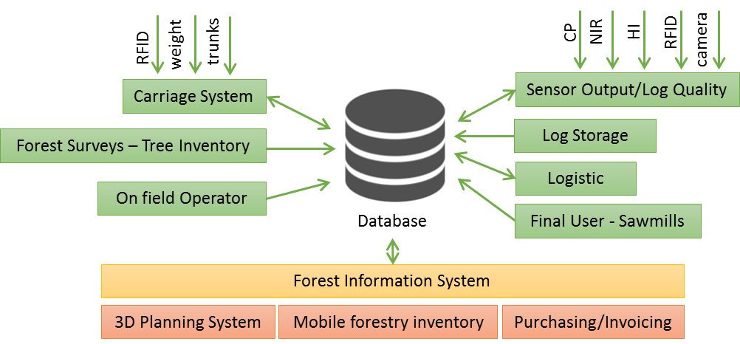
System Architecture

Slide 7
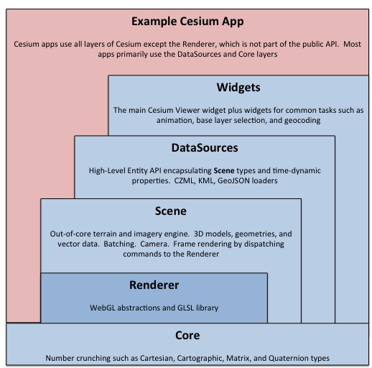
System Architecture
Source: https://cesiumjs.org/

Slide 8
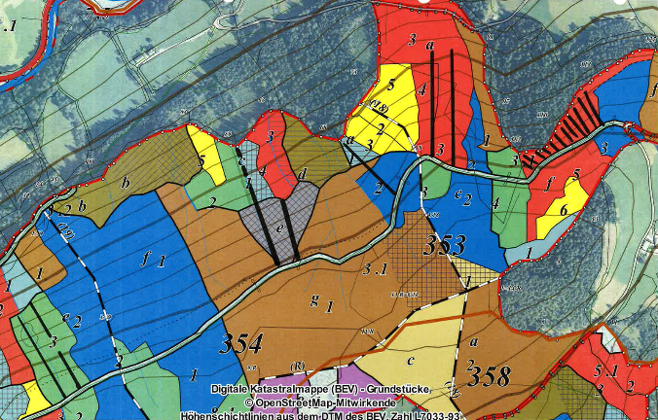
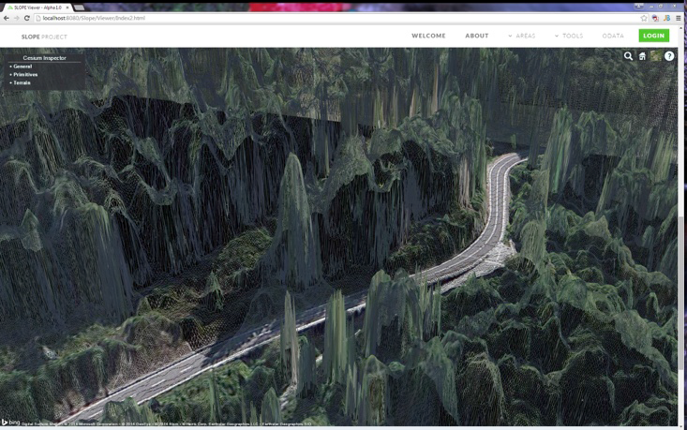
Two levels of abstraction
1St Level: 2D map accessing of forest and logistic information including:
Cadastral data, Volume of timber, accessibility of area.
2nd Level: 3D forest information and visualization of the single tree and stems profile.
Cable Crane positioning and tools to plan harvesting area

Slide 9
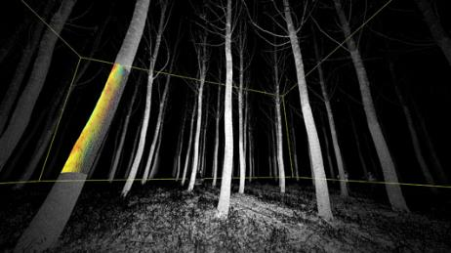
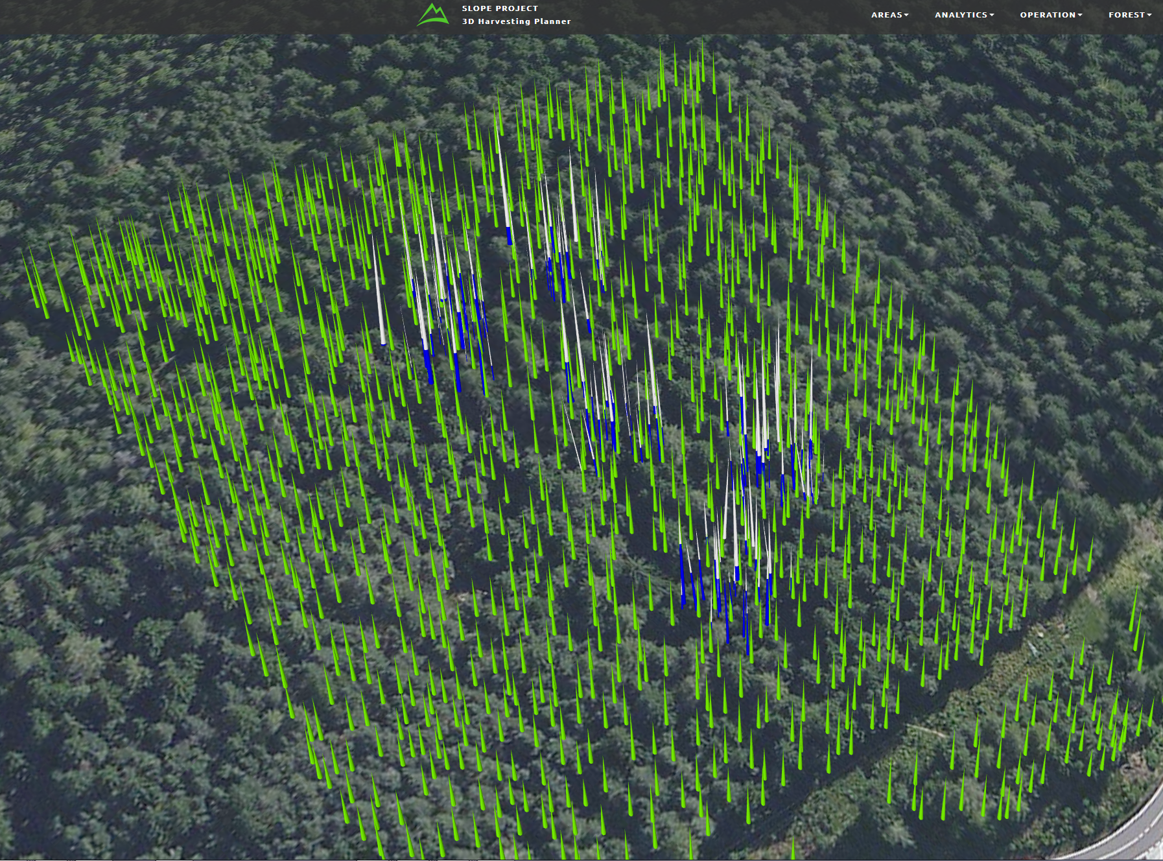
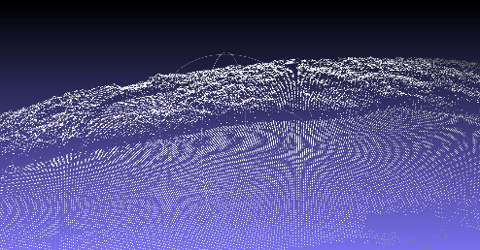
Integrating Data
Using the remote data (Satellite, UAVs orthophotos and digital surface model) combined with on field information (TLS), each single tree feature will be segmented including its deducted geometric properties.

Slide 10
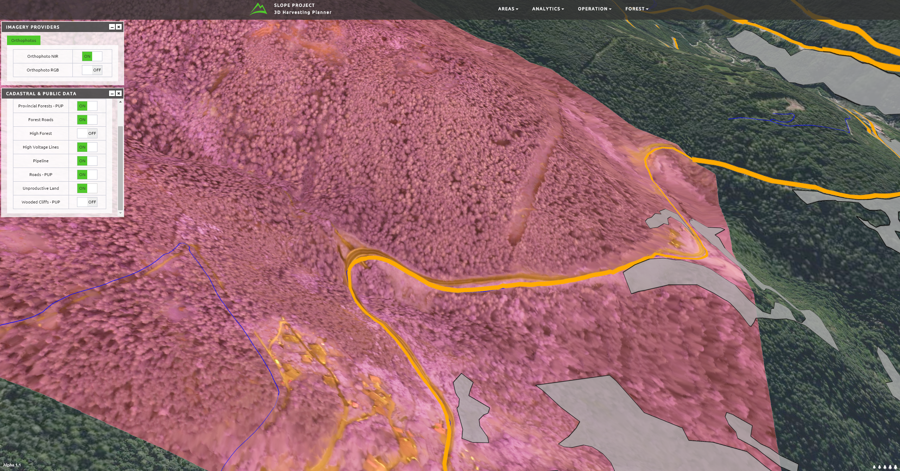
3D Harvesting Planner
WebGL Based : HTML5 canvas – no need for plugin, run in almost any modern browser. Serving spatial-data through Tile Map Service and Web Map Service compliant server.

Slide 11
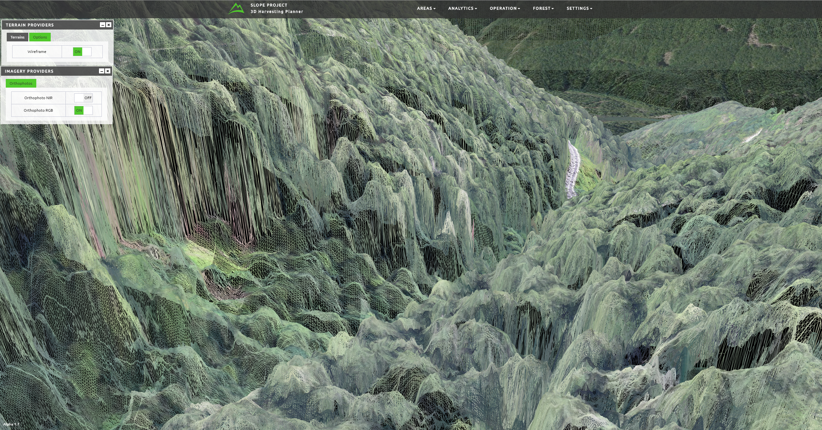
3D Harvesting Planner
Visualization of HR Digital Surface Model using (Multiresolution terrains)

Slide 12
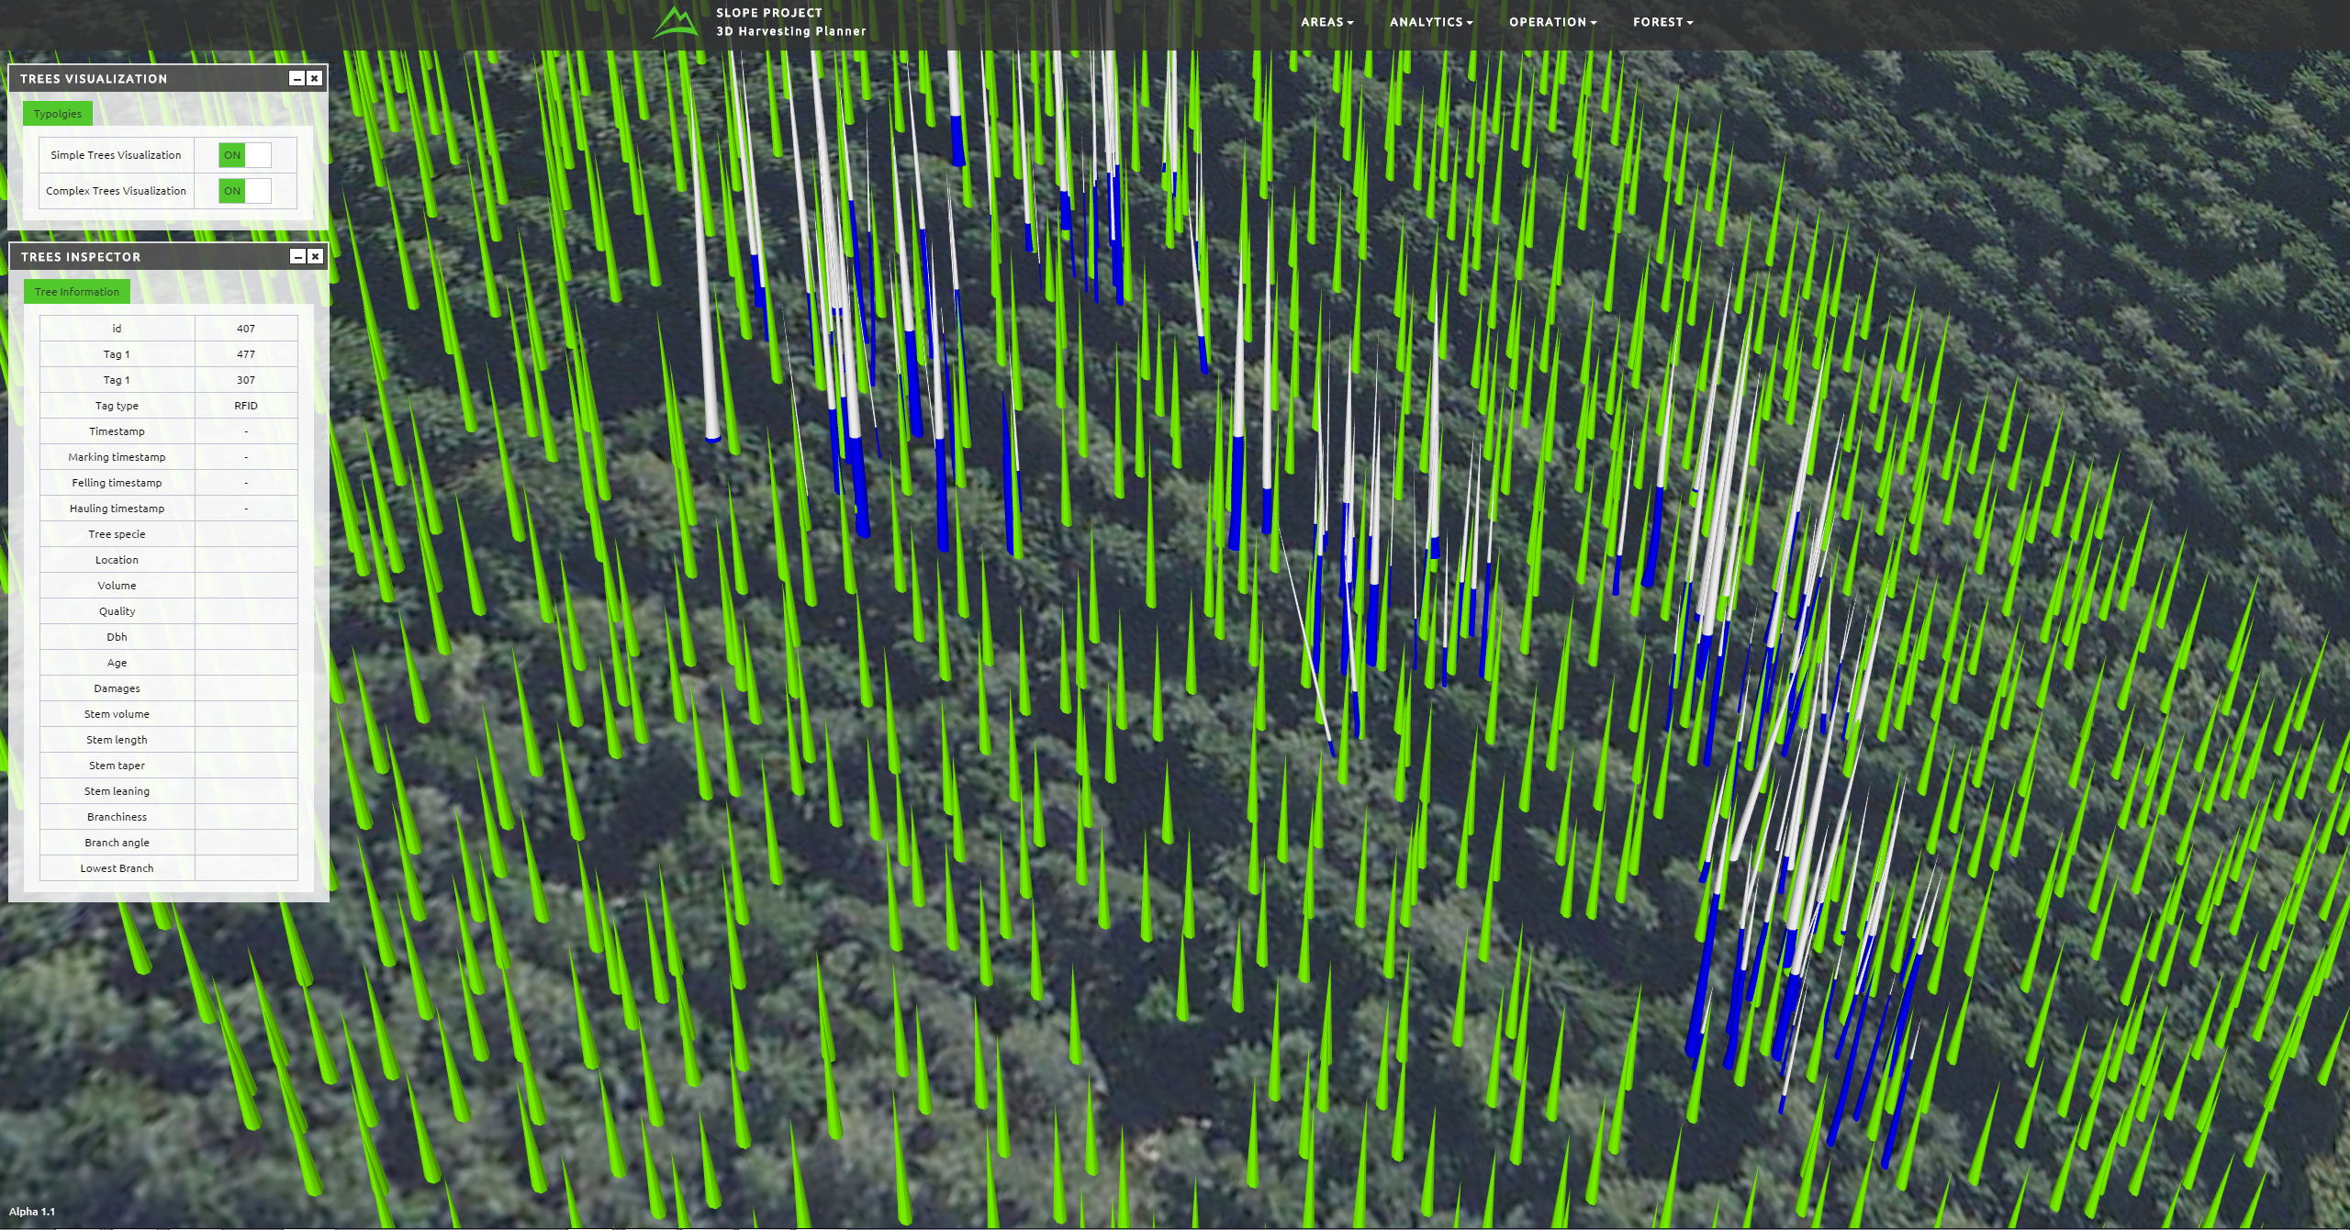
3D Harvesting Planner
Single Tree visualization and stems profile
Notes:
Forest Road and Trentino road Highlighted

Slide 13
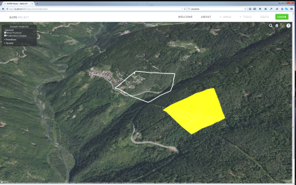
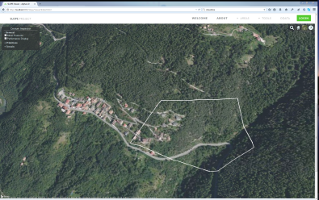
3D Harvesting Planner
Planning Tools for measurements
User could draw a polygonal area ora a line that will be used to take measurements useful to setup a landing zone or any other operational area
Notes:
Like for instance log carriage for logistic

Slide 14
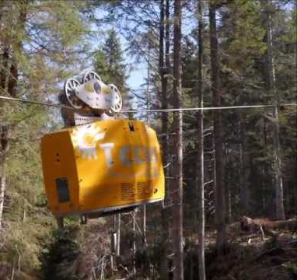
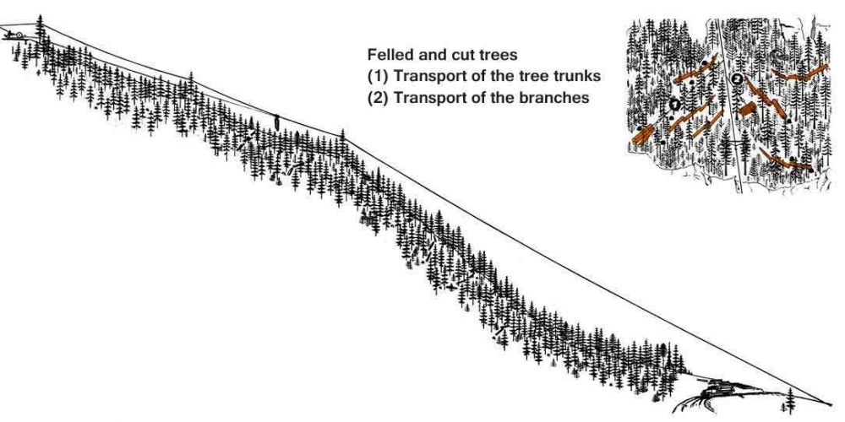
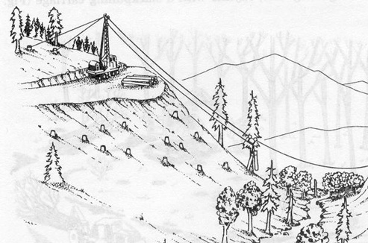
3D Harvesting Planner
Cableway positioning simulation and cable crane following Greifenberg guidelines and suggestion
Notes:
Forest Road and Trentino road Highlighted

Slide 15
3D Harvesting Planner
Typology of Cableway used by in alpine/mountainuous scenario
Operational lane of carriage/lifting
Catenary Simulation
Constrains on real operational scenario for cableway construction
Notes:
Forest Road and Trentino road Highlighted

Slide 16
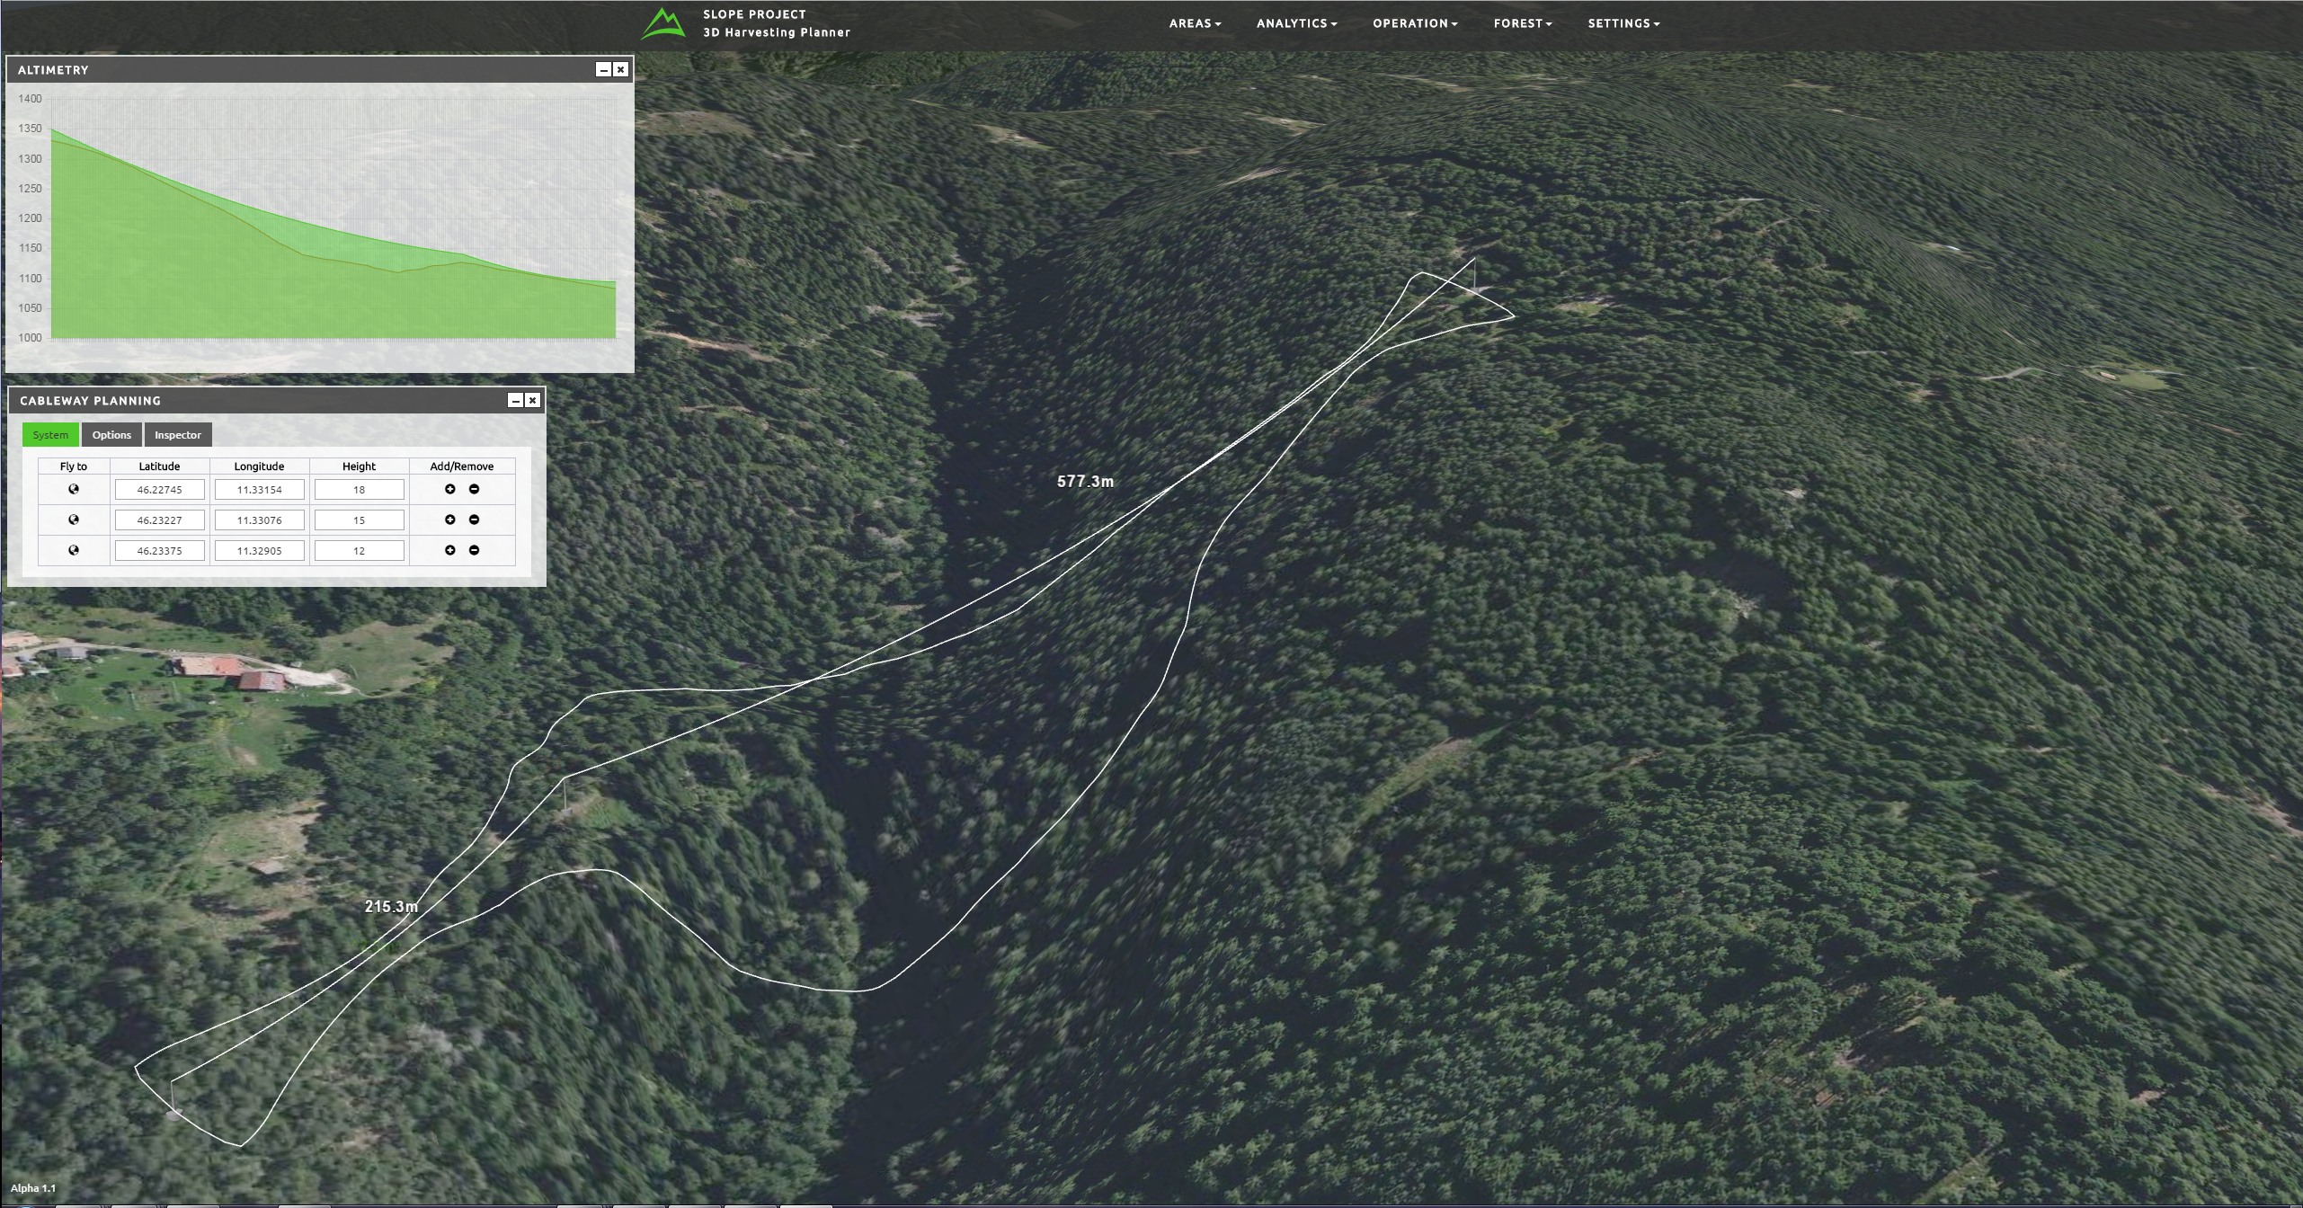
3D Harvesting Planner
Cable Crane Setup Simulation
Notes:
Forest Road and Trentino road Highlighted

Slide 17
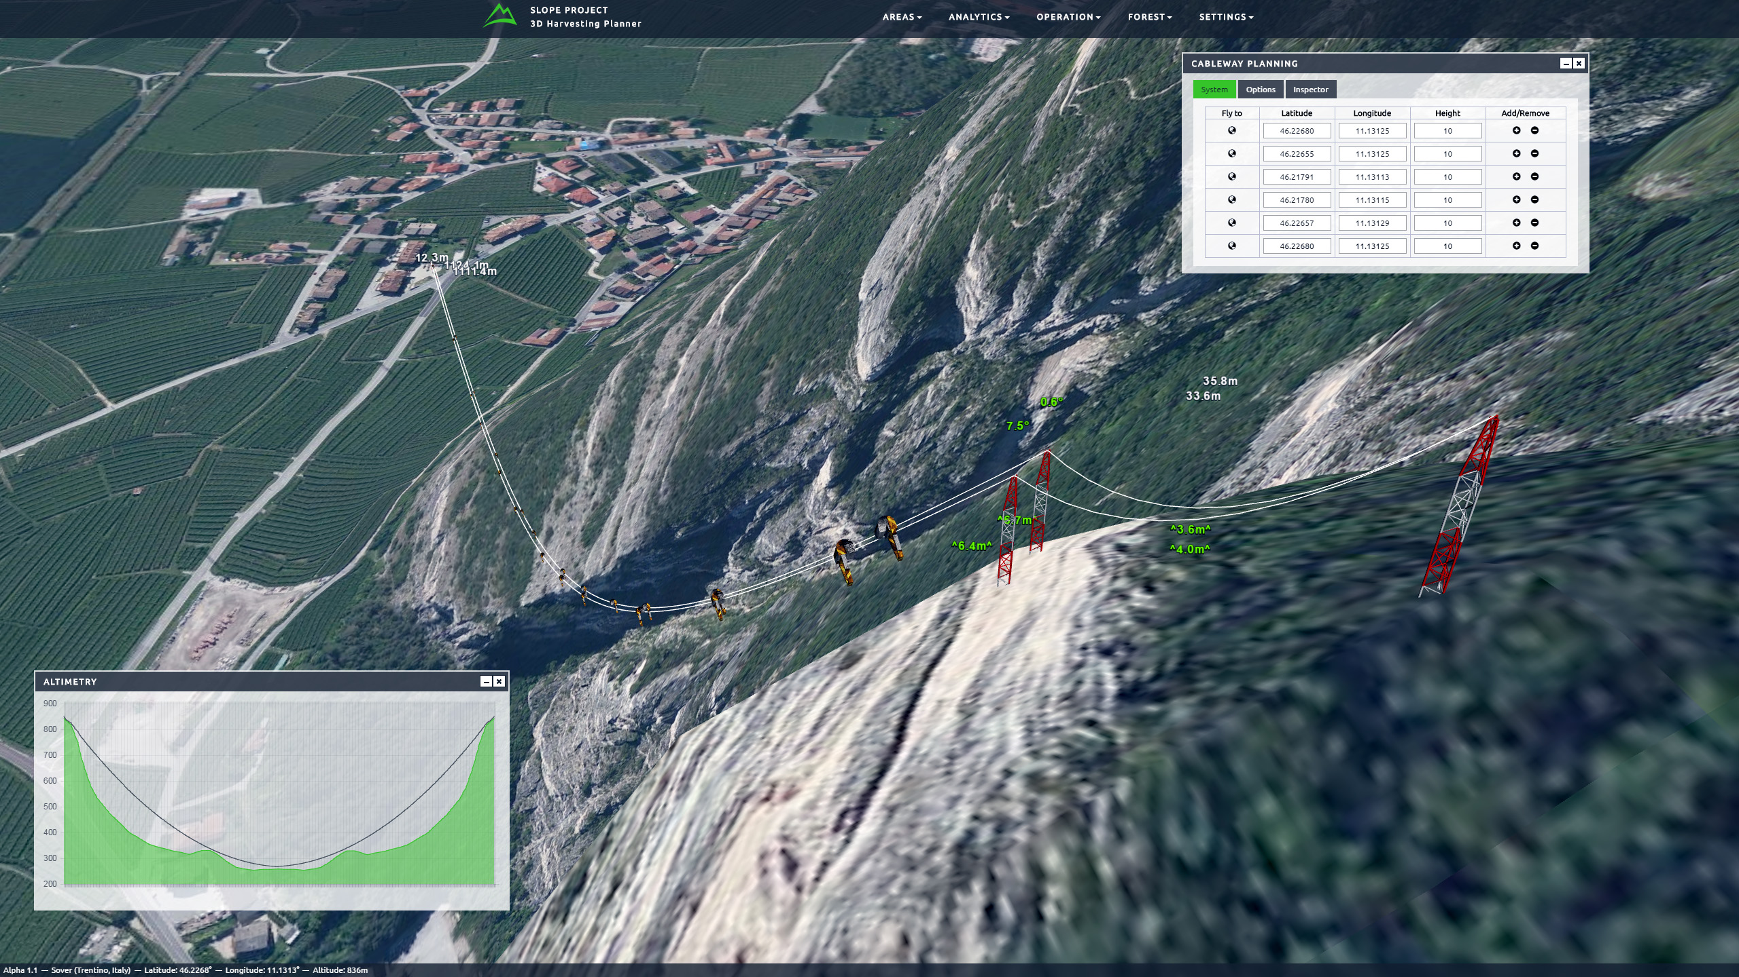
3D Harvesting Planner
Notes:
Forest Road and Trentino road Highlighted

Slide 18
Conclusion and Future works
Tool for visualizing and planning marking and harvesting operation on mountain forests.
Web based and SOA system
Deploy the services to query the Forest Information system
Reporting functionalities
Notes:
Forest Road and Trentino road Highlighted

Slide 19
Demo
Demo
Video
Notes:
Forest Road and Trentino road Highlighted

Slide 20
Thank you for your attention
Federico Prandi
federico.prandi@graphitech.it
Fondazione Graphitech
Via Alla Cascata 56C
38123 Trento (ITALY)
Phone: +39 0461.283393
Fax: +39 0461.283398

