Slide 1
X3DOM
+
H-Anim
Bullet Physics
An introduction to x3dom – physics and making a ragdoll using hanim
2015

Slide 2
SCOPE
2015
TEI Crete
Kinesiology
Introduce H-Anim
Bullet Physics / Ammo.js
Exploit H-Anim

Slide 3
Kinesiology
2015
TEI Crete
Is the study of human and animal movement
Three major systems:
Nervous System
Skeletal System
Muscular System

Slide 4
Kinesiology
2015
TEI Crete
Segment
Skeletal System
Joints and Segments
Some attributes of them
Joint
Joints | Segments
DoF | Mass
Limits | Length
Type of joint | Center of mass
 | Inertia
designed by Freepik.com

Slide 5
H-Anim
2015
TEI Crete
Compatibility (is a standard to representing humanoids in VRML97)
Flexibility (allowing to create a humanoid with a different tool and animated with other)
Simplicity (it makes a lot easier the use of models and sharing)

Slide 6
H-Anim
2015
TEI Crete
In order to simplify the creation of humanoids they developed five new nodes:
Joint Node
Segment Node
Site Node
Displacer Node
Humanoid Node

Slide 7
H-Anim
2015
TEI Crete
Joint Node
Represents the joint in the body
Gives rotation and motion to segments
Can only be child of another Joint node
Fields | Information
name | Must exists, standard name
llimit | Optional, lower joint limits
ulimit | Optional, upper joint limits
…others … | ….

Slide 8
H-Anim
2015
TEI Crete
Segment Node
Represents the segment in the body
Can have Shapes or Transform nodes
Fields | Information
name | Must exists, standard name
mass | Optional, the mass of the segment
centerOfMass | Optional, center of mass
…others … | ….

Slide 9
H-Anim
2015
TEI Crete
Site Node
Defines an “end effector” location
An attachment point for accessories (jewelry)
Location for a virtual camera (through eyes)
Fields | Information
name | Must exists , "_tip" suffix appended
children | Stores any accessories to the segment
translation | Defines the location of end effector
…others… | ….

Slide 10
H-Anim
2015
TEI Crete
Displacer Node
Identifies specific groups of vertices (eyebrows)
Represents particular muscular action
Complete configuration of vertices in a Segment
Fields | Information
name | Must exists , "_feature" suffix or “_action” for motion
…others… | ….

Slide 11
H-Anim
2015
TEI Crete
Humanoid Node
Stores human-readable data
Can be used for positioning in space
Fields | Information
name | Must be present, for identification
version | Version of specification that follows
info | Information's about the author and the model
…others… | ….

Slide 12
H-Anim
2015
TEI Crete
Basic Modeling
The humanoid must be in a standing position
Facing +Z, +Y Up and +X to the humanoid’s left
Origin (0,0,0) located at ground level between the feet

Slide 13
H-Anim Hierarchy-Names
2015
HumanoidRoot
sacrum
l_hip
r_hip
sacroiliac
l_thigh
l_knee
l_calf
l_ankle
l_midtarsal
l_hindfoot
r_thigh
r_knee
r_calf
r_ankle
r_midtarsal
r_hindfoot
l_middistal
r_middistal
l_shoulder
pelvis
vl5
l_elbow
l_upperarm
l_wrist
l_forearm
l_hand
r_shoulder
r_elow
r_upperarm
r_wrist
r_forearm
r_hand
skullbase
l5
skull
TEI Crete
Joint
Segment

Slide 14
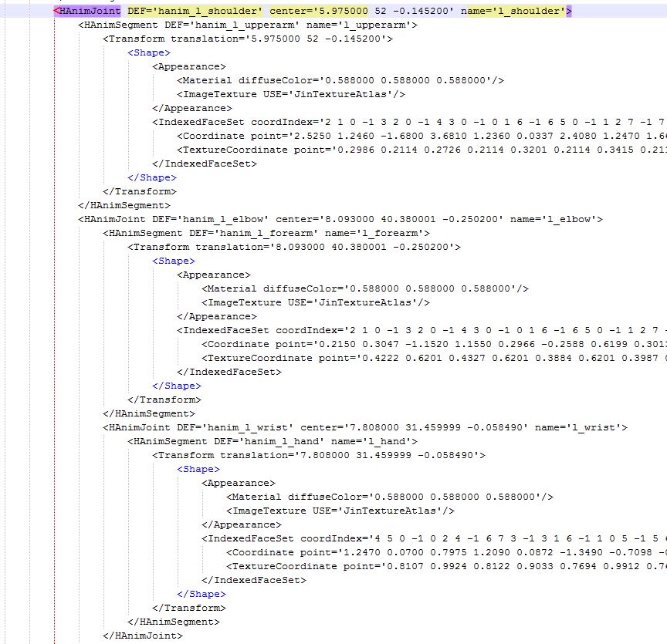
H-Anim
2015
TEI Crete
H-Anim in X3DOM:
Segment node
Transform node
Joint
node
Transform node
Joint
node
Segment node

Slide 15
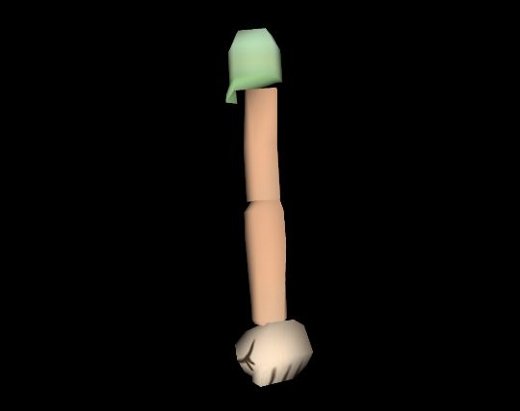
H-Anim
2015
TEI Crete
H-Anim in X3DOM:
xhtml Code
X3D Scene
Visual

Slide 16
Bullet Physics
2015
TEI Crete
Is a physics engine giving us simulation
Is written in C, C++
Free and open-source software
Features | About
Simulation | Collision detection, soft and rigid body dynamics
Collision shapes | Sphere, box, cylinder, cone, convex hull

Slide 17
Bullet Physics
2015
TEI Crete
Ammo.js
The direct port of Bullet physics to JavaScript (for web using)
Collider Shapes | Constraining Methods
btSphereShape | btPoint2PointConstraint
btBoxShape | btSliderConstraint
btCylinderShape | btGeneric6DofConstraint
btConeShape | btUniversalConstraint
btConvexHullShape | btHingeConstraint
btCapsuleShape | btConeTwistConstraint

Slide 18
Bullet Physics
2015
TEI Crete
BulletPhysics.js
Is an implementation of rigid body physics for X3DOM
Enables real-time physics simulation in X3D scenes

Slide 19
X3D-Bullet Physics
2015
TEI Crete
Pairing Ammo.js with BulletPhysics.js (Collidable Shapes)
X3D Collidable Shapes | Ammo.js Collider Shapes
Sphere | btSphereShape
Box | btSphereShape
Cylinder | btCylinderShape
Cone | btConeShape
IndexedFaceSet | btConvexHullShape
“Not exist” | btCapsuleShape

Slide 20
X3D-Bullet Physics
2015
TEI Crete
Pairing Ammo.js with BulletPhysics.js (Constrains-Joints)
X3D Joints Types | Ammo.js Constraining Methods
BallJoint | btPoint2PointConstraint
SliderJoint | btSliderConstraint
MotorJoint | btGeneric6DofConstraint
UniversalJoint | btUniversalConstraint
SingleAxisHingeJoint | btHingeConstraint
DoubleAxisHingeJoint | btHingeConstraint

Slide 21
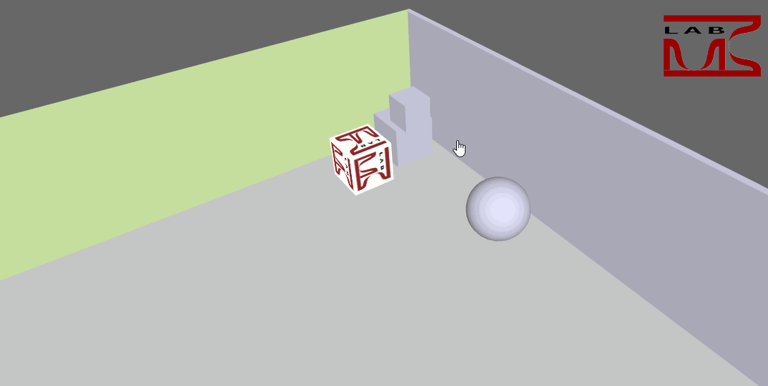
X3D-Bullet Physics
2015
TEI Crete
Demo 1:
Create a simple scene with rigid bodies

Slide 22
X3D-Bullet Physics
2015
TEI Crete
Transform Node (appears in X3D Scene “visual”)
Name of transform and location
Colors or texture image
Size of box (X,Y,Z)

Slide 23
X3D-Bullet Physics
2015
TEI Crete
CollidableShape Node (Physics part I)
Set with the same attributes from Transform and USE it

Slide 24
X3D-Bullet Physics
2015
TEI Crete
RigidBody Node (Physics part II)
Collection of rigid bodies
Defines gravity
Add rigid body inside
Defines attributes
If fixed=true, then can’t be use mouse on it
If mass=0 gravity doesn’t affect
USE an exist collidable shape

Slide 25
X3D-Bullet Physics
2015
TEI Crete
CollisionSensor Node (Physics part III)
Sense the collisions of rigid bodies
Setting the attributes and behaviors
USE of collidable shape and enabled it

Slide 26
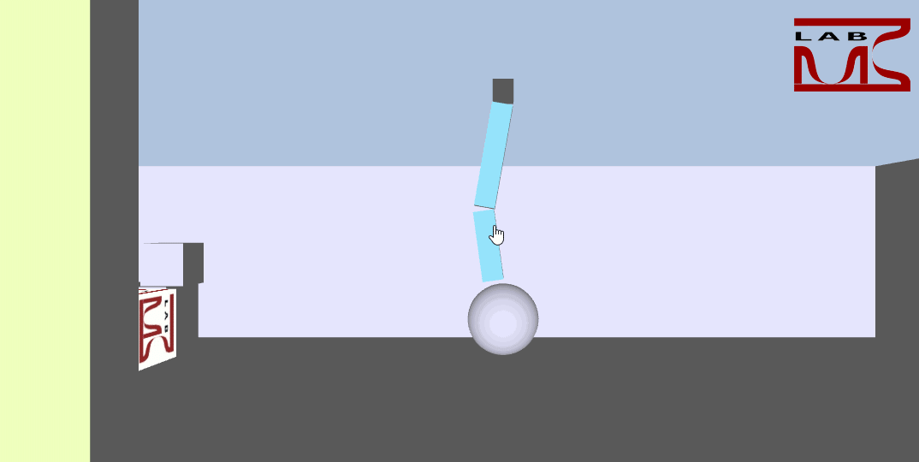
X3D-Bullet Physics
2015
TEI Crete
Demo 2:
Adding a simple hinge joint in the scene

Slide 27
X3D-Bullet Physics
2015
TEI Crete
Joint Node (hinge constraint)
Includes joints
Setting attributes anchorPoints of rigid bodies (depend from their size)
Setting limits and axis of rotation
USE rigid bodies as body1 and body2

Slide 28
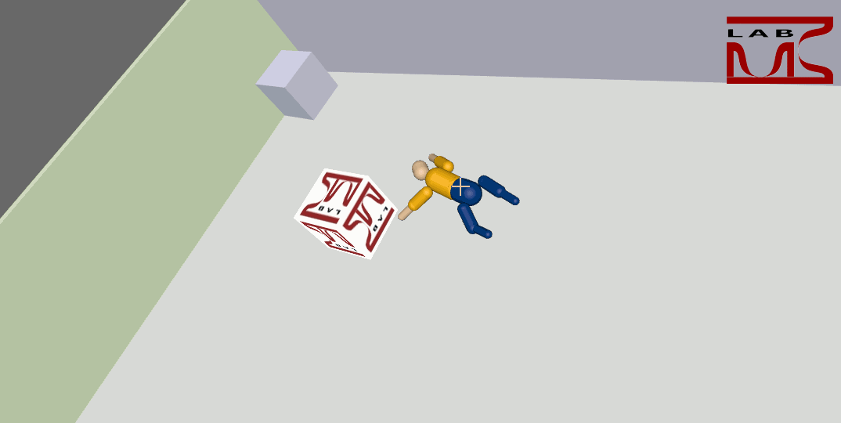
X3D-Bullet Physics
2015
TEI Crete
Demo 3:
Create a basic ragdoll

Slide 29
X3D-Bullet Physics
2015
TEI Crete
Ragdoll
In order to simulate human motion we implemented a new joint
ConeTwistJoint is useful for limbs like the upper arm or the upper leg

Slide 30
X3D-Bullet Physics
2015
TEI Crete
ConeTwistJoint
Attributes | About
anchorPoint1 | Specifies origin of body1
anchorPoint2 | Specifies origin of body2
euler1 | Specifies angle of body1
euler2 | Specifies angle of body2
swingSpan1 | The limit on the Z rotation axis in degrees
swingSpan2 | The limit on the Y rotation axis in degrees
twistSpan | The limit on the X rotation axis in degrees

Slide 31
X3D-Bullet Physics
2015
TEI Crete
Creating a ragdoll using H-Anim prototype:
Create dynamically ragdolls from file
More realistic
Benefits | Details
Dynamic | Dynamic creation of humanoids
Accurate | More accurate calculations
Fast | Faster than the normal way

Slide 32
X3D-Bullet Physics
2015
TEI Crete
We developed a JavaScript, for that work
X3D Scene
H-Anim
Find
Find
Collidables
Shapes
RigidBodies
Joints & Segments
Transforms to Scene
Transfer
Create
Physics Components
Constraints

Slide 33
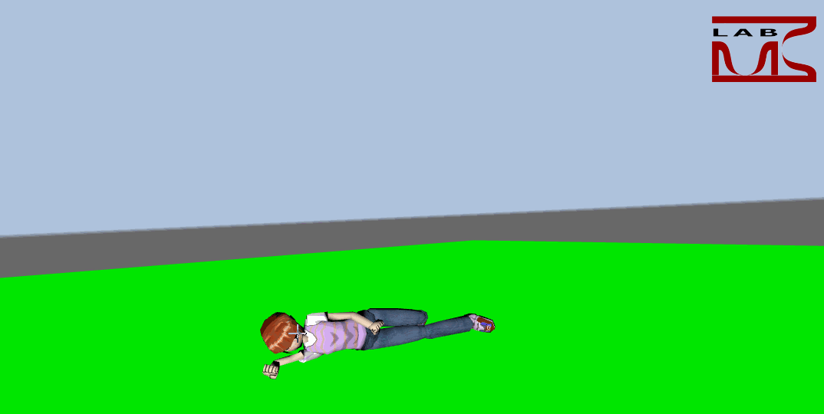
X3D-Bullet Physics
2015
TEI Crete
H-Anim based ragdoll:

Slide 34
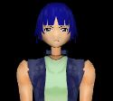
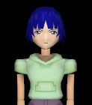
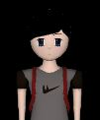
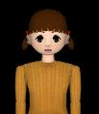
X3D-Bullet Physics
2015
TEI Crete
We can support several models from H-Anim examples

Slide 35
Thanks!

