Slide 1
Dynamic 3D Visualizations of Complex Function Surfaces Using X3DOM and WebGL
Bonita Saunders, Brian Antonishek, Qiming Wang, Bruce Miller
Applied and Computational Mathematics Division
National Institute of Standards and Technology
Gaithersburg, Maryland 20899
USA

Slide 2


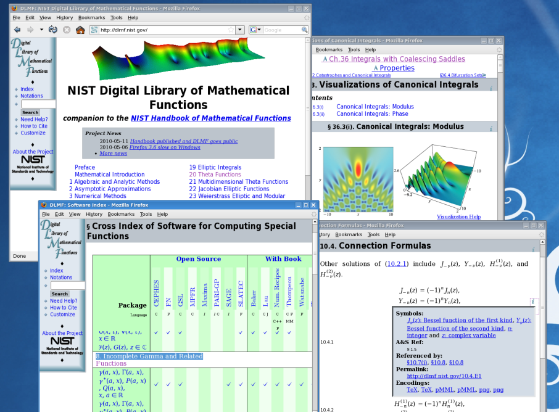
1964
Abramowitz & Stegun, eds.
NIST’s most widely distributed and cited publication of all time.

Slide 3
Challenges
Data Accuracy
Plot Accuracy
Rendering on Web

Slide 4
Data Accuracy
Function values computed by at least two methods
Standard computer algebra packages
Codes from reliable repositories like NIST Guide to Available Mathematical Software (GAMS)
Chapter author’s codes

Slide 5
Plot Accuracy
Poor resolution of poles
Bad clipping
Non-smooth color map

Slide 6
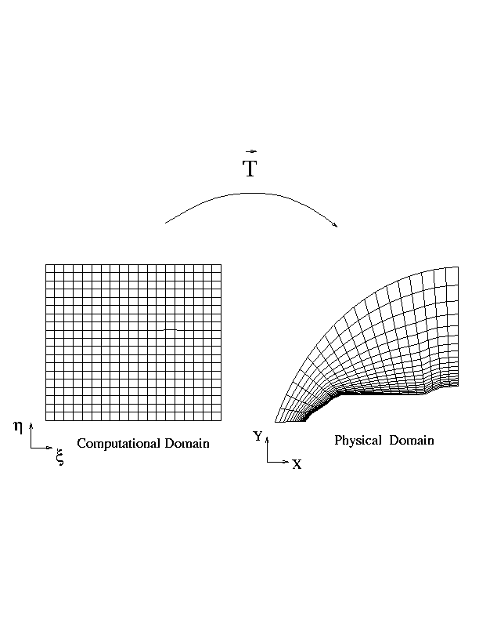
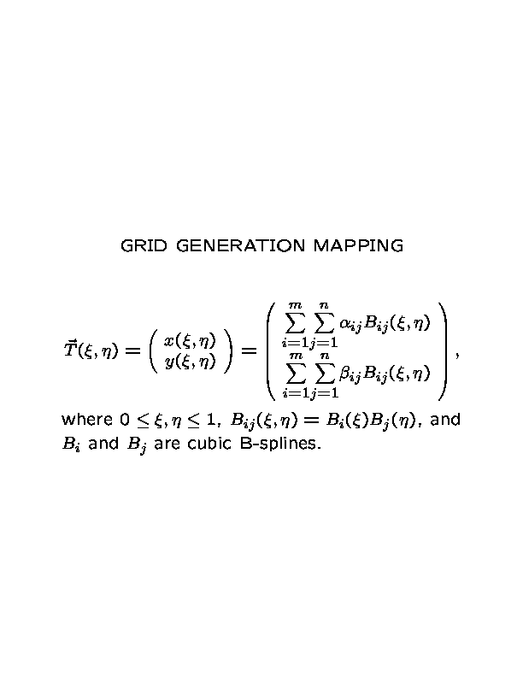
Numerical Grid Generation

Slide 7
Create Smoother, Orthogonal Coordinate Lines If Needed
Minimize functional
Where T denotes the grid generation mapping, J is the Jacobian of the mapping, and and are weight functions.
Notes:
Eps files are orthogpuzz_init.eps and orthogpuzz.eps in /home/saunders/conferences/Numgrid11 on the sgi.
Orthog weight is 2
Jacobian weight is 5
500 iterations and 50x50 grid

Slide 8
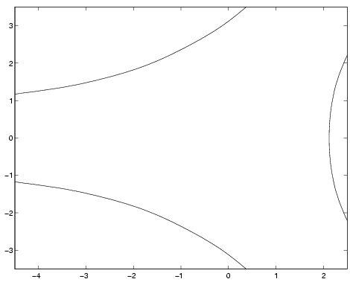
Airy Function |Bi'(x+iy)|
Contour curves for w=5
Contour mesh
Function computed over contour mesh
Function computed over rectangular mesh

Slide 9
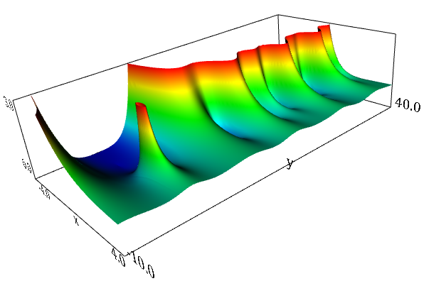
Riemann Zeta Function

Slide 10
File Formats for 3D Web Graphics
1990s : Virtual Reality Modeling Language (VRML)
2000 - 2010: VRML and Extensible 3D (X3D)
        Translated using Vrml97ToX3dNist (Qiming Wang)
        DLMF launched – VRML & X3D visualizations (2010)
2013 - now : X3DOM/WebGL

Slide 11
VRML and X3D
Pro:
Users can interactively explore graphs of high level mathematical functions
Con:
User must download graphics plugin/browser
Plugins may not be portable to different platforms
Visualizations may break when plugin, internet browser, or operating system updated
Many plugins unable to render complex cutting plane feature of DLMF visualizations

Slide 12
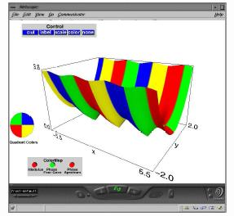
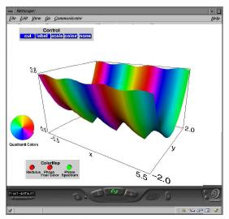
Color Map Control
Height based color mapping
Phase based color mapping
- Four color map : blue, green, red, yellow for phase value in first, second, third, fourth quadrant
- Continuous spectrum: smooth color change

Slide 13
Display of Cutting Plane Control

Slide 14
Definition of Prototypes
EXTERNPROTO MathViewer [
field MFNode surfaces
field SFInt32 numOfSets
field SFVec3f world_scale
field SFVec3f world_translation
field MFVec3f axes_point
field SFInt32 mapMethod
field SFInt32 noPhase
…
] “dlmf_proto.wrl#MathViewer”
EXTERNPROTO MathSurface [
field SFInt32 numOfSets
field MFNode surfaces
…
]“dlmf_proto.wrl#MathSurface”
EXTERNPROTO Surface [
field SFInt32 nx
field SFInt32 ny
field SFVec3f points
field MFInt32 index
field MFColor colors
field MFFloat phase
…
]”dlmf_proto.wrl#Surface”
DEF AI MathViewer {
surfaces [
DEF S1 Surface {
nx 30 ny 50
points […]
index […]
phase […]
…
}
DEF S2 Surface {
nx 30 ny 40
points […]
index […]
phase […]
…
}
…
]
axes_point […]
mapMethod 1 noPhase 1
numOfSets 2
…
}

Slide 15
X3DOM/WebGL – Default Format for NIST DLMF Visualizations (2014)
NIST DLMF Graphics team - 2 ½ year project to convert 200+ DLMF 3D visualizations into X3DOM/WebGL format
Interactive 3D graphics inside DLMF webpage
No plugin needed
Works with most common internet browsers – firefox, safari (mac), google chrome, opera,internet explorer (version 11)
Visualizations can be viewed on major platforms – windows, mac, linux, some mobile devices

Slide 16
http://dlmf.nist.gov
Digital Library of Mathematical Functions (DLMF) Demo (live)

Slide 17
Future
Implement continuous spin of function surface
Animation of 2D graphs – vary parameter similar to Mathematica “manipulate” option
Use adaptive mesh generation to create true zoom
Monitor progress of Microsoft with IE support of WebGL.
Drop VRML/X3D formats

Slide 18
Acknowledgements
Daniel Lozier, DLMF General Editor
Frank Olver, DLMF Mathematical Editor
Qiming Wang, DLMF Graphics (NIST retired)
Brian Antonishek (NIST)
Bruce Miller, DLMF Information Architect
Sandy Ressler (NIST ACMD)
Brianna Blaser, University of Washington (AAAS)
Sheehan Olver, U.Minn ->Cambridge University ->St. John’s College, Oxford-> University of Sydney, Australia
Elaine Kim, Stanford University (lawyer)
Shauntia Burley, Coppin State University (Census Bureau)
Michael Huber, American University (Google)

