Slide 1
3drepo.io: Building the Next Generation Web3D Repository with AngularJS and X3DOM
Tim Scully, Jozef Doboš, Timo Sturm and Yvonne Jung

Slide 2
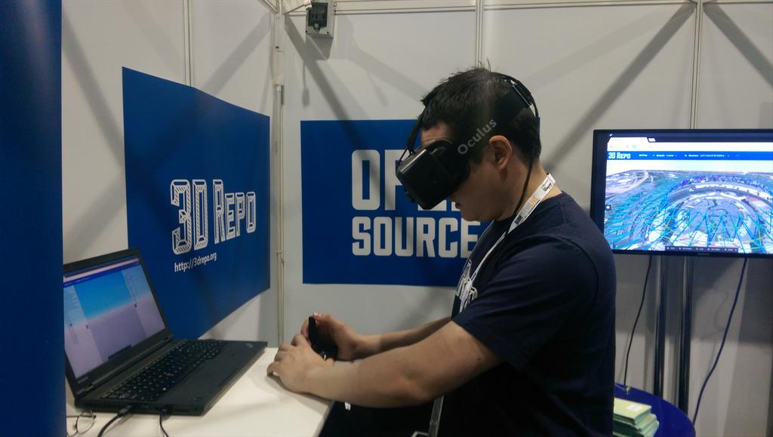
Tim Scully, CTO 3D Repo

Slide 3
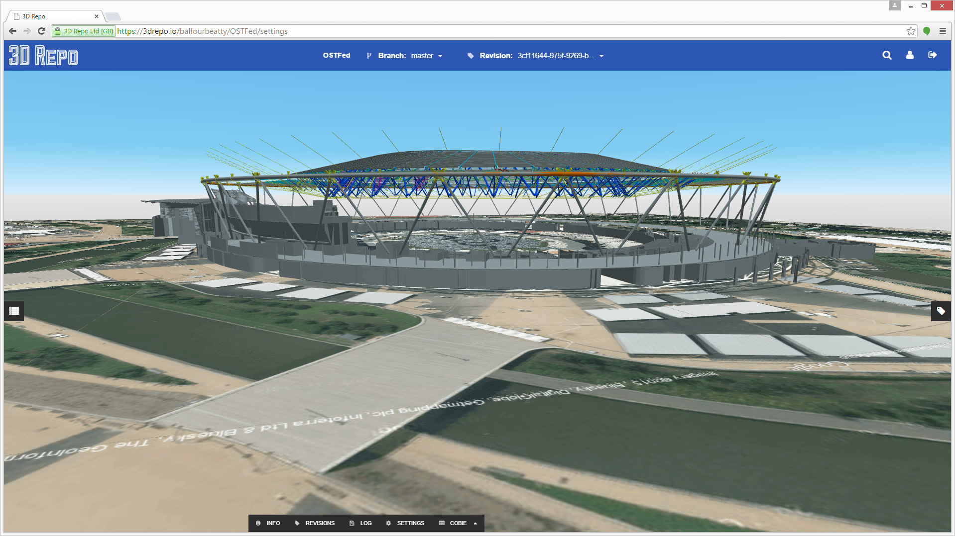
London Olympic Stadium

Slide 4
http://github.com/3drepo

Slide 5
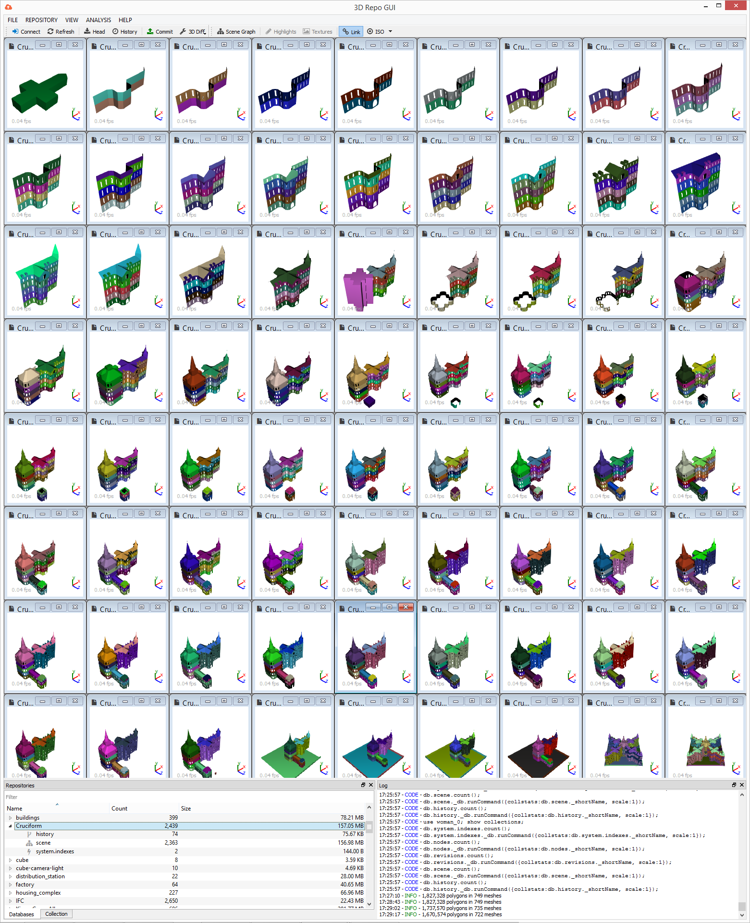
3D Repo is an open source collaborative 3D repository for the construction industry
A multi-award winning open source 3D version control software
Enables coordinated management of large scale 3D data over the Internet
One of very few cloud-based solution on the scale required by the industry
Facilitates cost savings & time efficiencies across a wide range of user applications

Slide 6
Clients
Advisers
Funders
Facility,
Managers
Property &
Lawyers
Asset Managers
Consultants
Government
Interest
Contract
Litigators &
Groups
Writers
Arbitrators
Architects
3D Repo
Professional
Engineers
Insurers
Surveyors
Logistics
Institutions
Suppliers
Standards
Educators
Setters
Town
Product
Planners
Suppliers
Tier 2
Regulators
Tier 1
Contractors
Growth through BIM Richard G Saxon CBE

Slide 7
“The one who makes the biggest mistake wins”
Industry expert
Notes:
Current tendering is slow and inefficient
2D engineering drawings
Omissions and errors
Man-days of work being wasted
Existing tools expensive and complicated

Slide 8
The UK Cabinet Office mandates the use of collaborative 3D tech in construction by 2016
UK Government Initiative
Construction Strategy Plan mandates the use of collaborative 3D technology by 2016, see http://digital-built-britain.com
Intelligent 3D models to inform and communicate project decisions
Reduction of costs and carbon emissions in construction by 20%
International ROI on BIM software is 10-25%
Graphisoft introduces ArchiCAD for Virtual Building & parametric models
Autodesk introduces BIM process for virtual collaboration specific to construction
UK Cabinet Office mandates the use of BIM by 2016 and commits £50m in public funding
1982
1995
2009
2020
1987
2003
2011
2016
Autodesk develops AutoCAD for 2D drawings & automated processing
Boeing 777 is designed entirely in 3D using Catia software by Dassault Systèmes, running on 8 mainframes & 2,200 workstations
Autodesk launches subscription-based
AutoCAD 360 for Web, iOS & Android
BIM expected to become mainstream, with cloud at center stage & VR spread among consumers

Slide 9
Deliberate vendor lock-in
==
Lack of interoperability
Notes:
Current tendering is slow and inefficient
2D engineering drawings
Omissions and errors
Man-days of work being wasted
Existing tools expensive and complicated

Slide 10
Industry Foundation Classes ISO 16739
...
#236002= IFCREINFORCINGBAR('0gn3fjXpH1MB3IUBNwwJwk',#41,'Rebar Bar:B32 : Shape 00:1295963',$,'Rebar Bar:B32:1580806',#235986,#236000,'1295963',$,32.,0.000804247719318986,12000.,.NOTDEFINED.,$);
#236005= IFCAXIS2PLACEMENT3D(#6,$,$);
#236006= IFCLOCALPLACEMENT(#95,#236005);
#236007= IFCCARTESIANPOINT((148588.143581212,-23415.9315567294,4645.));
#236009= IFCCARTESIANPOINT((148588.143581212,-23415.9315567294,-7355.));
#236011= IFCPOLYLINE((#236007,#236009));
#236013= IFCCOMPOSITECURVESEGMENT(.CONTINUOUS.,.T.,#236011);
#236014= IFCCOMPOSITECURVE((#236013),.F.);
#236017= IFCSWEPTDISKSOLID(#236014,16.,$,0.,1.);
#236018= IFCSHAPEREPRESENTATION(#73,'Body','SweptSolid',(#236017));
#236020= IFCPRODUCTDEFINITIONSHAPE($,$,(#236018));
#236022= IFCREINFORCINGBAR('0gn3fjXpH1MB3IUBNwwJwf',#41,'Rebar Bar:B32 : Shape 00:1295964',$,'Rebar Bar:B32:1580806',#236006,#236020,'1295964',$,32.,0.000804247719318986,12000.,.NOTDEFINED.,$);
...

Slide 11
Contributions
Practical solution for 3D VC on the web
Improved NoSQL schema for commercial BIM 3D
Novel REST API
Demonstration of use cases
Evaluation of jQuery vs AngularJS for 3D
Open source implementation

Slide 12
Related Work
BIM Server [Beetz et al. 2010]
XML3DRepo [Doboš et al. 2013]
Plant Layout Design [Mouton et al. 2014]
Instant3DHub [Behr et al. 2015]
Autodesk BIM 360
Graphisoft BIM Server
Trimble Connect
Esri CityEngine

Slide 13
Architecture Overview

Slide 14
Architecture Overview
3D Repo Core

Slide 15
Architecture Overview
3drepo.io

Slide 16
Architecture Overview
X3DOM
AngularJS

Slide 17
AngularJS
jQuery
- 2-way data binding
- Client-side parsing & routing
DOM decoupled from app logic
Controllers manage dynamic parts of a web page
Scope contains a set of variables to control output
- Compilation step loops over all directives
Set watch to monitor changes on scope
- DOM manipulation via events/functions
Listener triggers event
Changing element attributes via setAttribute()
Browser query selector
Direct modifications in 3D scene
Notes:
For direct manipulation – use directives = connection between element, attributes and controller scope
Set up a watch on scope to monitor changes

Slide 18
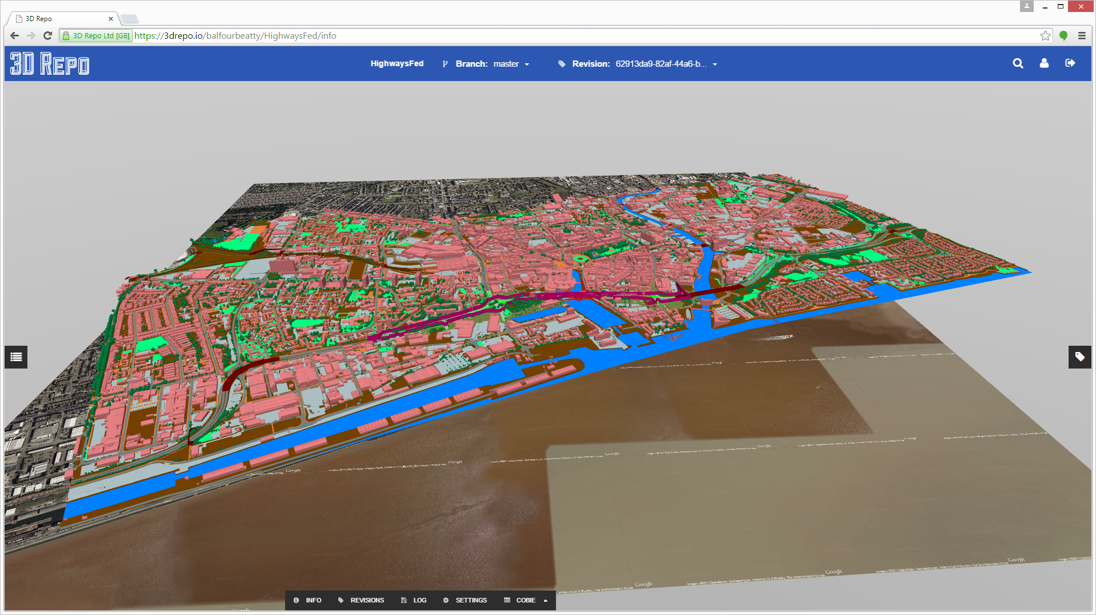
New Map DB Node

Slide 19
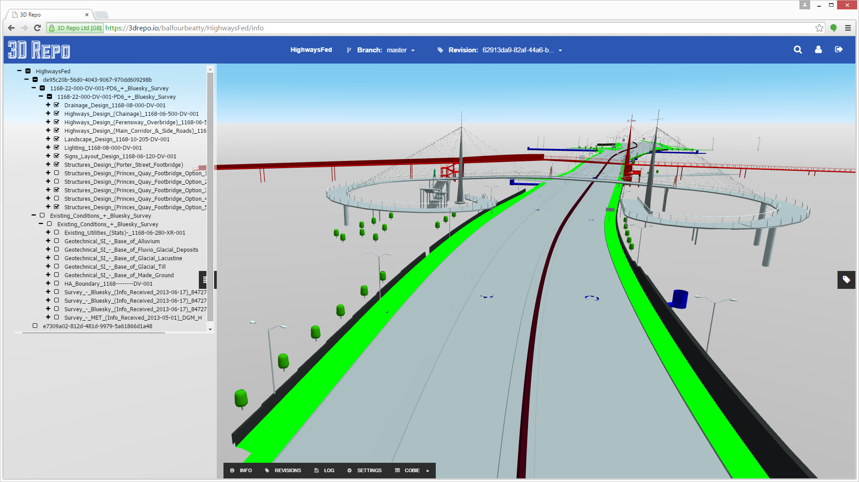
New Federation DB Node

Slide 20
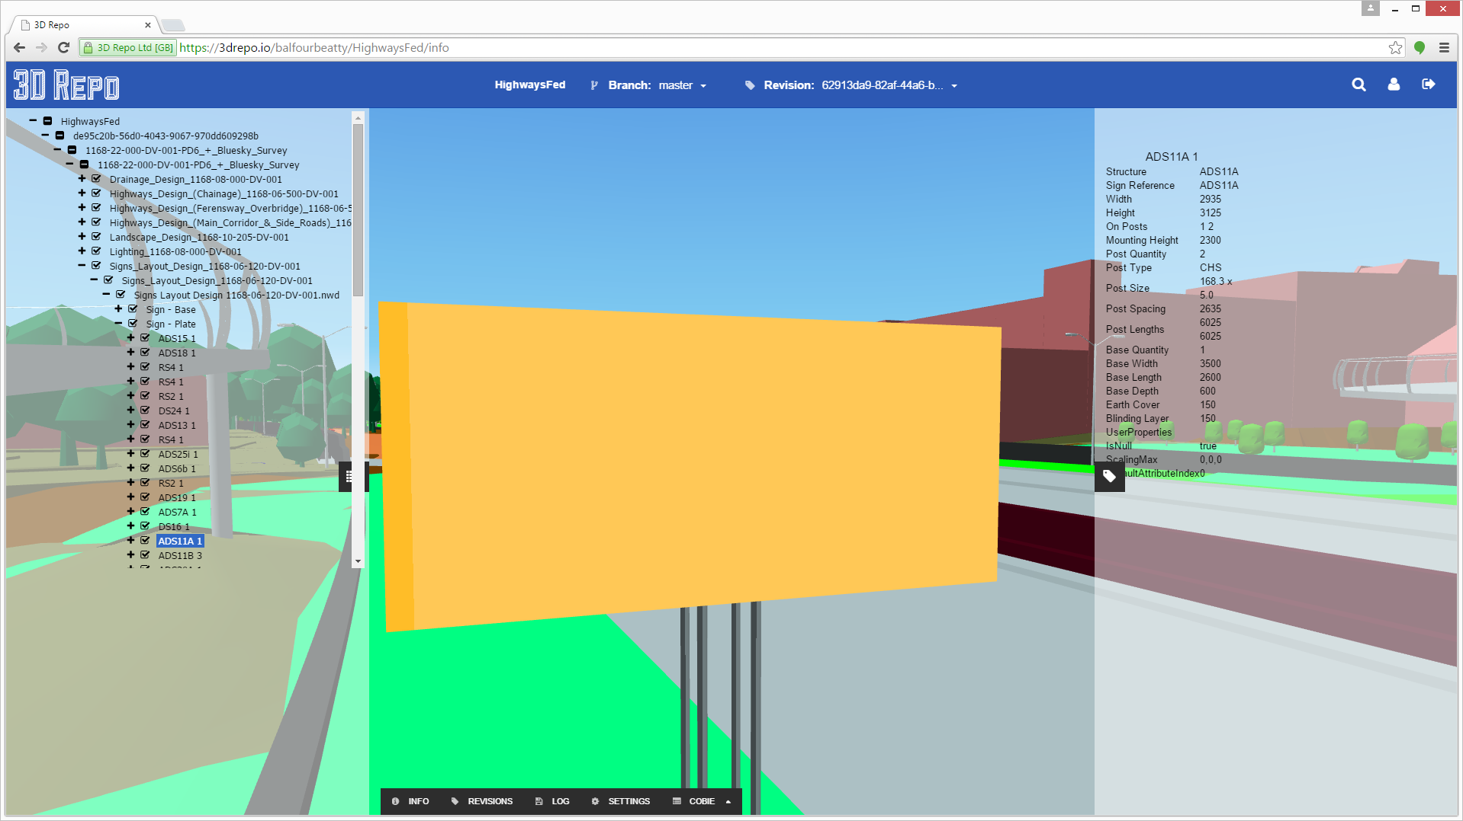
New Metadata DB Node

Slide 21
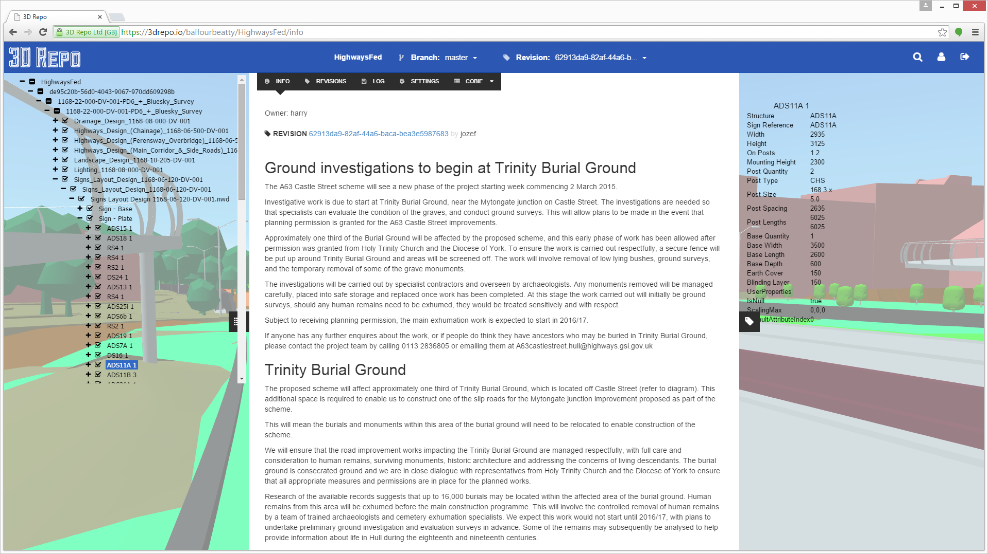
New Project Info

Slide 22
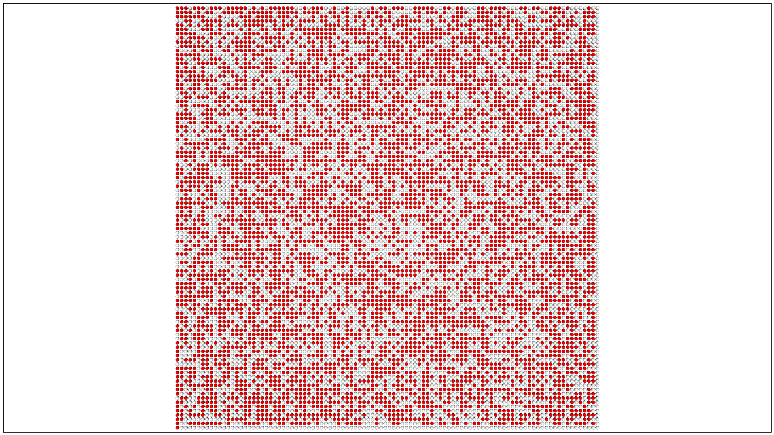
Notes:
10,000 nodes test scene

Slide 23
10k spheres
Notes:
10,000 nodes test scene

Slide 24
.directive('mySwitch', function() {
function link(scope, element, attrs) {
scope.$watch('onLights[' + attrs.id + ']', function(value) {
if (value) element.attr('diffusecolor','red');
else element.attr('diffusecolor','white');
}, true);
}
return {
link: link
};
})
<shape>
<appearance>
<material id="4" diffuseColor="white" my-switch>
</material>
</appearance>
<sphere radius="0.4"></sphere>
</shape>

Slide 25
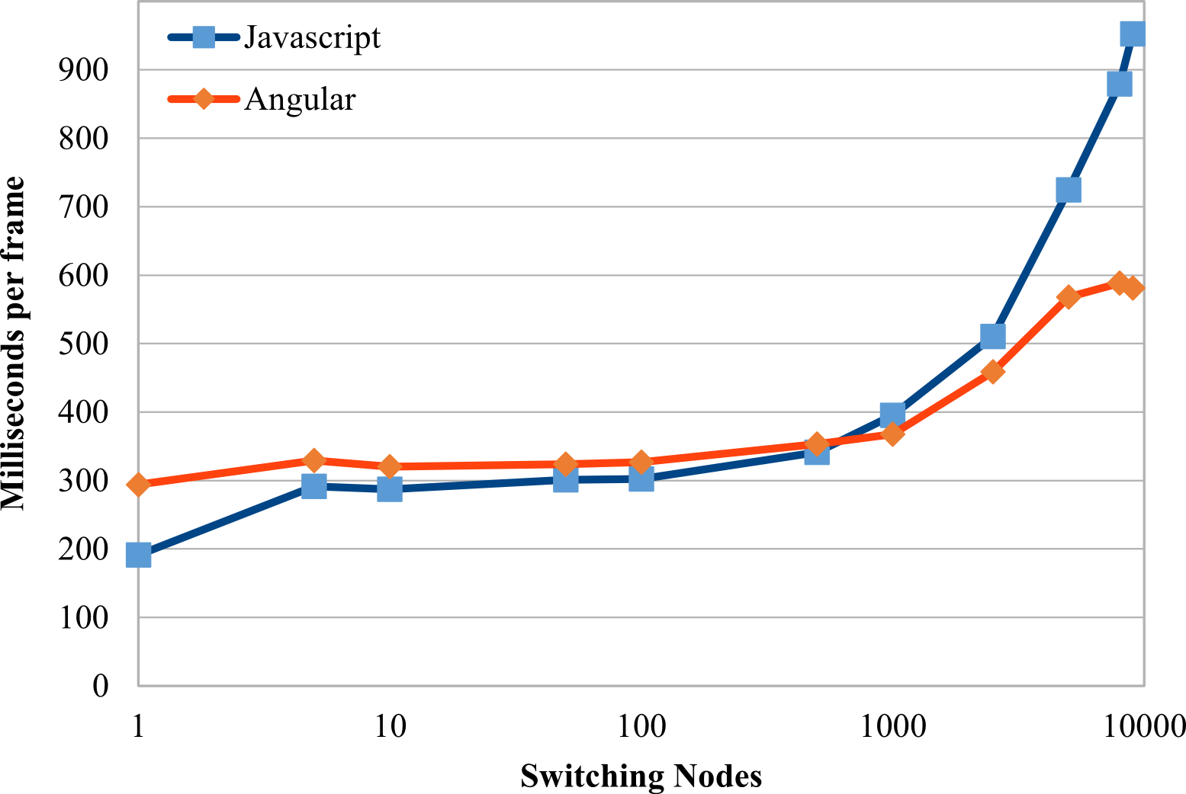

Slide 26
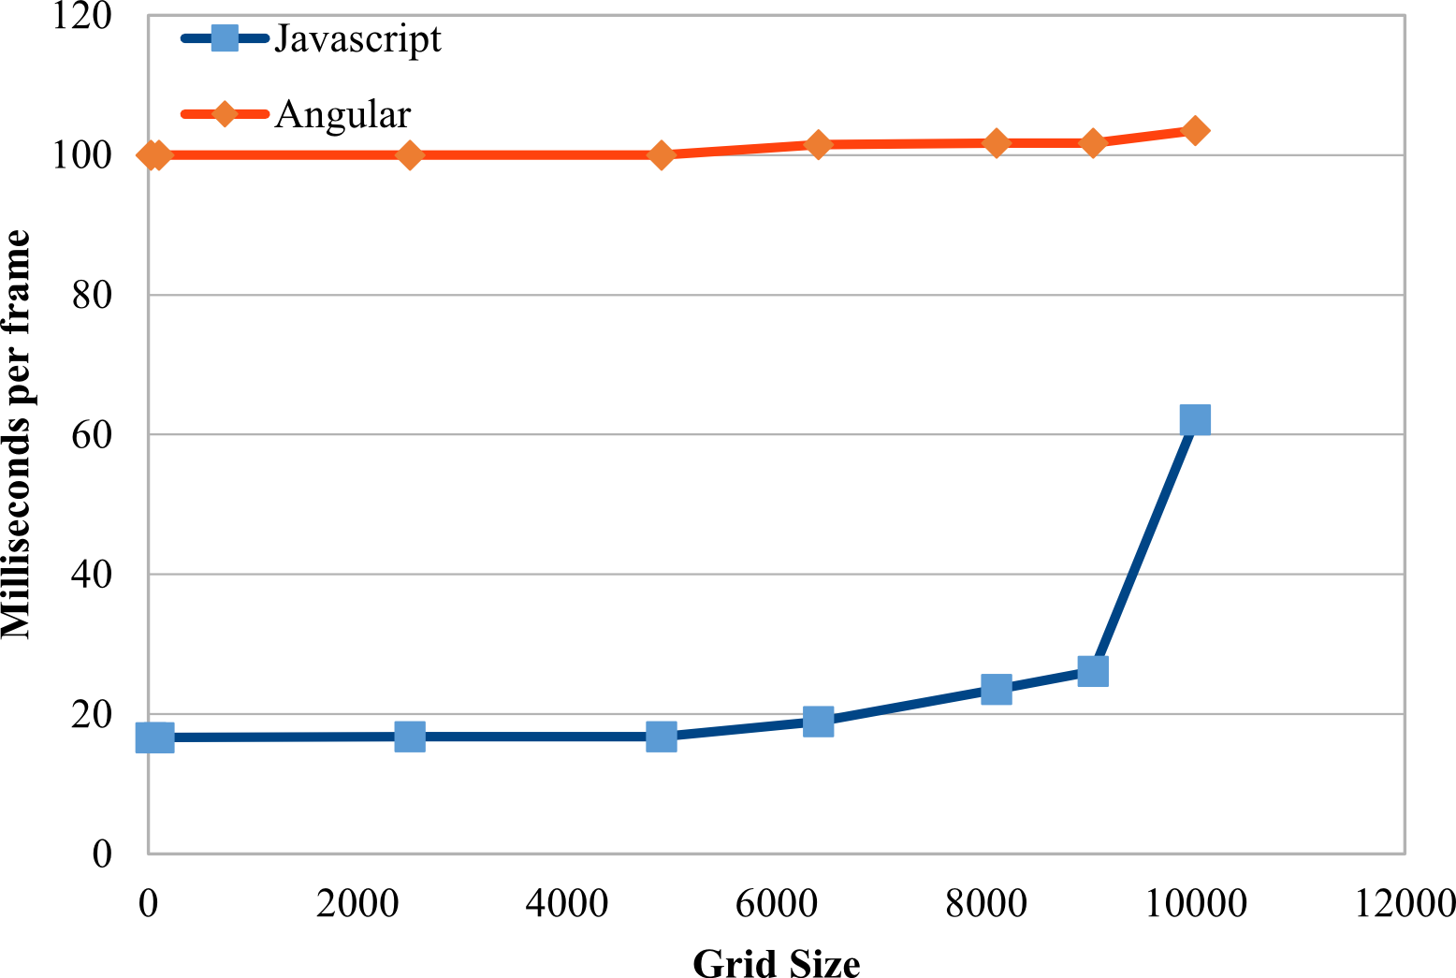

Slide 27
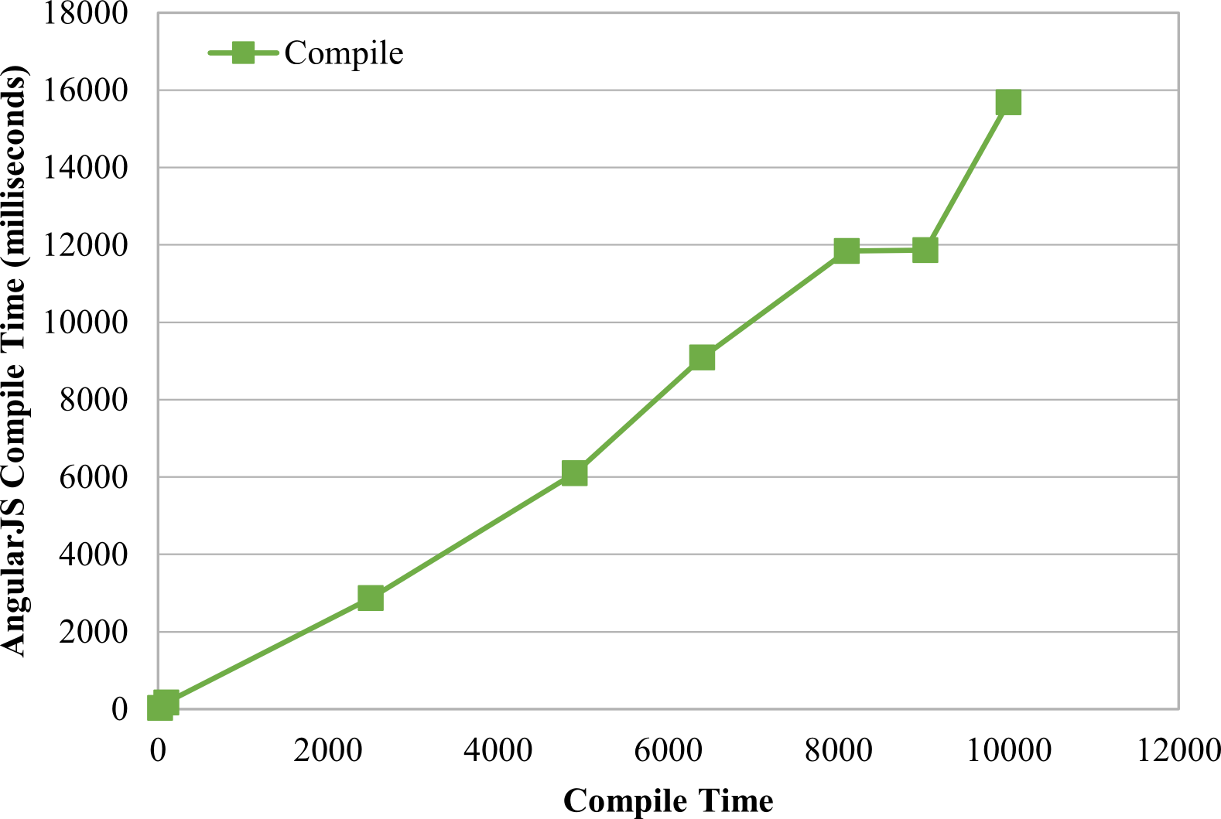

Slide 28
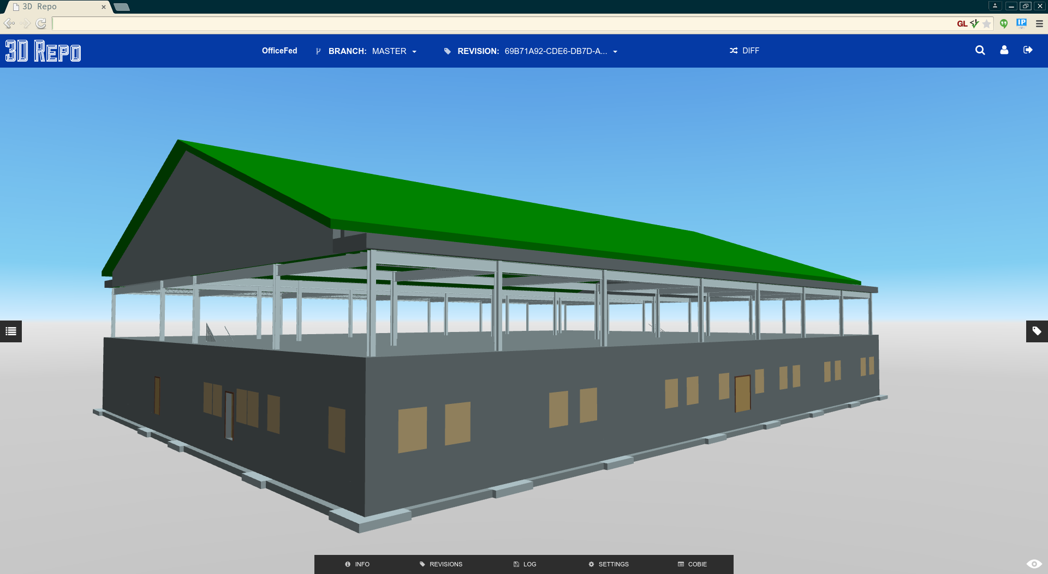

Slide 29
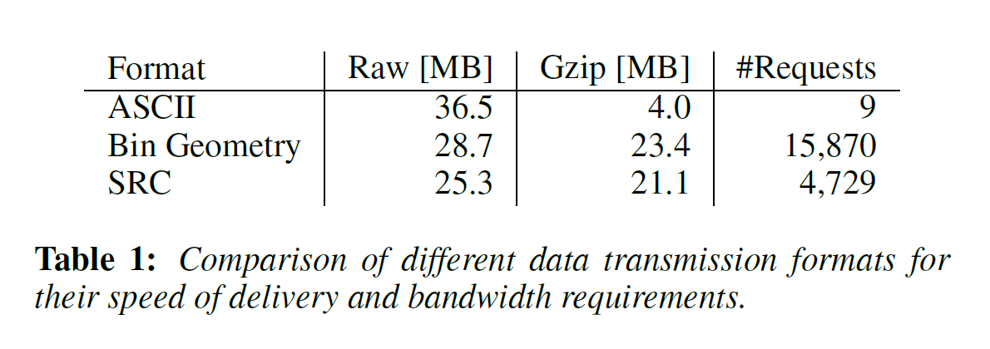

Slide 30
Rest API (XML3DRepo vs 3drepo.io)
XML3DRepo
/:id/:type
/:type/:id
3drepo.io
/login [POST]
/login [GET] Returns OK (200) if logged in, Unauthorized (401) otherwise
/:account/:project [GET] Returns the whole project page
/:account/:project/:uid.:ext [GET] Returns a specific asset
with a Unique ID uid where ext specifies the file format
/:account/:project/revision/:branch/:rid [GET]
/:account/:project/revision/:branch/:rid/:sid [GET]

Slide 31
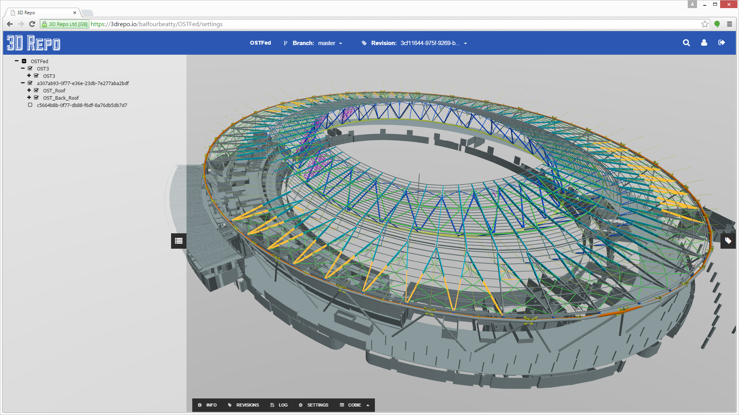
Scene Graph Optimization
Notes:
323,940 scene graph nodes reduced to 880. 8m polys and 450 shapes in X3DOM

Slide 32
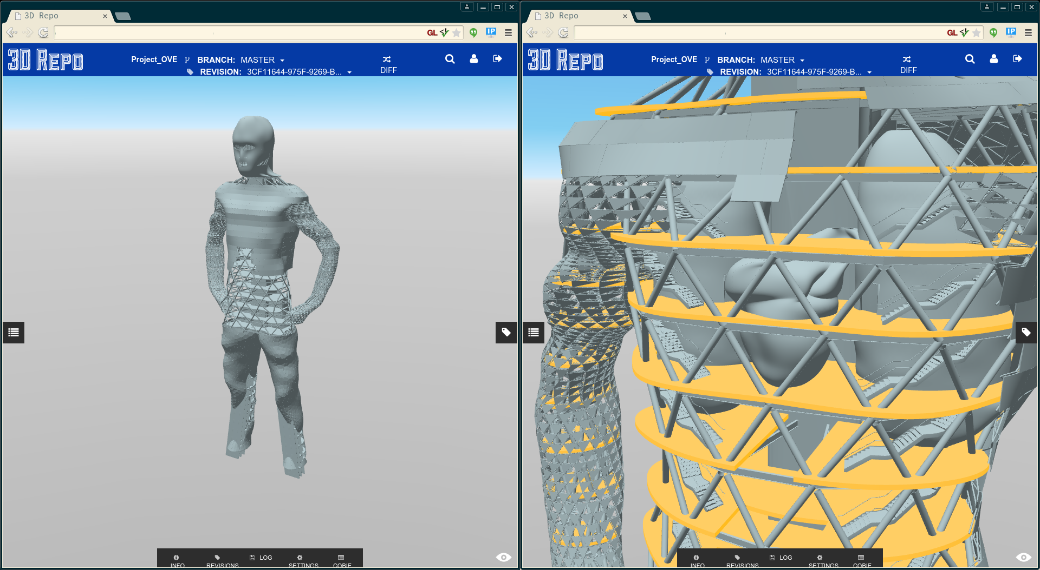
Scene Federation
Notes:
Project Ove

Slide 33
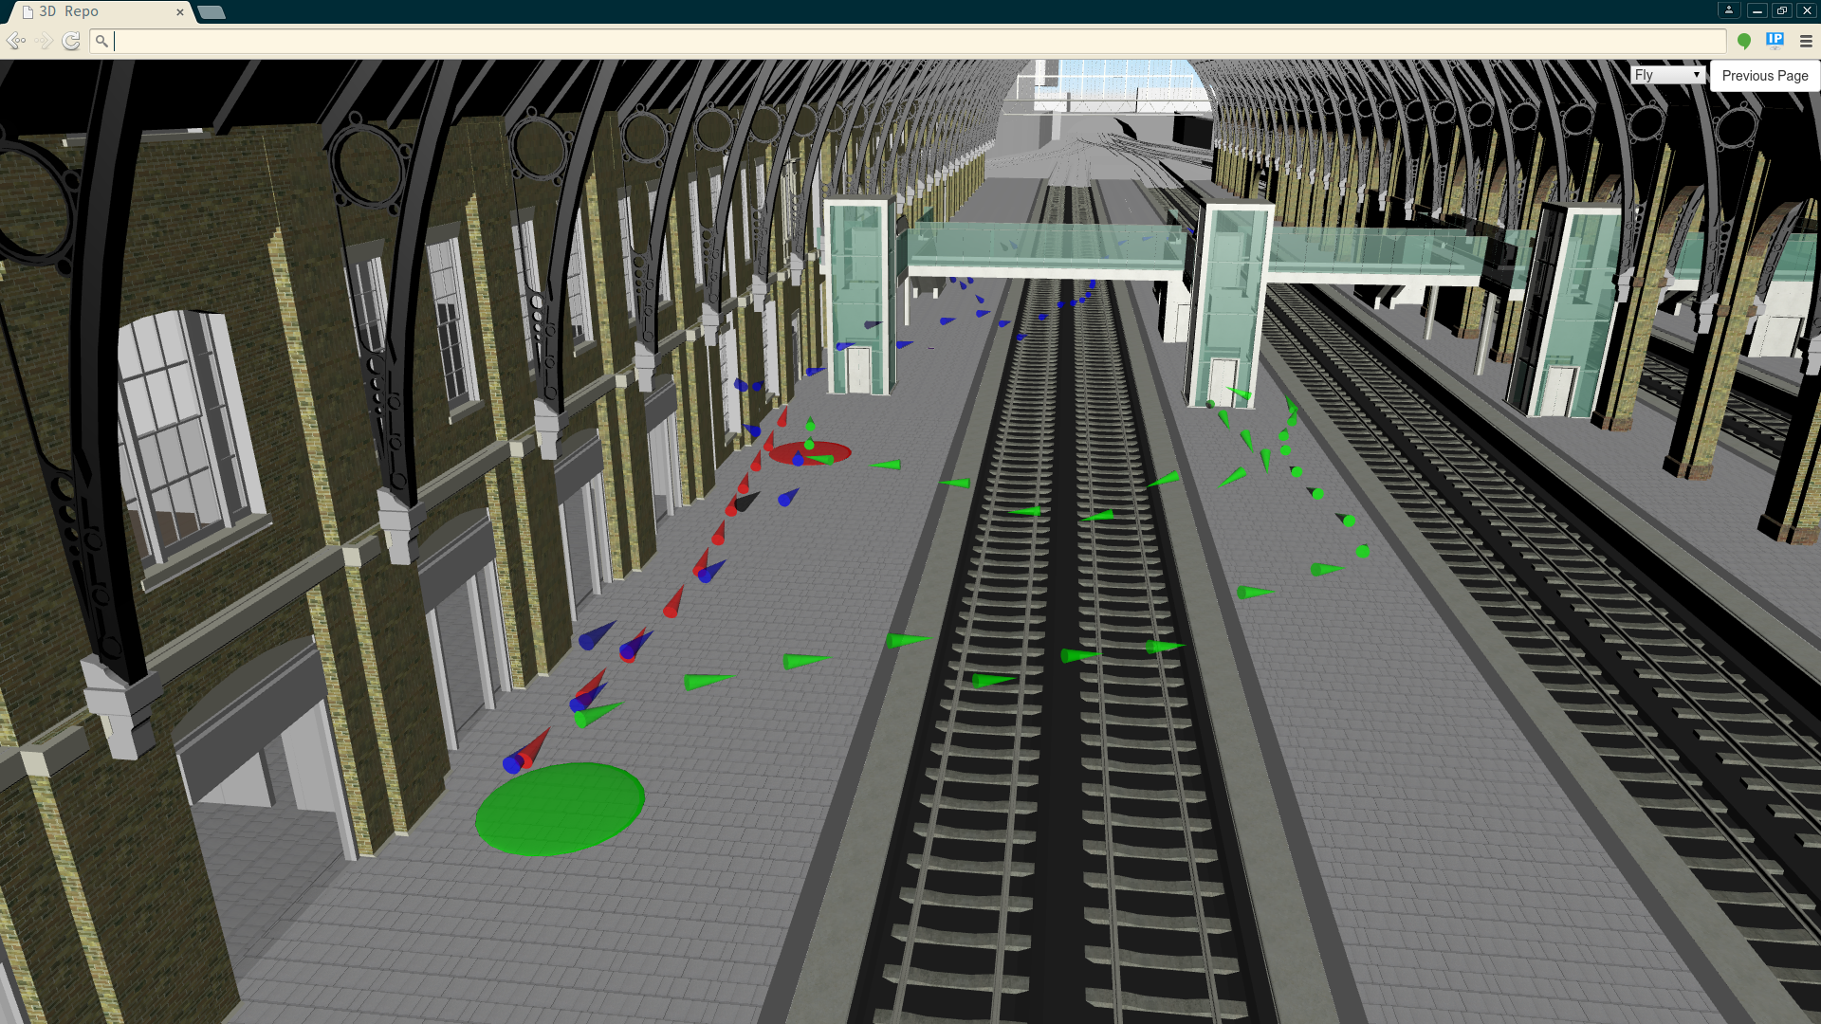
Wayfinding User Study

Slide 34
Conclusions
AngularJS + X3DOM + 3D Repo
Database schema improvements
Novel simplified REST API
Experiments show that:
AngularJS becomes impractical for complex scenes
Suffers from fixed overhead on scene manipulation
Once compiled, outperforms jQuery
SRC provides a balance of requests/file size

Slide 35
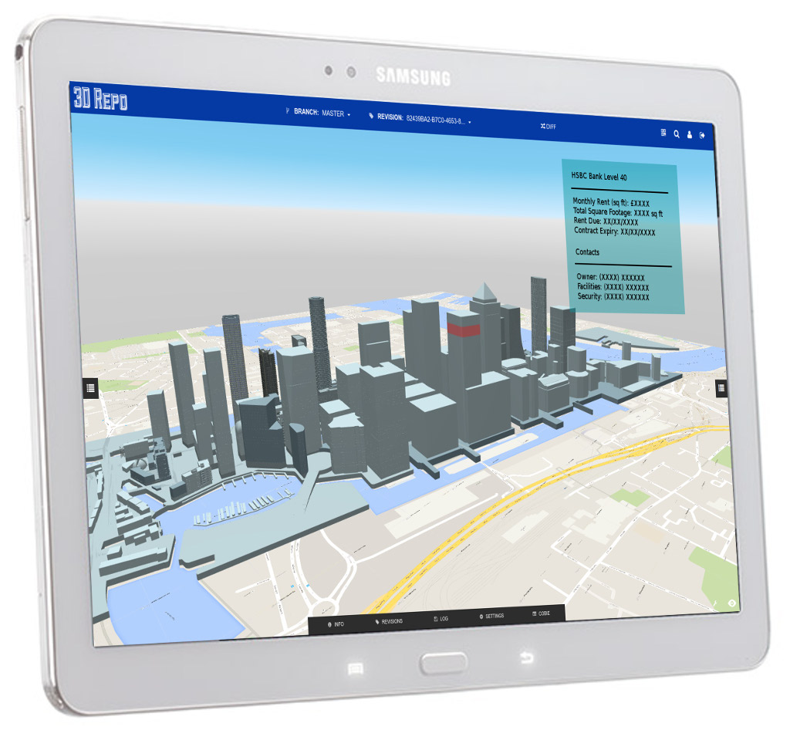

Slide 37
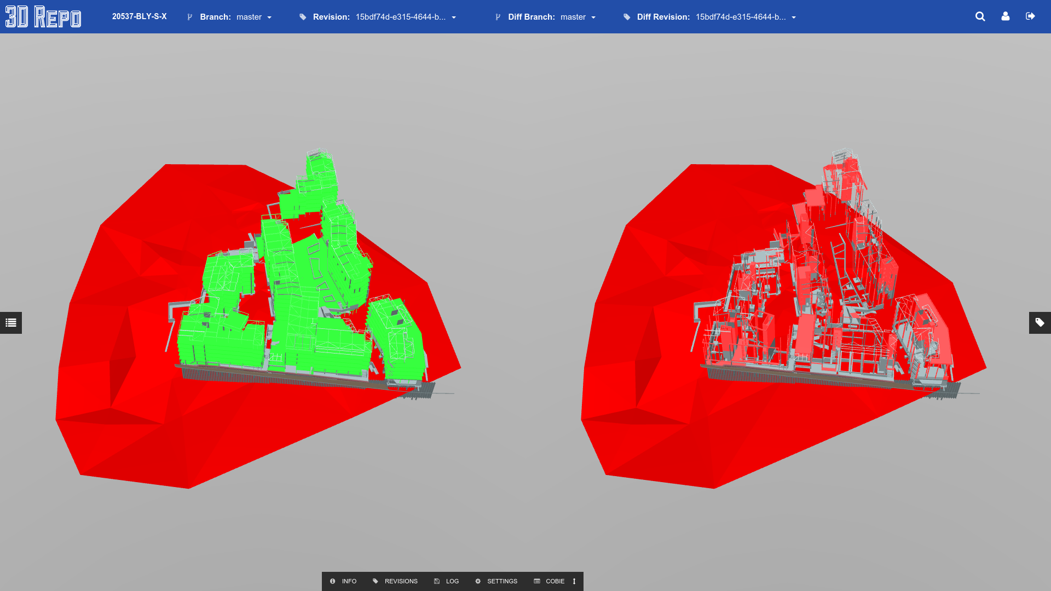
3D Diff

Slide 39
We’re hiring!

Slide 40
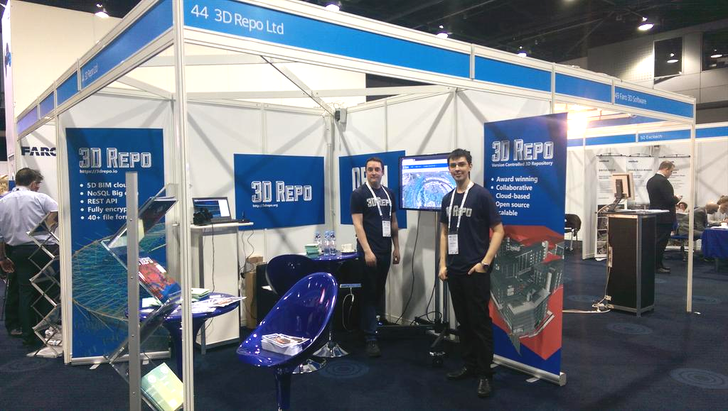
3D Repo Ltd, c/o EIT Digital, 56 Wood Lane, London W12 7SB, UK W: http://3drepo.org | E: sales@3drepo.org | T: +44 (0) 79 8913 2804
Registered in England & Wales No: 09014101 | VAT Reg: GB 206 9090 15
Notes:
And finally us at the UK’s largest BIM Show in Manchester
Thank you very much for listening!

