Slide 1
Synchronized Delivery of 3D Scenes With Audio and Video
Cyril Concolato
Jean Le Feuvre
Emmanouil Potetsianakis
Web3D 2015,
June 20

Slide 2
Synchronized Delivery of 3D Scenes With Audio and Video
Outline
3D Scenes, Audio & Video on the Web
Packaging 3D Scenes in MP4
Demo Application
GPAC
Algorithm for Extracting X3D Scenes
Seamless 3D Rendering
Future Work
20/06/2015
Synchronized Delivery of 3D Scenes With Audio and Video

Slide 3
3D Scenes with Audio & Video on the Web
Favorable Evolutions
HTML5 Elements (audio, video, canvas)
Javascript APIs (MediaSourceExtension, Webaudio)
Hardware acceleration in Graphics (WebGL)
Distribution Methods
3D Scenes loaded statically with webpage
AJAX
Generic Compression/Packaging (e.g. ZIP)
20/06/2015
Synchronized Delivery of 3D Scenes With Audio and Video

Slide 4
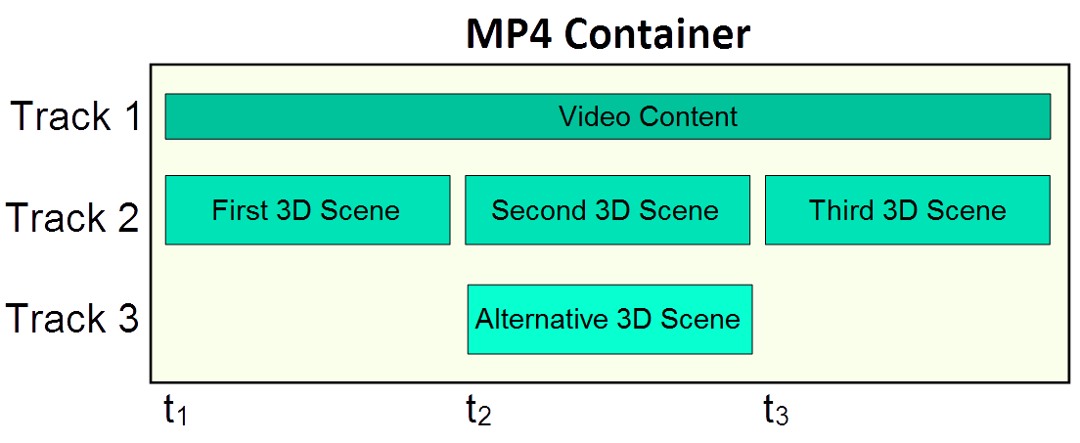
3D Scenes in MP4
Packaging in MP4 containers
How
Dedicated track(s) for 3D
3D Scenes in timestamped samples
Covers common scenarios
20/06/2015
Synchronized Delivery of 3D Scenes With Audio and Video

Slide 5
3D Scenes in MP4
Packaging in MP4 containers
Benefits
Synchronization
Alternative Representations
Streaming capabilities
Delivery options (over DASH, offline etc.)
AV content playable by clients without 3D support
20/06/2015
Synchronized Delivery of 3D Scenes With Audio and Video

Slide 6
Demo Application (for XML-based Scenes)
GPAC Project on Advanced Content - an open source cross-platform multimedia framework.
MP4Box packaging solution
Packaging into ISO file formats
XML support (using NHML descriptors)
DASH-ready content
MP4Box.js browser library
Exposes information of MP4 files
Extract samples from MP4 (for 3D Scenes)
X3DOM - an open-source framework and runtime for 3D graphics on the Web.
20/06/2015
Synchronized Delivery of 3D Scenes With Audio and Video

Slide 7
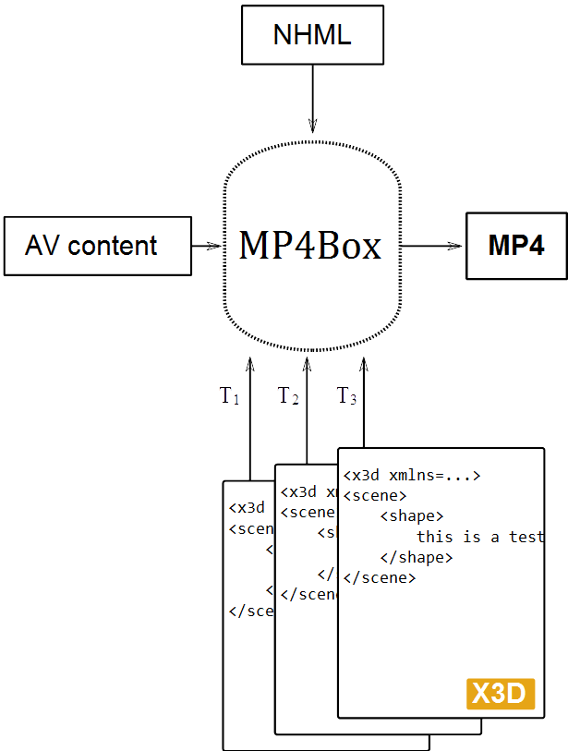
Packaging with MP4Box
Sample NHML file for X3D packaging
<NHNTStream timeScale="90000" mediaType="meta" mediaSubType="metx" xml_namespace="http://www.web3d.org/specifications/x3d-namespace" >
<NHNTSample DTS="0" isRAP="yes" mediaFile="first.x3d"/>
<NHNTSample DTS="900000" isRAP="yes" mediaFile="second.x3d" duration="9900000"/>
</NHNTStream>
20/06/2015
Synchronized Delivery of 3D Scenes With Audio and Video

Slide 8
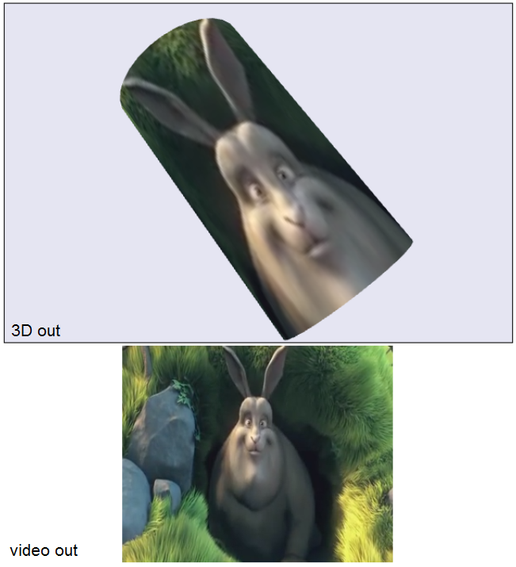
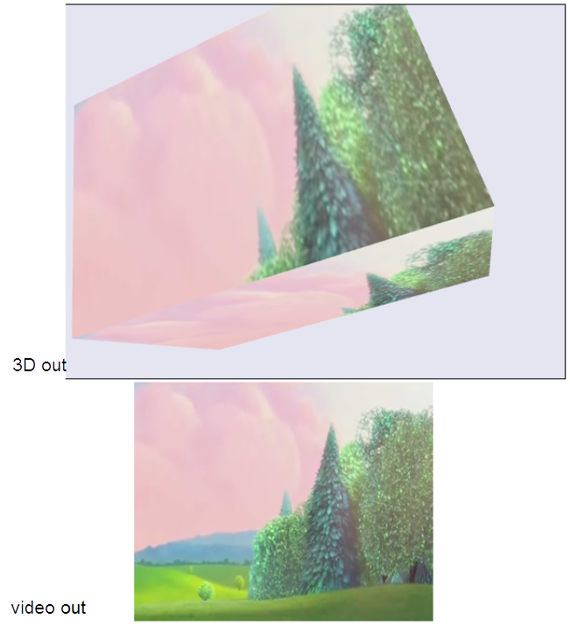
Demo Application Screenshots
20/06/2015
Synchronized Delivery of 3D Scenes With Audio and Video

Slide 9
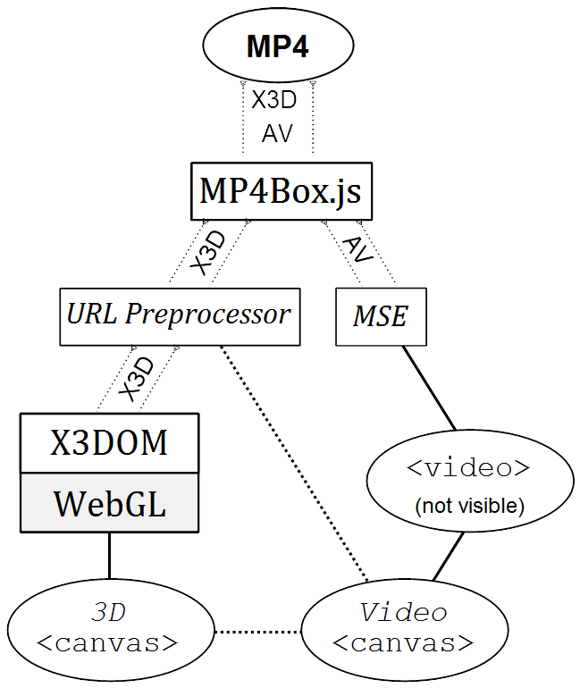
Demo Application Outline
20/06/2015
Synchronized Delivery of 3D Scenes With Audio and Video

Slide 10
X3D from MP4 Algorithm
analyze(MP4File);
foreach track in MP4File {
if(track.type equals "video" or "audio") {
initMSE();
if(track.type equals "video"){
initVideoCanvas(); }
} else if(track.type equals "X3D") {
init3DCanvas(); }
} onSample(s) {
if(s.type equals "X3D") {
foreach node in s.scene {
if(node.textureURL equals MP4File.URL) {
pointTextureURLtoVideoCanvas(node);}
}
createX3DOMScene(s.scene);
if(s.dts/s.timescale equals video.currentTime) {
renderToX3DOMCanvas(s.scene);
}
}
}
20/06/2015
Synchronized Delivery of 3D Scenes With Audio and Video

Slide 11
Seamless 3D Rendering Timeline
20/06/2015
Synchronized Delivery of 3D Scenes With Audio and Video

Slide 12
Future Work
Target Scenarios with stream-based animations (e.g. BIFs)
One track contains the base scene while another the animations
Tackle latency issues with complex 3D Scenes
Render scene backbone and then perform progressive enhancement of the Scene
Analyze scene in background for render time estimation
20/06/2015
Synchronized Delivery of 3D Scenes With Audio and Video

Slide 13
The End
More info:
GPAC: www.gpac.io
MP4Box.js: www.github.com/gpac/mp4box.js
Contact:
firstname.lastname@telecom-paristech.fr
20/06/2015
Synchronized Delivery of 3D Scenes With Audio and Video

