Slide 1
Animation On The Web : A Survey
Amit L Ahire, Alun Evans, Josep Blat
Interactive Technologies Group, Universitat Pompeu Fabra,
Barcelona, Spain

Slide 2
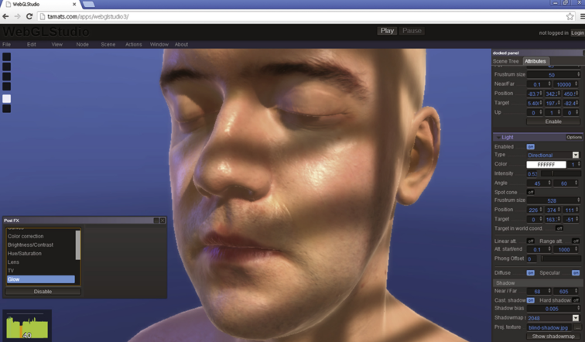
Motivation
Evans et al. [2014] - 3D Graphics On The Web : A Survey
But there was no section on Animation, Why?
Because there is not much work done on Animation on the web. Why?
That’s the motivation!!

Slide 3
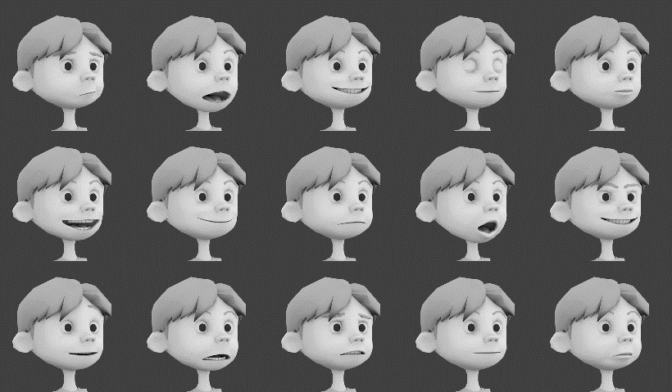
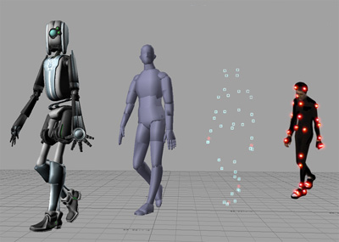
Introduction
Computer Animation is rendering sequence of images.
Interactive, Simulations, Entertainment – Movies and CGI.
Blend shapes, Skeleton rig, Face rig – Bones & transformation
Real time rendering – Problems and Challenges associated with it.
Stating specific challenges for web- based animation.
Survey the state of the art.
Current approaches and possible future trends.

Slide 4
What is Animation?
For Real Time Rendering – Any object should contain
Surface representation of object
Mechanism for generation and fetching of object properties.
Animation of Static Or Rigid Objects :
Animation of Deformable Objects :
Notes:
For Real Time Rendering – Any object should contain
Surface representation of object
Mechanism for generation and fetching of object properties.
Animation of Static Or Rigid Objects :
Applying transformations.
Numerically integrating object properties over time.
Animation of Deformable Objects :
Deformability due to external forces.
Need to consider object’s physical attributes.

Slide 5
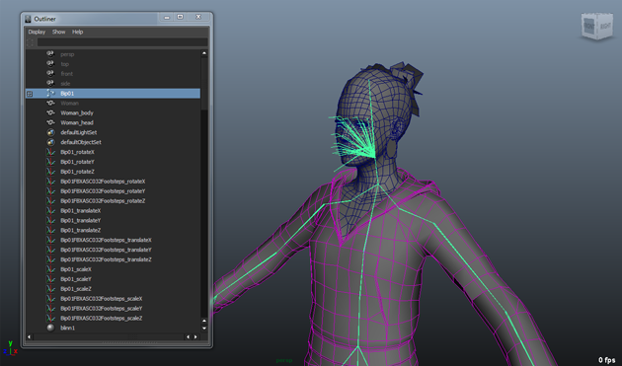
Overview Of Challenges
For successful animation :
Sufficient control points.
Interpolation or extrapolation techniques.
Offline animation - carried out by accessing key frames of
the objects or by using some sort of physical based animation.
Main bottle necks for Web Based / Real Time Animation :
Animation file size and transmission over network.
Techniques to reduce transmission size and
Need to apply efficient compression algorithm and Level Of Detail techniques.
Notes:
For successful animation :
sufficient control points and rules create the key frames.
Interpolation or extrapolation techniques subsequent frames are generated.
Offline animation maybe carried out by accessing key frames of the objects or by using some sort of physical based animation.
But for Web Based / Real Time Animation :
Main bottle necks – Animation file size and transmission over network.
Employ techniques to reduce transmission size and
Need to apply efficient compression algorithm and Level Of Detail techniques.

Slide 6
Main Aspects Of Real Time Animation
Transmission Of Data
Compression and Preprocessing
Rendering

Slide 7
Transmission Of Data
Transmission of 3D data – usually a two step process
Object structure is sent to the client.
Handling and processing of data at the client end.
Lots of compression and transmission technique for static 3D object.
Which “can be” extended to animation files.
But there is lack of uniformity among various techniques and technological standards on the web.
Notes:
Explain lack of uniformity.

Slide 8
Challenges - Transmission Of Data
Transmission Of data uses basic protocols such as TDP and UDP.
Basic problem associated with these protocols :
Latency
Accuracy
Bandwidth
Nowadays mobile devices are equipped with so much processing power : Problem depends on network bandwidth and how the transmission is structured.
Notes:
Devices are equipped with so much processing power that the negative impact on the interactivity of the application mostly depends on network bandwidth and how the transmission is structured
Animation of 3D objects requires transmitting extra data than compared to a static scene.
Transmission Of data uses basic protocols such as TDP *Transmission Control Protocol* and UDP *User Datagram Protocol*.
Basic problem associated with these protocols :
Latency – Can be perceived as time needed to fully refine 3D object since application start up.
Accuracy
Bandwidth – Mobile network still largely suffers from low bandwidth.
Devices are equipped with so much processing power : Problem depends on network bandwidth and how the transmission is structured

Slide 9
Challenges - Transmission Of Data
Important - data is transmitted in structured manner.
Generally methods :
Decimate and employ a spatial structure
Split the 3D object and transmit in structured manner.
The exact method depends on the requirement.
There is a need for schema-less, encoding agnostic, structured format.
Notes:
Important - data is transmitted in structured manner and there is minimum possible interaction between server and client.
Generally methods are used which can decimate the whole 3D objects and employ a spatial data structure to traverse the structure for various LOD
Another would split the 3D object in coherent manner and transmit in structured manner.
The exact method depends on the requirement – There is a need for schema-less, Encoding agnostic, structured format.

Slide 10
Current Approaches - Transmission Over The Web
Textual Representation & Binary Transmission – JSON and XML.
Image Based
Sequential Image Geometry (SIG) - Quantization & Progressive Loading
Domain Based : OpenCTM; WebGL-Loader etc.
Notes:
Binary Transmission : Data is transmitted by encoding it in textual formats (XML or JSON). External data is requested using a XMLHttpRequest (XHR) request separately.
Image Based : Mesh data is encoded into images. Which can be provide us with the opportunity to use the GPU power.
Image decoding is done natively in the browser, totally bypassing any JavaScript based decoding.
Sequential Image Geometry (SIG) extends this approach further by adding quantization and progressive loading.
Domain Based : Different kind of 3D data requires different techniques – OpenCTM; WebGL-Loader are lossless. But these methods are comparatively slower than image based GPU solutions.

Slide 11
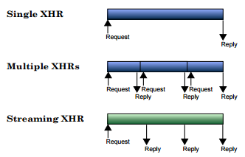
Future Trends - Transmission
Web is in need of a binary transmission format for 3D data.
Domain specific solution.
Standard compression algorithm.
Key aspects would be:
Reduce number of requests to the server.
Caching strategies
Websockets
Gobbetti et al [2012] proposed a images based mesh description format – Build a tight atlas map of the mesh geometry.
Extracted from : LIMPER, M., THÖNER, M., BEHR, J., AND ELLNER, D.W. 2014 – “SRC - a stream able format for generalized web-based 3D data transmission.”
Notes:
domain specific solution or a standard compression algorithm
X3DOM – BinaryGeometry node.
Web is in need of a binary transmission format for 3D data. Which provides either a domain specific solution or a standard compression algorithm.
HTTP 2.0 – Progressive Streaming
Key aspects of this :
Reduce number of requests to the server.
[Limper et al 2014] aims to minimize the number of HTTP requests by progressively transmitting an arbitrary number of mesh data. (Using a SRC File – Which contains the reference to all the resources of data.)
Another approach to solve the bandwidth problem is to use the caching strategies – But requires bi-directional communication which is not available in HTTP protocol.
Websockets – Can improve the latency and supports full duplex communications channels.
Gobbetti et al [2012] proposed a images based mesh description format – Build a tight atlas map of the mesh geometry.

Slide 12
Main Aspects Of Real Time Animation
Transmission Of Data
Compression and Preprocessing
Rendering

Slide 13
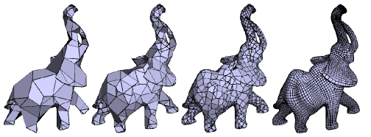
Compression & Preprocessing
Every mesh and its animation data is defined by
Geometry; 2) Connectivity; And 3) Texture/Colour data.
Different types of Compression :
Single Rate Compression
Progressive Compression
Notes:
Every mesh and its animation data is defined by
1) Geometry; 2) Connectivity; And 3) Texture/Colour data.
Different types of Compression :
Single Rate Compression
Encodes and Decodes the 3D object as a whole.
Removes redundancy in the datasets.
Employs good compression ratio but unsuitable for networking.
Progressive Compression
Refinement over time.
Main Idea – Transmit a crude approximation first then generate refinement of mesh progressively.

Slide 14
Current Approaches - Compression & Preprocessing
During decoding the connectivity of geometry is reconstructed incrementally from the transmission stream.
Advantage - Minimal wait time.
LOD : Reduction of quality and detail of the mesh in interactive applications.
Mesh & Animation LOD : Representation of Object based on their distance from the camera
Deformation Sensitive Decimation (DSD) by Mohr and Gleicher [2003]
Pilgrim et al.[2006] - Progressive Skinning .
Mukai and Kuriyama [2007] introduce the idea of motion level of detail using an LOD control.
Notes:
LOD : Reduction of quality and detail of the mesh in interactive applications. Progressive meshes [Hoppe 1996] :
Mesh simplification process;
Exploiting progressive transmission and decompression schemes.
Mesh & Animation LOD : Representation of Object based on their distance from the camera
Deformation Sensitive Decimation (DSD) by Mohr and Gleicher [2003] was based on the idea of QEM *quadratic error metric. * [Garland and Heckbert 1997] for measuring the cost of edges.
Evaluate potential collapses • Determine optimal new vertex locations
Pilgrim et al.[2006] present Progressive Skinning – A view and pose independent methods for automatic skeleton simplification for the methods given in [DeCoro and Rusinkiewicz 2005].
Mukai and Kuriyama [2007] introduce the idea of motion level of detail using an LOD control method of motion synthesis with a multilinear model.

Slide 15
Compression & Preprocessing
Improving quality of level of detail is more important than being clever & gaining a few extra bits.
Wen et al. [2014] presents similarity aware 3D model reduction method. Which uses a Lightweight Scene Graph (LSG) – doesn’t require any decompression at the client end.
Compression and Preprocessing needs to rely on simple and effective algorithm.
Notes:
The objective of progressive compression is to speed up the transmission over the network.
But if decompression take long on the client side, then there is no point in applying fancy techniques and data structures

Slide 16
Main Aspects Of Real Time Animation
Transmission Of Data
Compression and Preprocessing
Rendering

Slide 17
Challenges - Rendering
WebGL (Imperative Approach) uses HTML5 canvas and JavaScript to expose the low level OpenGL ES 2.0 Implementation.
Large Memory footprint
DOM onProgress event : Used to use time based event, Better to have a trigger based on event.
Current limitations is with the specification of the API.
Indexed 16 bit array : Not anymore.
Texture : Extensions
Notes:
WebGL (Imperative Approach) uses HTML5 canvas and JavaScript to expose the low level OpenGL ES 2.0 Implementation.
Large Memory footprint of the declarative languages : WebKit and Mozilla currently store the full text representations of all vertex data in the DOM, which increases the memory footprint.
DOM onProgress event : Used to use time based event, Better to have a trigger based on event.
Indexed 16 bit array : Current limitations is with the specification of the API.
glDrawElement() - limiting it to a maximum of 65536 vertices.
(Easily elevated using extensions)

Slide 18
Rendering Animation
A coarse representation is rendered on the screen after the minimal transmission.
As more data and information is downloaded, the compressed animation is refined. Mostly these refinement methods can be classified into
Connectivity updating.
Geometry updating.
Reduce state changes - mesh data in a single image (either a texture atlas or map)
Notes:
For rendering progressive animation in WebGL, a coarse representation is rendered on the screen after the minimal transmission
As more data and information is downloaded, the compressed animation is refined. Mostly these refinement methods can be classified into
Connectivity updating - which changes the feature shapes of an animation, and
Geometry updating – which changes the complexity of the object.
Reduce state changes - One approach to reduce the vertex buffer switches, is to have all the mesh data in a single image (either a texture atlas or map)

Slide 19
Future Trends – Rendering
Parallelism of JavaScript :
JavaScript is single-threaded.
WebWorkers.
Leverage the power of GPU – Using WebCL and River Trail.
WebGL 2.0 : Specification approaching release. Equivalent to OpenGL ES 3.0
Occlusion Query; Transform Feedback; Multiple Render Targets.
Stein et al [2014] uses some of these features visualize medical data on the web.
Texture Compression.
Notes:
Texture can also contain other data which can helpful for rendering.
Parallelism of JavaScript :
JavaScript is single-threaded . Large amount of data processing can stall the performance.
WebWorkers – Takes care of some task in the background and passes the processed data to the main thread using message passing.
Another way to leverage the power of GPU – Using WebCL and River Trail.
WebGL 2.0 : WebGL 2.0 specification approaching release. Equivalent to OpenGL ES 3.0
Major Features Include :
Occlusion Query; Transform Feedback; Multiple Render Targets.
Stein et al [2014] uses some of these features visualize medical data on the web.
Texture Compression :
It can drastically reduce the amount of memory consumption in a 3D scene.
WebGL supports many compression extensions – Which allows for direct upload of the compressed textures on to the GPU without the need of any processing step.

Slide 20
Conclusion
Very little work is done on bringing animation on the web.
Open challenges -
Proper transmission format for animation data.
Protecting intellectual data post transmission.
Currently lots of research being done on rendering on the web.
Notes:
An overview of state of the animation over the web.
Very little work is done on bringing animation on the web. Most of the work is focused on static and multiresolution meshes, which are extended to animation files.
Open challenges present in the context – Such as
Proper transmission format for animation data.
Protecting intellectual data post transmission.
Currently lots of research being done on rendering on the web. WebGL 2.0 and other new specification can provide new avenues for the future.

Slide 21
Thank You!
Questions?

