Slide 1
X3D Roadmap … for discussion please!
Don Brutzman
with many inputs from
Web3D Board of Directors and X3D Working Group
Web3D 2015 Conference, Heraklion Crete Greece, 18 June 2015

Slide 2
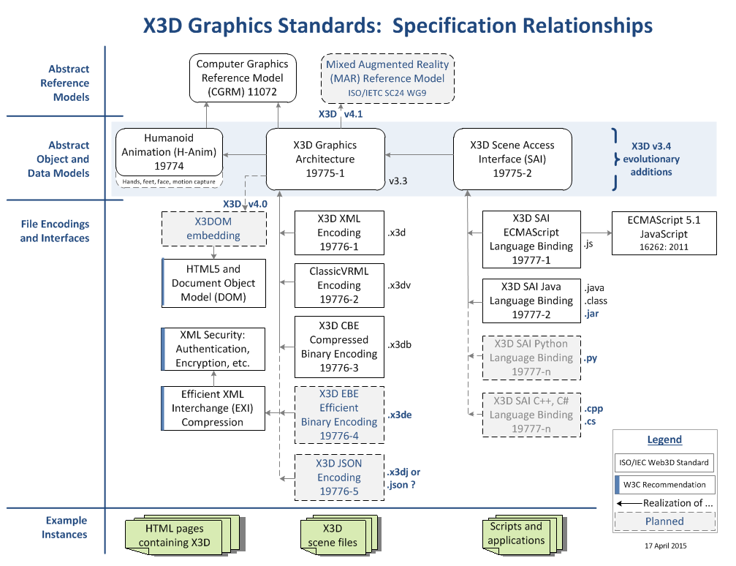
X3D Specification Relationships

Slide 3
X3D Specification Roadmap
spec | X3D v3.4 | X3D v4.0 | X3D v4.1 | X3D EBE | X3D JSON | H-Anim v2.2
what | Continued evolution of scene-graph capabilities | X3DOM + HTML5 + CSS + JavaScript for Open Web Platform | ISO Mixed Augmented Reality (MAR) Reference Model | Efficient Binary Encoding: | Encoding for JavaScript Object Notation | Anatomical completeness hands/feet/face plus improved animation
goal | Evolution | Deployment | AR and VR | Compression and Streaming | Developers | Animators
with | Numerous capabilities to match evolving landscape of 3D graphics | Authors can publish with complete confidence | Promotion path for fully mature v3.4 capabilities | src Shape Resource Container; are glTF mods or separate spec needed? | Loaders usable by JavaScript library APIs (e.g. Three.js) | MOCAP motion capture: convert BVH streams to interpolators
 | Additional support for server side? | Industry can count on deliverability, business can place dependable bets | WebAudio spatialized sound? | Efficient XML Interchange Recommendation | Data-driven visualization (e.g. d3.js) | Music video competition?
 | Review node catalogs of implementers | Developers have clear targets for deploying results |  | X3D Security: Digital Signature and Encryption | Round-trip interoperability and reuse | Metadata for medical records
when | 2015-2016? | December 2015 | 2016 | 60% | 50% | 40%

Slide 4
CAD Working Group
Much work on X3D for Secure Printable Models
3D printing, 3D scanning, additive manufacture (am)
Metadata embed: licensing and usage, references, pedigree, parts availability, interactive engineering tech manuals (IETM), PLM hooks, CAM usage
Cybersecurity: Confidentiality, Integrity, Availability of physical data through XML Encryption, Signature and compression
Architecture Engineering Construction (AEC) and Building Information Models (BIM): similar patterns

Slide 5
H-Anim Working Group
Medically correct definitions for hands, feet
Modeling human faces
Conversion of motion-capture (mocap) data from BVH streams into X3D interpolators
Various utility tools
Considering 3D Music Video contest
Explore application of DICOM metadata norms to captured/scanned human anatomy models, prototype X3D medical records

