Slide 1

X3D Distributed Interactive Simulation (DIS) Implementation and Run-Time Discovery of New Entities using X3DOM
Don McGregor, Byron Harder, Don Brutzman .
Modeling, Virtual Environments Simulation (MOVES) Institute
Naval Postgraduate School, Monterey California
Web3D 2015 Conference, Crete Greece
18 June 2015

Slide 2
Topics
Standards Approach for Networked Virtual Environments (NVEs)
  X3D, JavaScript, X3DOM and WebGL
  DIS, WebSockets and WebRTC
  Geospatial and Modeling Conventions
X3DOM source for X3D DIS component
Performance and Demonstration
Conclusions and Future Work

Slide 3
Standards-Based Approach for
Networked Virtual Environments (NVEs)
Motivation: Web is the real NVE
  Everything else is smaller
Twenty five year challenge
“Break out” time!

Slide 4
X3D, HTML5 and JavaScript
Multiple technologies need to be aligned
X3D and Script node
HTML and scripts
Bridging event models between X3D, HTML
X3DOM implementation, X3D v4 strategy
  http://x3dom.org
  http://web3d.org/standards

Slide 5
IEEE Distributed Interactive Simulation (DIS) Protocol
Network protocol, IEEE standard since 1995
  IEEE 1278 is a communications standard for physically based distributed simulations
  Standard defines binary layout of messages used to transmit simulation information
  Often used in military applications since IEEE 1278 covers a wide range of data: entity location, velocity, and orientation, and more features such as signal and supply support
  Civilian applications: air-traffic control, etc.

Slide 6
DIS protocol and X3D
  IEEE Distributed Interactive Simulation (DIS) protocol has been used for many years to build networked simulations that share state
  X3D DIS component aligns these capabilities with X3D scenes to enable sharing of state data
  EspduTransform: protocol data units (PDUs) for EntityState, Collision, Fire, Detonation
  Signals: ReceiverPdu,SignalPdu,TransmitterPdu
  Real-time discovery, display of new entities: DISEntityManager, DISEntityTypeMapping
  Tutorial slides X3D for Advanced Modeling, DIS

Slide 7

  WebSockets Networking
IETF/W3C standard API
  RFC 6455 et al. (Wikipedia)
  Language agnostic, includes JavaScript API
Technical summary:
  TCP-like sockets for web browsers, http/https
  Reliable connection-oriented, provides framing
  Client-server architecture (not peer-peer)
  No broadcast or multicast
Browser support excellent (including mobile)

Slide 8






WebSockets diagram
A TCP socket is established
from the web browser
to the server, and state
updates relayed through
the server

Slide 9
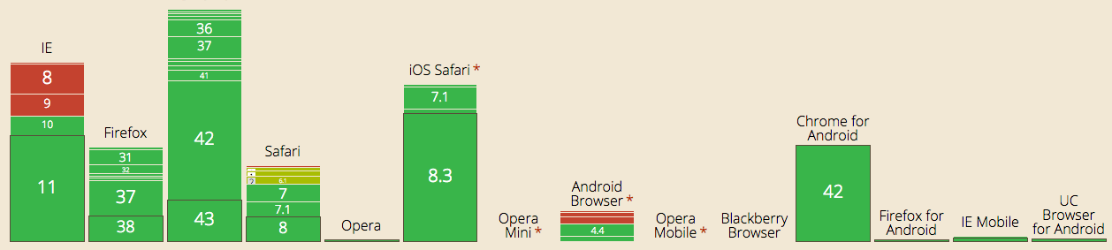
WebSockets Browser Adoption
~85% of deployed browser user base can use WebSockets, including mobile
http://caniuse.com/#feat=websockets

Slide 10

WebRTC Networking
IETF/W3C standard API
  RFC standards still in development
  Language agnostic with JavaScript API
Browser support growing (including mobile)
Technical summary:
  UDP-like sockets for web browsers; encrypted
  Best effort (e.g. “unreliable”) message-oriented, acceptable to drop packets
  Client-server or peer-peer (rendezvous point)
  No broadcast or multicast

Slide 11

WebRTC diagram
Initial signaling step using
external rendezvous service
allows browsers to find each
other
After signaling step, direct browser-to-browser
communication of data possible using WebRTC UDP

Slide 12
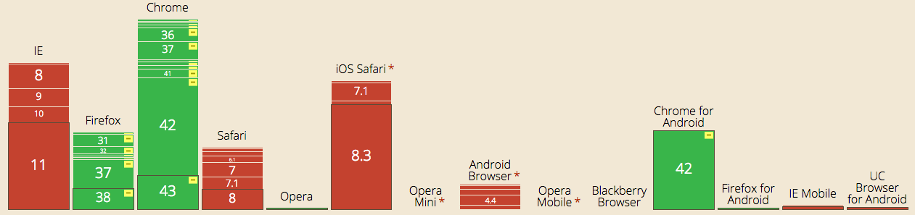
WebRTC Browser Adoption
~ 50% of installed browser user base is capable of using WebRTC
http://caniuse.com/#search=WebRTC

Slide 13
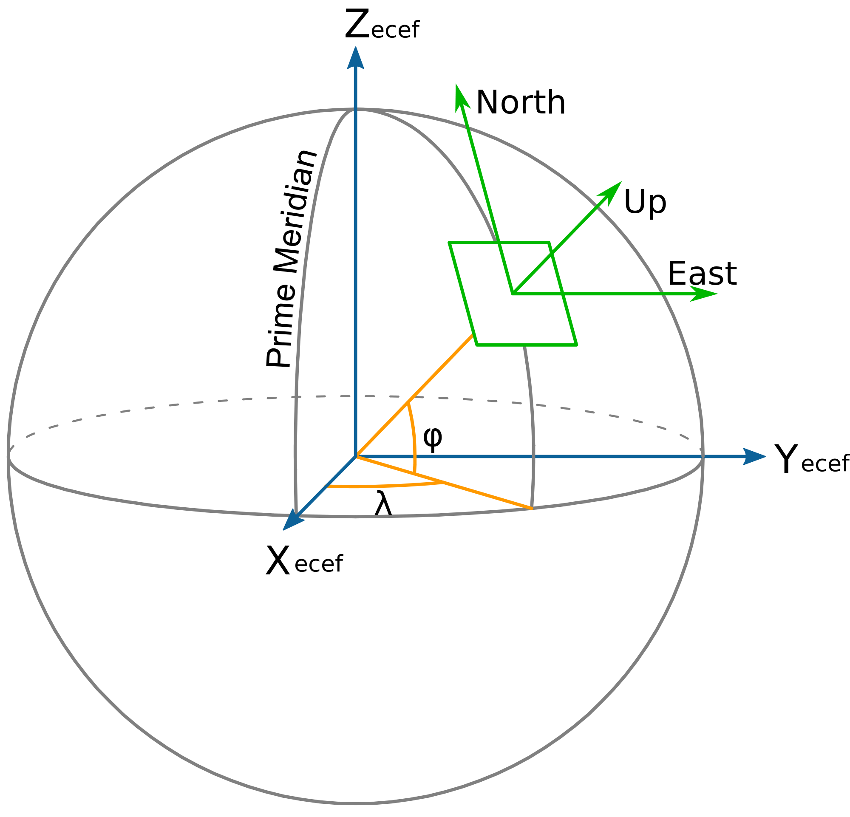
  Geospatial Conventions
DIS Coordinate System
Uses WGS84 Geocentric coordinate system (only)
Problem: missing geospatial conventions
X3D: WGS84 and other datums allowed
Many different terrain models in the heterogeneous DIS application domain
Caveat tester: current prototype uses “flat earth” coordinates, clamped data inputs to surface

Slide 14
Modeling Conventions
DIS
  Orientation: Euler angle rotations from geocentric earth fixed world coordinate system to body coordinate system
X3D
  Orientation convention: X nose, Y up, Z RHS
  X3D Scene Authoring Hints collects numerous “best practices” for compatible, scalable models
  Savage Developers Guide lists our design patterns for configuration and setup

Slide 15
Performance
Chen-Fu Hsiao thesis 2014 looked at WebSocket & WebRTC performance in a 3D environment
  Significant performance differences between browsers at the time of publication; this is likely to converge as implementations mature
Approximately 5000 messages per second can be achieved with commodity desktop/laptop; low value of ~2000 messages per second with some implementations of WebRTC, likely due to immature browser implementation. Some test results > 10K PDUs/second !!
That is a LOT of state transfer possible!
  Enough for numerous networked games and NVES
Further scalability possible through server-to-server bridging and filtering, area of interest management, etc.

Slide 16
Demonstrations available
Web-Enabled DIS Maps with Websockets
https://track.nps.edu
Simple text HTML
GoogleMaps API
Three.js
X3DOM

Slide 17
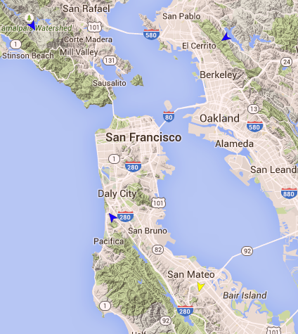
Google Maps Demo
Generate simulated traffic for San Francisco Bay Area
Entities displayed on map real-time
Can easily hook up live ship position feeds from Automated Information System (AIS) streams

Slide 18
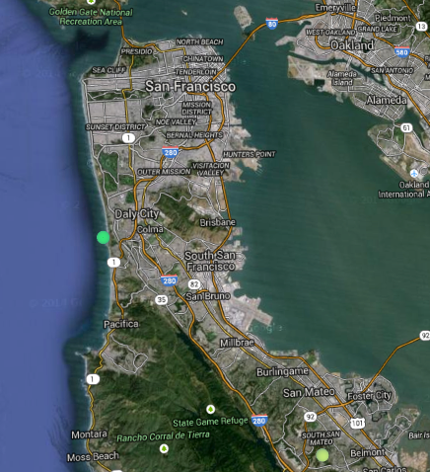
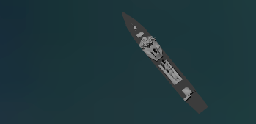
X3DOM
Same traffic as Google Maps scene
Live 3D entities added to scene

Slide 19




Demonstration topology
track.nps.edu
Backend: open-source Jetty WebSockets Server, modified X3DOM javascript engine, models, and maps loaded from server
Crete
Internet
(proxies OK!)
NPS and other
enterprise
firewalls
https://track.nps.edu
Serves content

Slide 20
Various implementation issues
Choosing and implementing a terrain model
Nonconventional entity models (and workarounds)
Modeling dynamic features like shot animation and damage/destruction
Practical limits of unicast routing
EspduTransform + Transform workaround
Ungraceful degradation of connection-oriented protocol (WebSocket) forwarding UDP stream
  Application gateway filtering may be appropriate, TBD

Slide 21
X3DOM source for X3D DIS component
sourceforge.net/projects/open-dis
  Java, JavaScript, C++, C#, Objective-C
  XML definitions + code generators = agile, easy
x3dom.org
  Checked out a pull, sent back a push
  github.com/mcgredonps/x3dom
  Several work-weeks effort
  Ready to work with Fraunhofer team

Slide 22
X3D specification coverage
Available for X3DOM
  EspduTransform including ESPDU, Fire, Detonation PDUs
TODO
  Collision PDU (integrated with EspduTransform)
  Receiver, Signal, Transmitter PDU
  Align X3D DIS and Geospatial components
  Specify parameters for WebSockets, WebRTC as part of url field

Slide 23
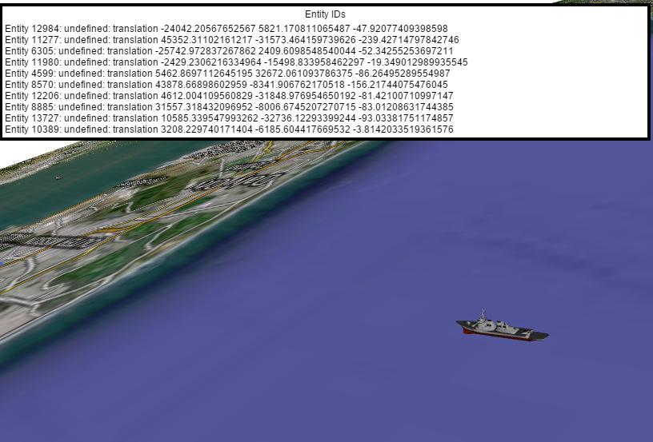
Current State
Connect to websocket server and load X3DOM-powered viewer page
Display, navigate on flat map
Forward DIS via websocket
Display and move entities driven by DIS PDUs
Display basic entity info
Demonstration video: https://savage.nps.edu/videos/McGregorHarderBrutzmanOpenDisX3domWeb3d2015.mov

Slide 24
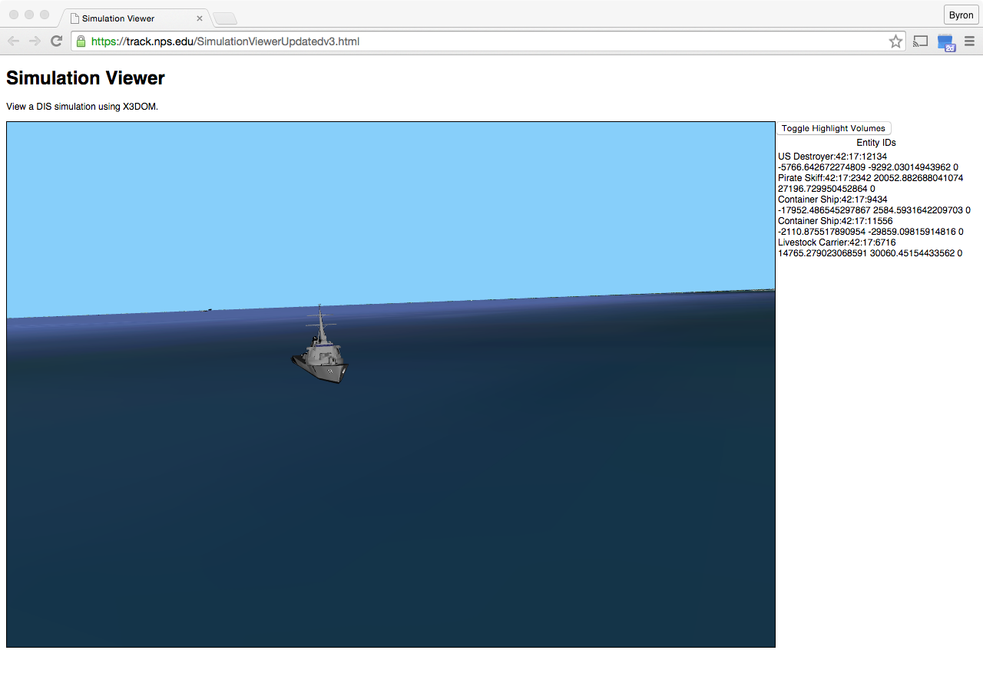

Slide 25
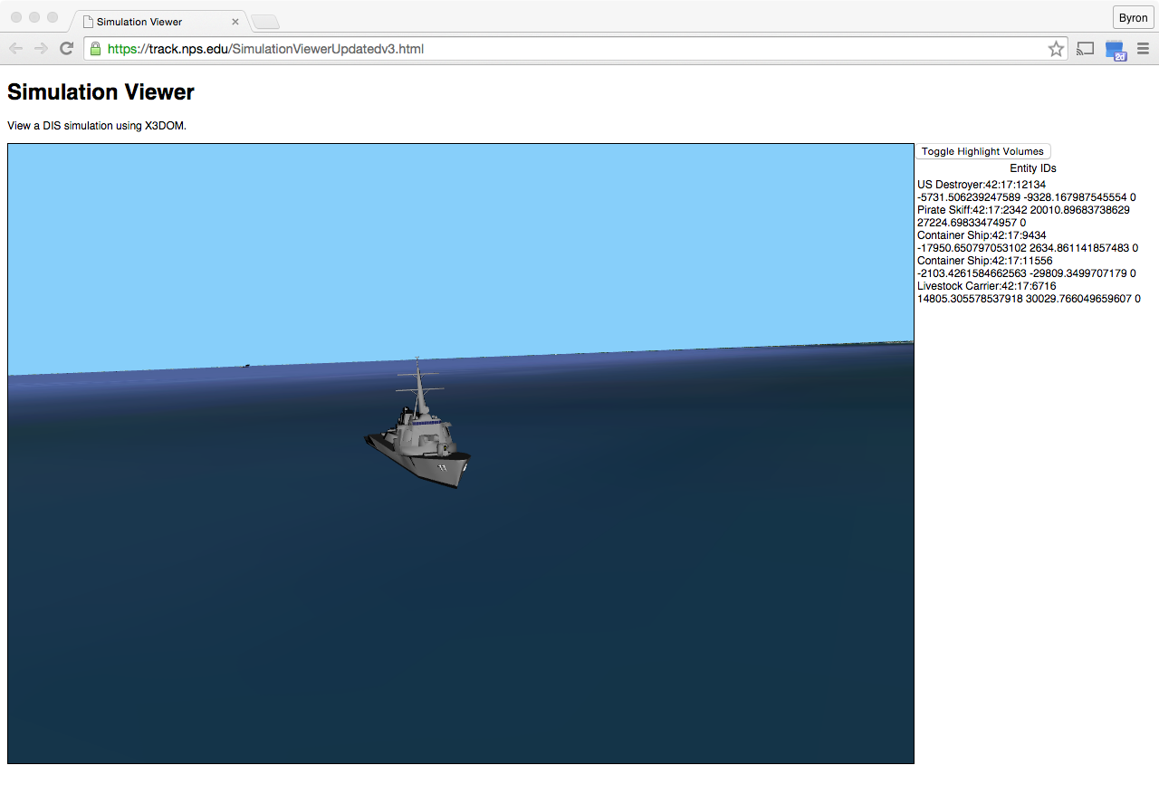

Slide 26


Slide 27
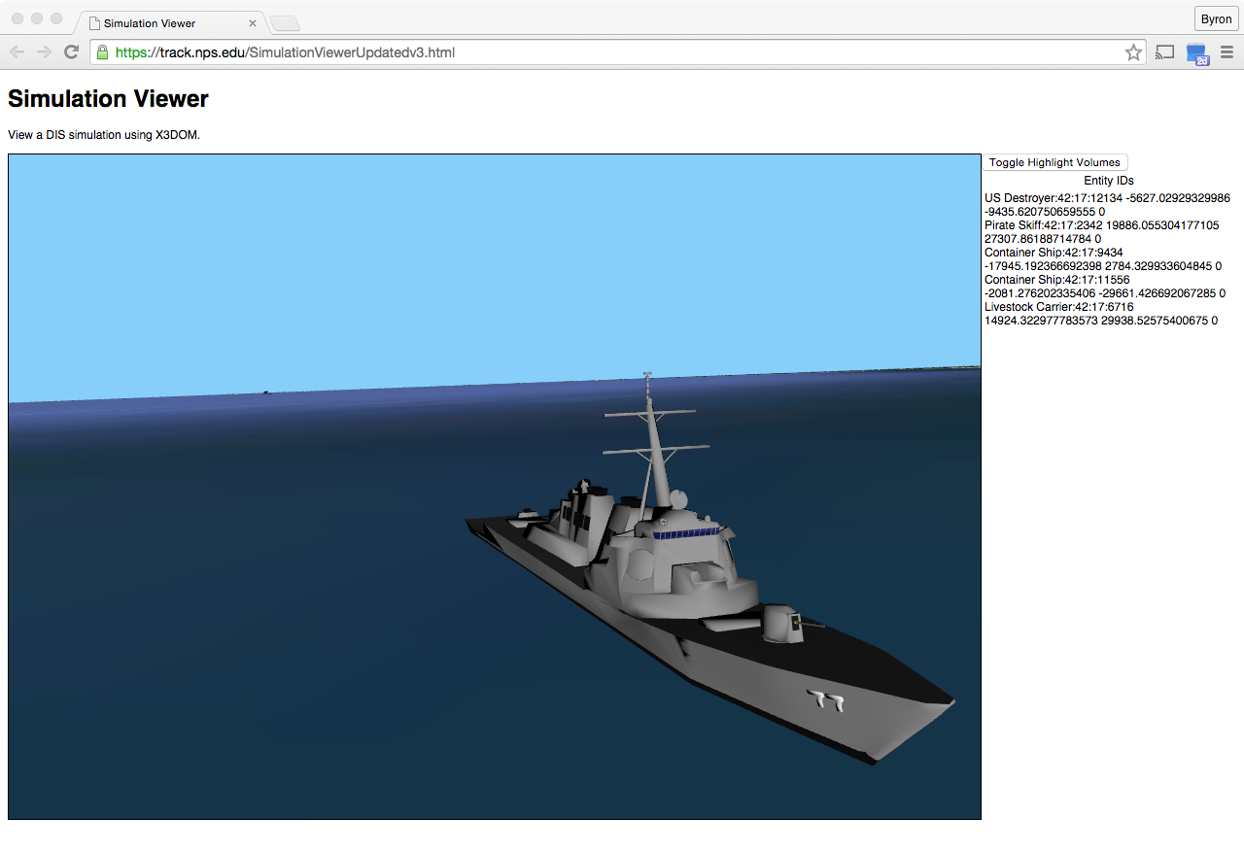

Slide 28
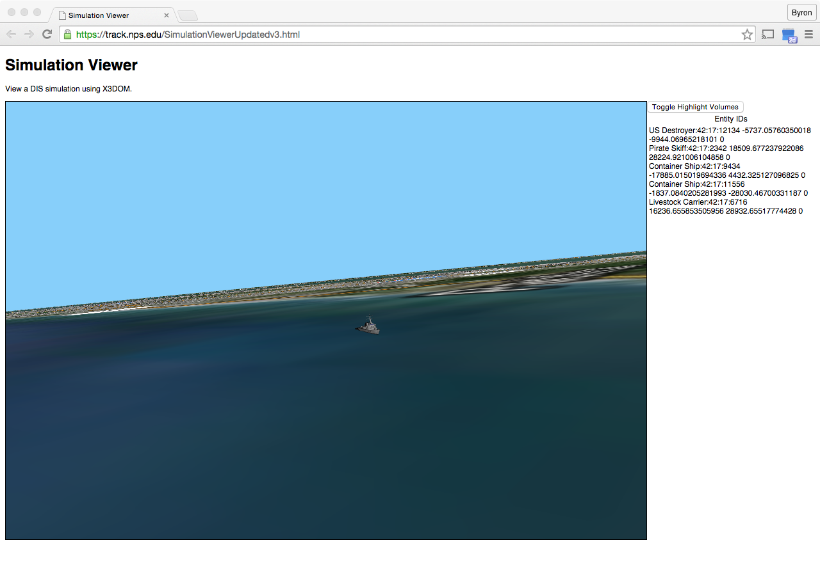

Slide 29


Slide 30
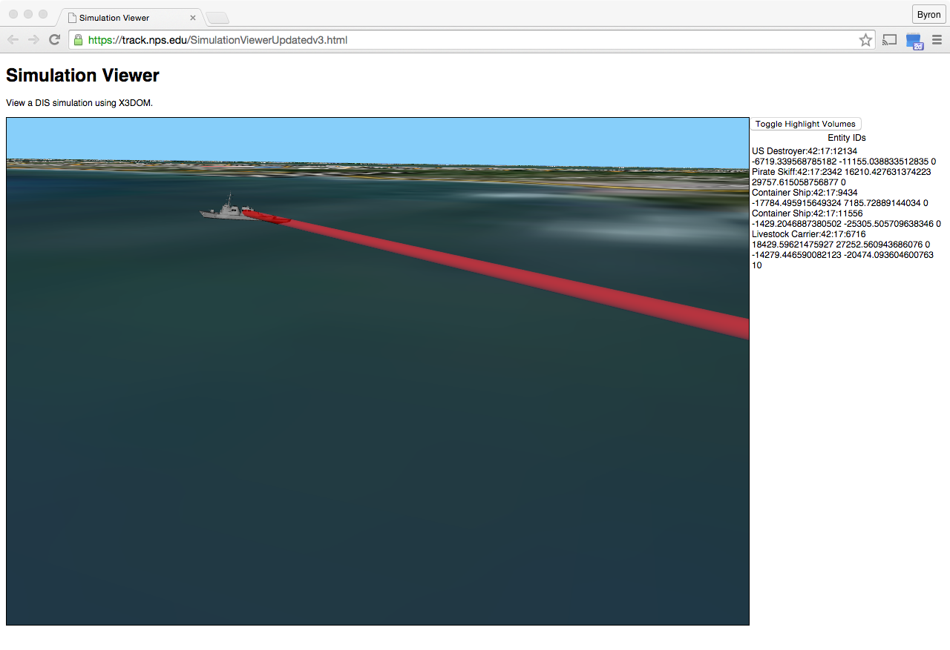

Slide 31
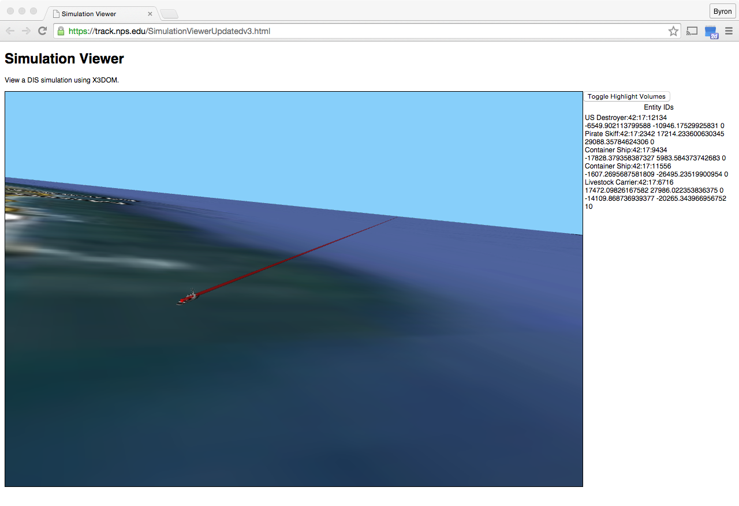
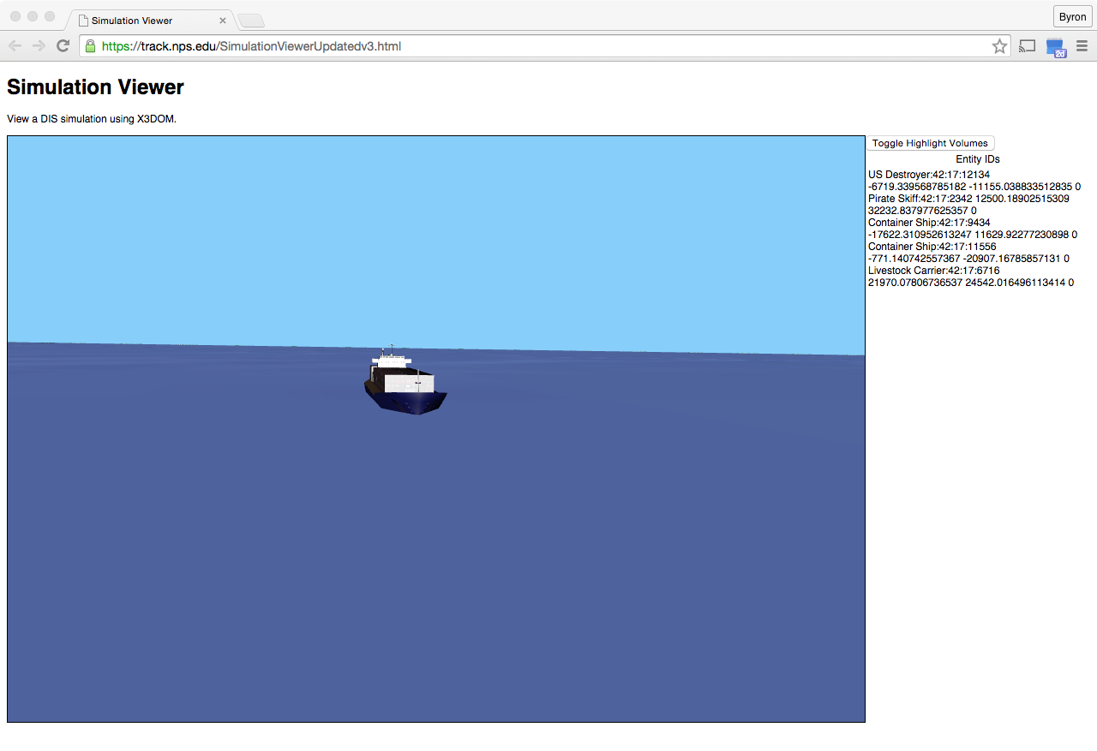

Slide 32
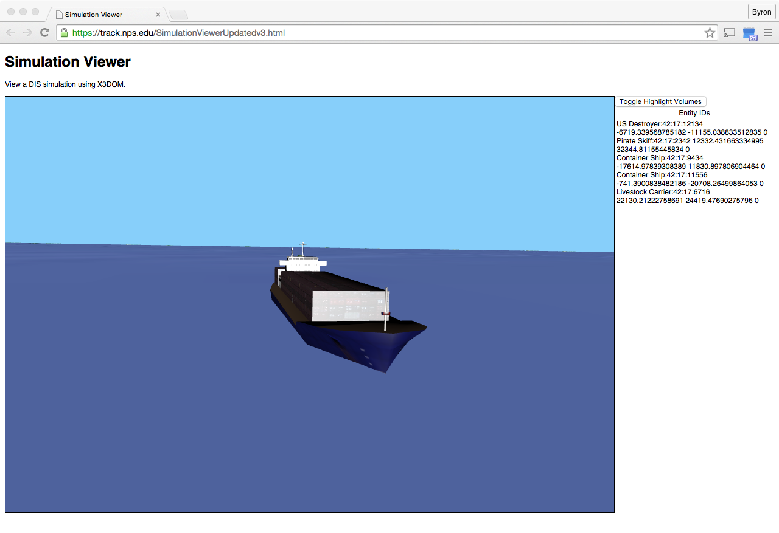

Slide 33
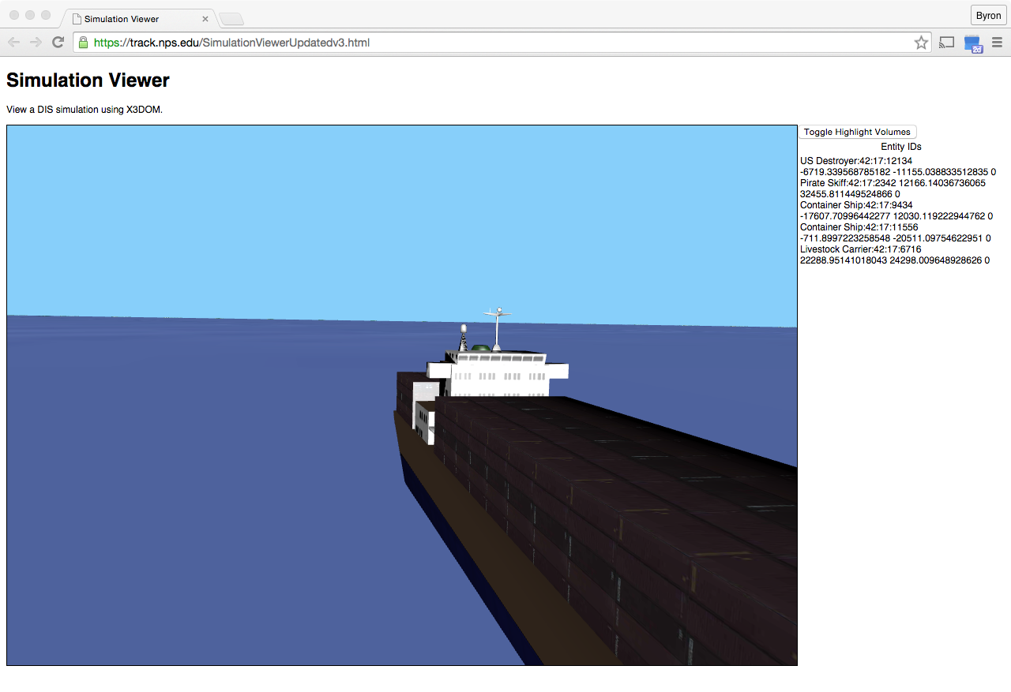

Slide 34
Remaining Issues
Clamping entity elevation to (flat) sea level, need integration with geospatial X3D terrain
Proper scaling while also maintaining useful user visibility and interaction conventions
  “Highlighting bubble” for quick visual location
Smooth animation between movement locations based on ESPDU dead reckoning
Display FirePDUs, DetonatePDUs – boom!
Testing (and debugging) on bigger networks

Slide 35
Conclusions
X3DOM-based client deployment of DIS is feasible with initial implementation available
  Availability of models, documentation, code
Ready to make this technology mashup reliable and maintainable
  Extending to entity control and PDU injection in dynamic simulations

Slide 36
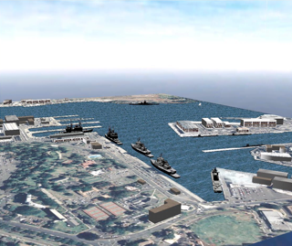
Future work 1
Integrate with X3DOM
  Add, integrate other PDUs in EspduTransform
  True dead reckoning
Candidate future PDUs for X3D specification
  Comment and Simulation Management PDUs
  Intercom PDUs (Voice over IP)
Open-DIS
  Coordinate system conversion
  libraries
  Orientation conversion

Slide 37
Future work 2
X3D-Edit
  Embed Jetty web-socket server
  Auto-configure connections to Web3D channels
  Simplified DIS network integration into scenes
Web3D Projects Wish List
  Stand-alone fully configured X3D server
  Compatible with open-source GeoServer

Slide 38
Contact
Don McGregor, Byron Harder, Don Brutzman
mcgredo@nps.edu brharder1@nps.edu brutzman@nps.edu
Modeling, Virtual Environments Simulation (MOVES) Institute
Naval Postgraduate School
Monterey California 93943-5000 USA

Slide 39
Backup slides

Slide 40
Overview
Use Cases
Sequence Diagram
Domain Model
Deployment Diagram
Current State
Remaining Issues
Conclusion

