Slide 1
X3D Sensor-based Thermal Maps for
Residential and Commercial Buildings
Felix G. Hamza-Lup, Ph.D.
Associate Professor Computer Science and Information Technology
Armstrong State University
Savannah GA, USA
20th International Conference on 3D Web Technology (Web3D 2015), June 18-21, Heraklion, Crete, Greece

Slide 2
Outline
Motivation
Thermal Modeling – Brief Review
Thermal Comfort
Humidity and Temperature Monitoring System
Data Acquisition
X3D Data Representation
Scalability and Validation
20th International Conference on 3D Web Technology (Web3D 2015), June 18-21, Heraklion, Crete, Greece

Slide 3
Motivation
Sustainable methods of construction - zero-carbon passive heating technologies
Thermally deficient western methods of construction - huge potential of applying energy-efficiency improvements
Sub-tropical climate zones which have entirely different requirements when it comes to designing energy-efficient and low-carbon houses
The proposed system:
  Cost effective solution for seasonal thermal monitoring
  Simple, Scalable, Web-based visualization of 3D Thermal Maps
  Facilitates decision making in terms of architectural modifications for energy-efficiency improvements from residential to commercial buildings
  Independent of proprietary software packages and their integration solutions.
20th International Conference on 3D Web Technology (Web3D 2015), June 18-21, Heraklion, Crete, Greece

Slide 4
Thermal Modeling – Brief Review (1)
Conventional models of thermal representations are in use by: construction professionals and HVAC engineers.
National Institute of Building Sciences are proposing baseline standards [NIBS 2015] for thermal performance of building enclosures with measurement and verification for design and construction of enclosure assemblies.
California lays the groundwork for adoption of a Zero Net Energy (ZNE)-ready code by 2020
Thermal analysis software products: SolidWorks Simulation, Ansys Advantage, Ansys CFX and many others that support CAD-based models integration.
20th International Conference on 3D Web Technology (Web3D 2015), June 18-21, Heraklion, Crete, Greece

Slide 5
Thermal Modeling – Brief Review (2)
Complex computational fluid dynamics (CFD) simulations used for the past 20 years to model the flow of air in buildings.
  simulation systems presented are proprietary
  too complex to be applied in conjunction with real-time data.
Ham et al. [2014] presents a thermography-based (IR cameras) method to visualize the actual thermal resistance and condensation problems in buildings.
Lee et al. [2014], measured the impact of three newly developed dynamic clothing insulation models using EnergyPlus, version 6.0.
20th International Conference on 3D Web Technology (Web3D 2015), June 18-21, Heraklion, Crete, Greece

Slide 6
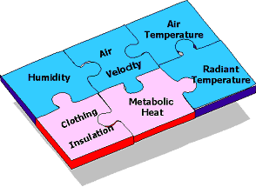
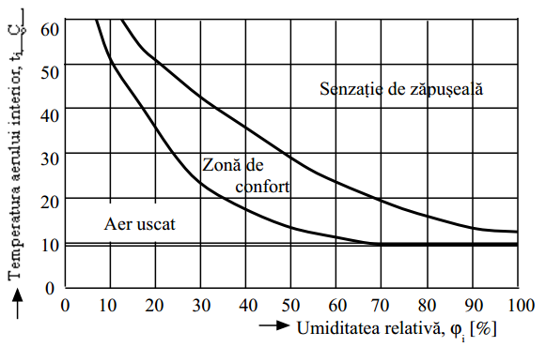
Thermal Comfort
A complex problem: 6 major factors (environmental & personal)
Rijal et al. [2014] - conducted a thermal comfort and occupant behavior survey in 30 living rooms during the hot and humid season in the Kanto region of Japan. Residents adapt to the hot and humid environments by increasing the air movement using behavioral adaptation such as window opening and fan use.
Pitts [2013] deals with transition spaces like entrance foyers, circulation zones, lift lobbies, stairways and atria, and thermal comfort experiences.
Opportunities to reduce environmental conditioning and therefore energy use in such spaces.
20th International Conference on 3D Web Technology (Web3D 2015), June 18-21, Heraklion, Crete, Greece

Slide 7
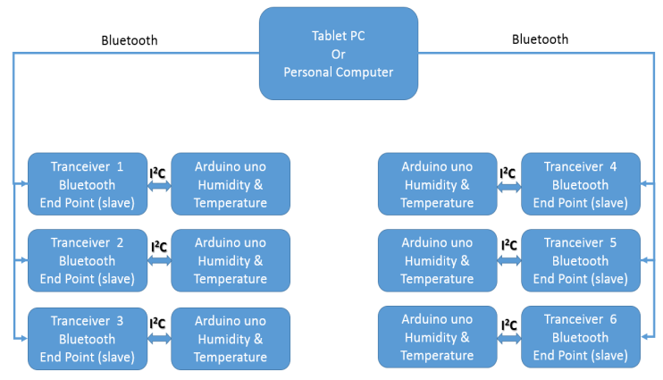
Humidity and Temperature Monitoring System (1)
Arduino Uno [Arduino 2015] based on ATmega328 microcontroller
20th International Conference on 3D Web Technology (Web3D 2015), June 18-21, Heraklion, Crete, Greece

Slide 8

Humidity and Temperature Monitoring System (2)
Data acquisition module
  Sensor (Sensirion) dimensions and energy consumption is minimized;
  The hardware components are cost-effective;
  High accuracy for temperature .01°C, relative humidity ±2%
  High reliability (99.9%) of the network;
  Simple command and control communication protocol tunneled through Bluetooth wireless.
  1 Hz update – real time monitoring
20th International Conference on 3D Web Technology (Web3D 2015), June 18-21, Heraklion, Crete, Greece

Slide 9
Data Acquisition
The wireless sensors are producing measurement values every second in the data buffer.
The data buffer is consumed by the data acquisition client (DAQ) that plays the role of the master (e.g. a tablet, smartphone or PC)
Data is saved on permanent storage for later use (e.g. playback of sensor data for extended periods of time)
20th International Conference on 3D Web Technology (Web3D 2015), June 18-21, Heraklion, Crete, Greece

Slide 10
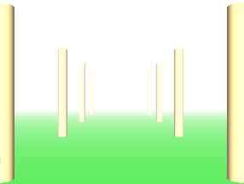
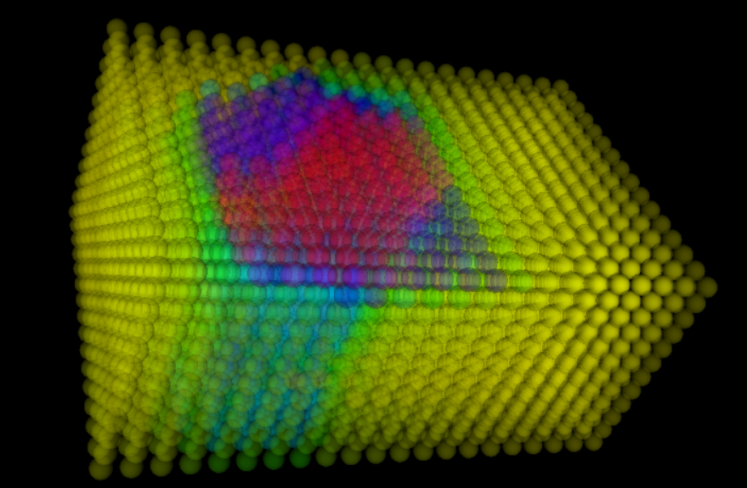
X3D Data Representation
X3D nodes explored:
  X3D Fog
  X3D Primitives

Slide 11
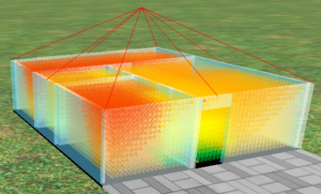
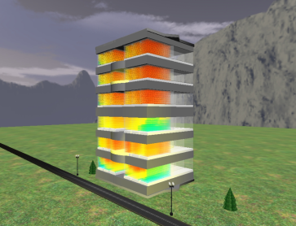
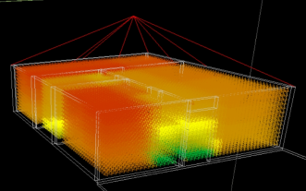
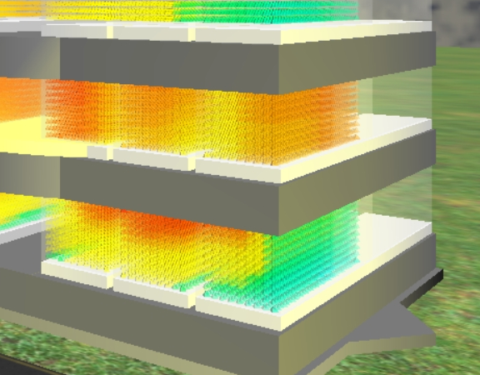
X3D Data Representation
Semi-transparent walls
Scaling to Large Commercial Buildings
Results that are representative of the actual interior physics assuming a laminar air-flow, non-turbulent steady-state condition of airflow
Wire-frame rendering
20th International Conference on 3D Web Technology (Web3D 2015), June 18-21, Heraklion, Crete, Greece

Slide 12
Scalability
Scalability to large commercial buildings is possible using simple polygonal elements – billboards => 15+ FPS
Scalability to city regions is possible – algorithms are under implementation, keeping framerate above 15
  Fully interactive
  Partially interactive i.e. predefined view points
  Non-interactive - animation
20th International Conference on 3D Web Technology (Web3D 2015), June 18-21, Heraklion, Crete, Greece

Slide 13
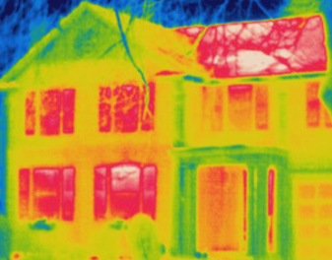
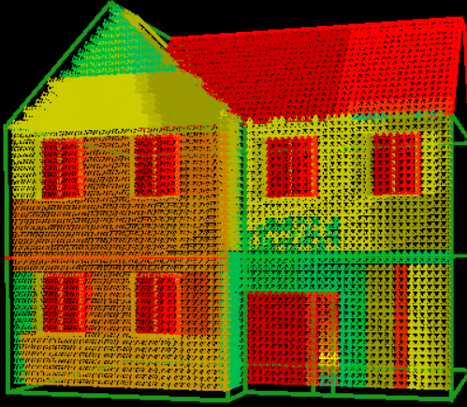
Validation
Image based on IR Camera System
Validation method for the simulation system using infrared (IR) thermography with a thermal imaging camera
  Mockup X3D model
  Sensor data simulated through dynamic arrays
Automatic validation through image analysis – under development.
X3D Thermal Map
20th International Conference on 3D Web Technology (Web3D 2015), June 18-21, Heraklion, Crete, Greece

Slide 14
Conclusions
Basic and cost effective system for temperature/humidity data acquisition
Scalable X3D system for 3D Thermal Maps representation
Building energy modeling can be applied early in the design development phase, as a collaborative effort between the energy consultant and the architect.
Initial energy modeling scenarios may use forward simulation models to predict approximate values for annual energy consumption and energy costs.
The type of early design impact analysis allowed by X3D sensor-based thermal comfort simulation may be one of the key aspects of sustainable design, pre-construction, construction and operation phases of the respective residential or commercial building.
The study will be expanded for case studies dealing with various human comfort zones during year-round seasons as humidity plays a major role in heat transfer.
20th International Conference on 3D Web Technology (Web3D 2015), June 18-21, Heraklion, Crete, Greece

Slide 15
Acknowledgements
Co-authors
  Prof. Paul Borza, Transilvania University Brasov, Romania
  Research Assistant Dorin Dragut, Transilvania University, Brasov, Romania
  Prof. Marcel Maghiar, Georgia Southern Univ. Statesboro GA, USA
Questions about the project:
  Felix.Hamza-Lup@armstrong.edu
  http://felixlup.net
20th International Conference on 3D Web Technology (Web3D 2015), June 18-21, Heraklion, Crete, Greece

